Slide 1
The lord’s prayer : part 3
Matthew 6:9-13
Notes:
More than 2000 bible verses on money, 500 on prayer. 40% of Jesus parables deal with money. Why? Because it is about justice

Slide 2
The Lord’s Prayer (Matt 6:9-13)
Our Foundation
“Our Father in heaven,
hallowed be your name, ¹⁰ your kingdom come, your will be done, on earth as it is in heaven.
¹¹ Give us today our daily bread. ¹² And forgive us our debts, as we also have forgiven our debtors. ¹³ And lead us not into temptation, but deliver us from the evil one.’
Petition
(God)
Petition
(Us)

Slide 3
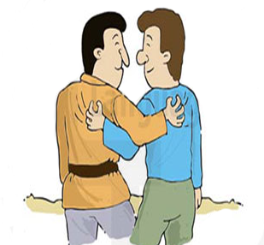
Matthew 6:33
But seek first the kingdom of God and His righteousness, and all these things shall be added to you.

Slide 4
In the beginning
OUR
WORLD
HEAVEN

Slide 5
Our Misconception
OUR WORLD
HEAVEN

Slide 6
God’s plan
Matthew 4:17 From that time Jesus began to preach and to say, “Repent, for the kingdom of heaven is at hand.”
OUR WORLD
HEAVEN
God’s Kingdom
JESUS

Slide 7
The heartbeat of Jesus (Matt 6:9-13)
Our Foundation
“Our Father in heaven,
hallowed be your name, ¹⁰ your kingdom come, your will be done, on earth as it is in heaven.
¹¹ Give us today our daily bread. ¹² And forgive us our debts, as we also have forgiven our debtors. ¹³ And lead us not into temptation, but deliver us from the evil one.’
Petition
(God)
Petition
(Us)
Notes:
What he thinks about and what’s important to him

Slide 8
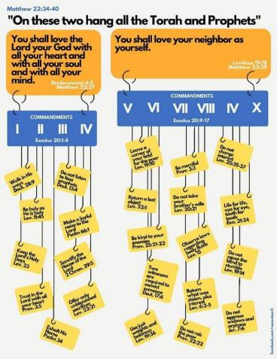
Our foundation
“Our Father in heaven,
Hallowed be your name, ¹⁰ your kingdom come, your will be done, on earth as it is in heaven.
¹¹ Give us today our daily bread. ¹² And forgive us our debts, as we also have forgiven our debtors. ¹³ And lead us not into temptation, but deliver us from the evil one.’
Love God
Love Your Neighbour as Yourself
Notes:
Which can be tidily categorized according to the two most important commandments as well

Slide 9
The lord’s prayer (part 3)
Matthew 6:9-13
God’s provision
God’s pardon
God’s protection
God’s provision

Slide 10
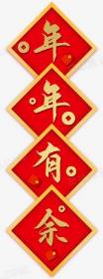
The Lord’s Prayer (Matt 6:9-13)
¹¹ Give us today our daily bread.
Dependence
Gratitude
Necessities
Epiousios (Daily ration)
Communal
Compassion
Notes:
Give – acknowledging everything we have comes from God. From having sunlight, to having logistics, to having people, having money, having health to eat. Even our ability to work and earn money, store money.
Us – it’s not just about me, it’s us as a community of believers
Daily – Daily dependence. Enough for today. Not bread for tomorrow.
Bread – Necessities. Things we need.
We never have enough no matter what. Always wanting more

Slide 11
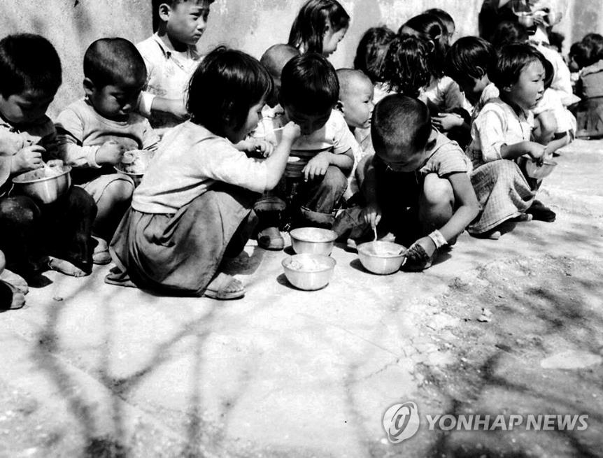
Notes:
How happy were you when you received your first cheque? Is it still enough now?
How happy were you when got to go for the first nice restaurant? Still good enough now?
They were orphans
Worried about where the next meal will come from

Slide 12
Our heavenly daddy knows what we need
Matthew 6:31 So do not worry, saying, ‘What shall we eat?’ or ‘What shall we drink?’ or ‘What shall we wear?’ 32 For the pagans run after all these things, and your heavenly Father knows that you need them. 33 But seek first his kingdom and his righteousness, and all these things will be given to you as well.

Slide 13
We even get the necessities that we do not know we should ask for
Moses is called to free God’s people by talking to a burning bush.
10 plagues
Pillar of cloud and a pillar of fire.
Red Sea parted and the people walk through on dry ground.
Pharaoh’s army drowned.
Water from a rock
Food called manna falling from the sky
Manna able to store for sabbath
In their first battle, the Israelites prevail because Moses kept his hands in the air.
Jericho walls fell when the Israelites shouted on the 7th day

Slide 14
Do we passively rely on God for necessities?
Joshua 5:10 On the evening of the fourteenth day of the month, while camped at Gilgal on the plains of Jericho, the Israelites celebrated the Passover. 11 The day after the Passover, that very day, they ate some of the produce of the land: unleavened bread and roasted grain. 12 The manna stopped the day after they ate this food from the land; there was no longer any manna for the Israelites, but that year they ate the produce of Canaan.

Slide 15
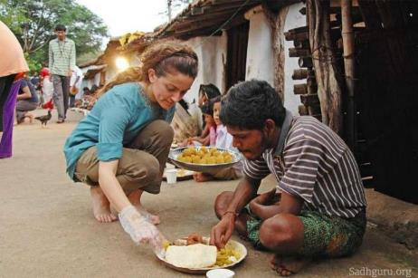
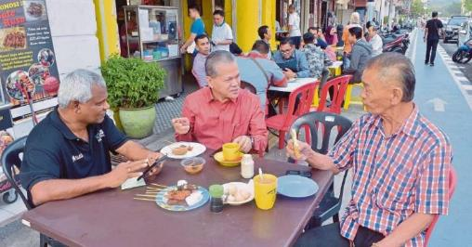
We also have obligation to others
Job 29: 14 I put on righteousness as my clothing; justice was my robe and my turban. 15 I was eyes to the blind and feet to the lame. 16 I was a father to the needy; I took up the case of the stranger. 17 I broke the fangs of the wicked and snatched the victims from their teeth.

Slide 16
No needy persons among the early church
^{Acts 4:33} With great power the apostles continued to testify to the resurrection of the Lord Jesus. And God’s grace was so powerfully at work in them all ³⁴ that there were no needy persons among them. For from time to time those who owned land or houses sold them, brought the money from the sales ³⁵ and put it at the apostles’ feet, and it was distributed to anyone who had need.

Slide 17
The lord’s prayer (part 3)
Matthew 6:9-13
God’s provision
God’s pardon

Slide 18
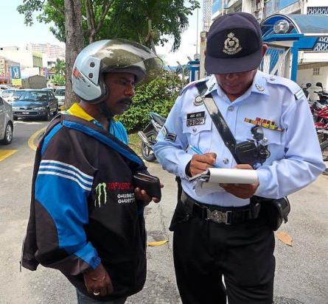
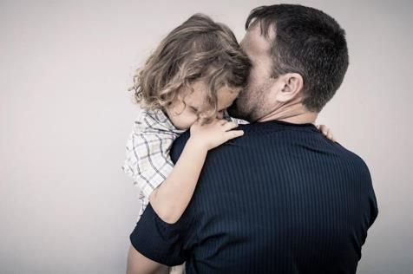
The Lord’s Prayer (Matt 6:9-13)
And forgive us our debts, as we also have forgiven our debtors.
Those who wrong us
Restoration of relationships
Pray and emphatise with others
Sins of commission & omission (Obligations)
All have sinned
Extend grace to others
Notes:
Give – acknowledging everything we have comes from God. From having sunlight, to having logistics, to having people, having money, having health to eat. Even our ability to work and earn money, store money.
Us – it’s not just about me, it’s us as a community of believers
Daily – Daily dependence. Enough for today. Not bread for tomorrow.
Bread – Necessities. Things we need.

Slide 19
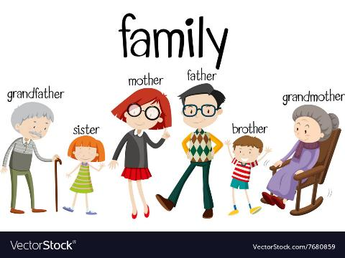
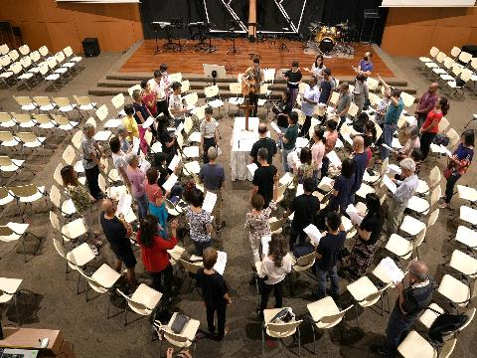
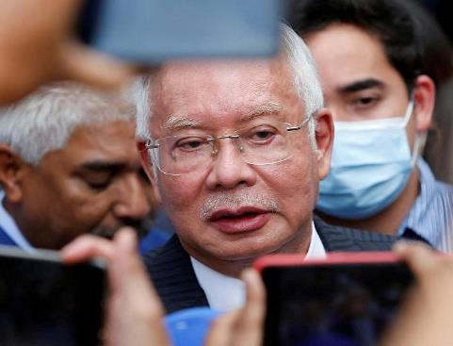

Slide 20
The lord’s prayer (part 3)
Matthew 6:9-13
God’s provision
God’s pardon
God’s protection

Slide 21
The Lord’s Prayer (Matt 6:9-13)
And lead us not into temptation, but deliver us from the evil one.
Negative request
We are in constant attack
Recognize we are weak
God’s mercy and protection
^{James 1:13} When tempted, no one should say, “God is tempting me.” For God cannot be tempted by evil, nor does he tempt anyone; ¹⁴ but each person is tempted when they are dragged away by their own evil desire and enticed. ¹⁵ Then, after desire has conceived, it gives birth to sin; and sin, when it is full-grown, gives birth to death.
Notes:
Give – acknowledging everything we have comes from God. From having sunlight, to having logistics, to having people, having money, having health to eat. Even our ability to work and earn money, store money.
Us – it’s not just about me, it’s us as a community of believers
Daily – Daily dependence. Enough for today. Not bread for tomorrow.
Bread – Necessities. Things we need.

Slide 22
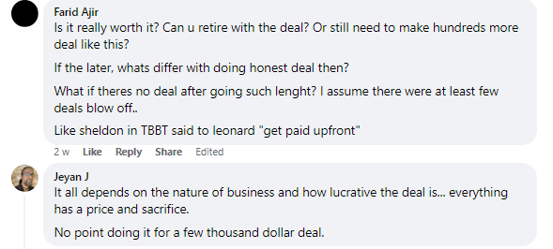
Temptation is everywhere

Slide 23
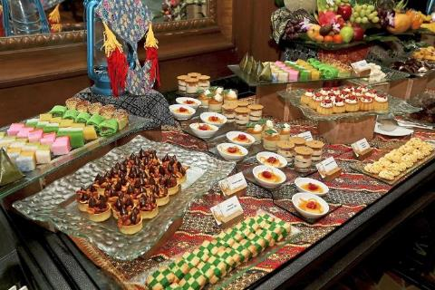

Slide 24
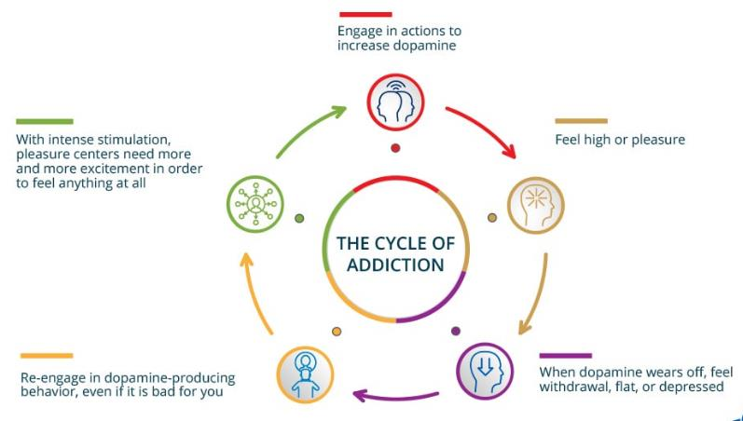
Sin leads to death
James 1:15 Then, after desire has conceived, it gives birth to sin; and sin, when it is full-grown, gives birth to death.

Slide 25
The lord’s prayer (part 3)
Matthew 6:9-13
God’s provision
God’s pardon
God’s protection

Slide 26
The Lord’s Prayer (Matt 6:9-13)
Our Foundation
“Our Father in heaven,
hallowed be your name, ¹⁰ your kingdom come, your will be done, on earth as it is in heaven.
¹¹ Give us today our daily bread. ¹² And forgive us our debts, as we also have forgiven our debtors. ¹³ And lead us not into temptation, but deliver us from the evil one.’
Petition
(God)
Petition
(Us)

Slide 27
God’s plan for us
John 10:10 The thief comes only to steal and kill and destroy;
I have come that they may have life, and have it to the full.
OUR WORLD
HEAVEN
God’s Kingdom
JESUS

Slide 28
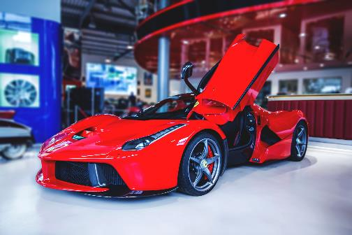
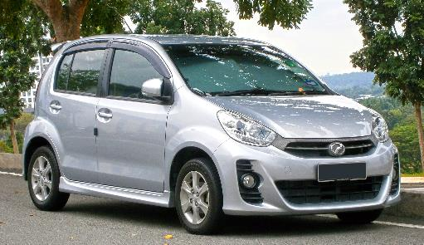
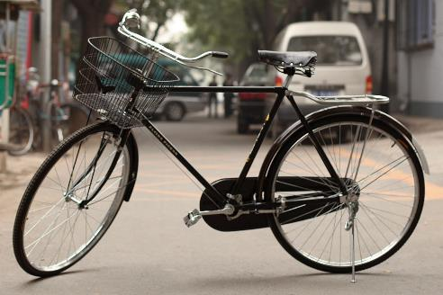
What is our daily bread?

Slide 29
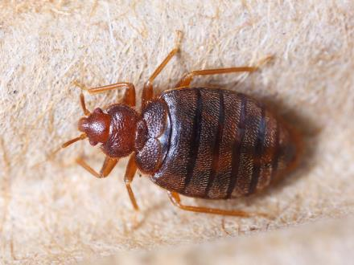
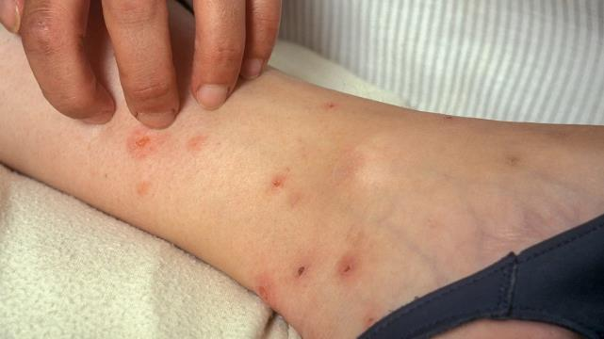
Can this be your daily bread?

Slide 30
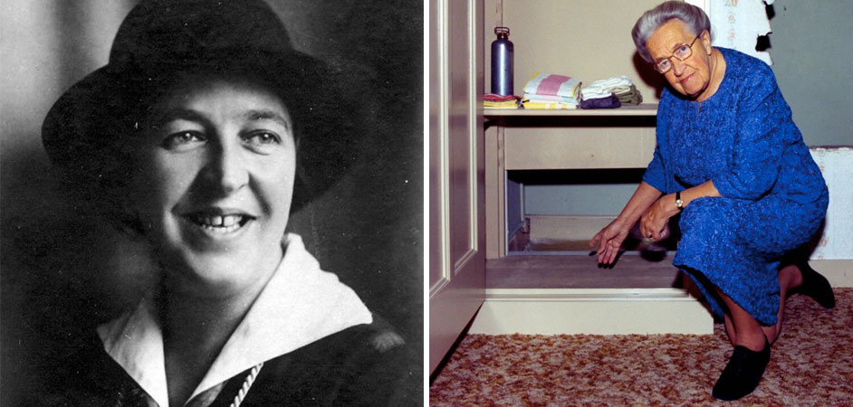

Slide 31
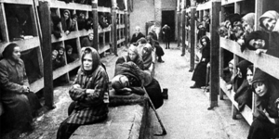
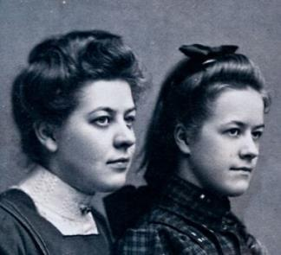
Thank God for the fleas
1 Thes 5:14 And we urge you, brothers and sisters, warn those who are idle and disruptive, encourage the disheartened, help the weak, be patient with everyone. 15 Make sure that nobody pays back wrong for wrong, but always strive to do what is good for each other and for everyone else.
16 Rejoice always, 17 pray continually, 18 give thanks in all circumstances; for this is God’s will for you in Christ Jesus.
Notes:
Hitler
Fleas
Bible
Clerical error
Corrie and Betsie found they could not sit upright on their own platform without hitting their heads on the deck above them. They lay back, struggling against nausea that swept over them from the reeking straw.
Suddenly Corrie started up, striking her head on the cross-slats above. Something had bitten her leg. “Fleas!” she cried. “Betsie, the place is swarming with them!” Descending from the platform and edging down a narrow aisle, they made their way to a patch of light. “Here! And here another one!” Corrie wailed. “Betsie, how can we live in such a place?”
“Show us. Show us how,” Betsie said matter-of-factly. It took Corrie a moment to realize that her sister was praying. “Corrie!” Betsie then exclaimed excitedly. “He’s given us the answer! Before we asked, as He always does! In the Bible this morning. Where was it? Read that part again!”
Corrie checked to make sure no guards were nearby, then drew from a pouch a small Bible she had managed to smuggle into the concentration camp. “It was in First Thessalonians,” she said, finding the passage in the feeble light. “Here it is: ‘Comfort the frightened, help the weak, be patient with everyone. See that none of you repays evil for evil, but always seek to do good to one another and to all. Rejoice always, pray constantly, give thanks in all circumstances; for this is the will of God in Christ Jesus …’ ” (1 Thessalonians 5:14-18).
“That’s it!” Betsie interrupted. “That’s His answer. ‘Give thanks in all circumstances!’ That’s what we can do. We can start right now to thank God for every single thing about this barracks!”
Corrie stared at her incredulously, then around at the dark, foul-smelling room. “Such as?” she inquired.
“Such as being assigned here together.”
Corrie bit her lip. “Oh yes, Lord Jesus!”
“Such as what you’re holding in your hands.”
Corrie looked down at the Bible. “Yes! Thank You, dear Lord, that there was no inspection when we entered here! Thank You for all the women, here in this room, who will meet You in these pages.”
“Yes,” agreed Betsie. “Thank You for the very crowding here. Since we’re packed so close, that many more will hear!” She looked at her sister expectantly and prodded, “Corrie!”
“Oh, all right. Thank You for the jammed, crammed, stuffed, packed, suffocating crowds.”
“Thank you,” Betsie continued on serenely, “for the fleas and for …”
That was too much for Corrie. She cut in on her sister: “Betsie, there’s no way even God can make me grateful for a flea.”
“ ‘Give thanks in all circumstances,” Betsie corrected. “It doesn’t say, ‘in pleasant circumstances.’ Fleas are part of this place where God has put us.” So they stood between the stacks of bunks and gave thanks for fleas, though on that occasion Corrie thought Betsie was surely wrong.
As the weeks passed, Betsie’s health weakened to the point that, rather than needing to go out on work duty each day, she was permitted to remain in the barracks and knit socks together with other seriously-ill prisoners. She was a lightning fast knitter and usually had her daily sock quota completed by noon. As a result, she had hours each day she could spend moving from platform to platform reading the Bible to fellow prisoners. She was able to do this undetected as the guards never seemed to venture far into the barracks.

Slide 33
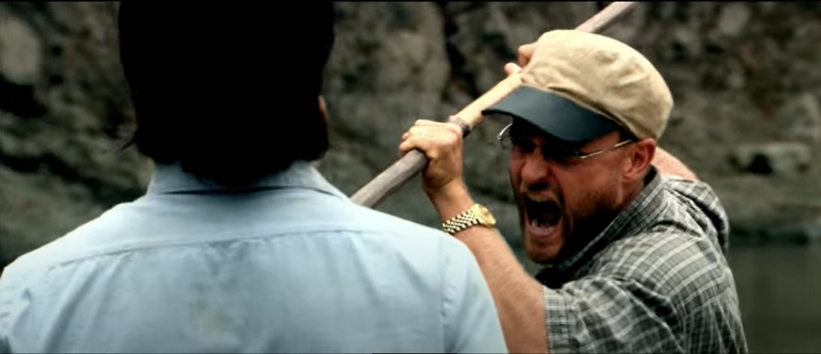
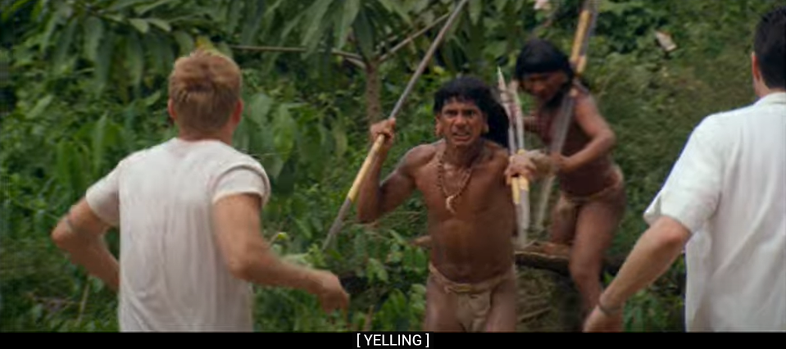
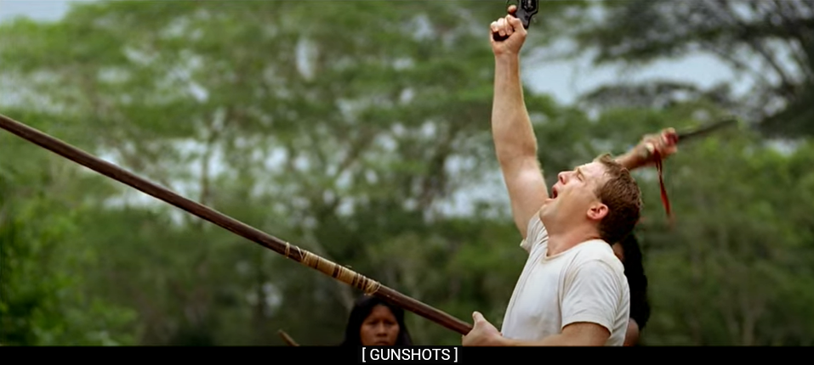
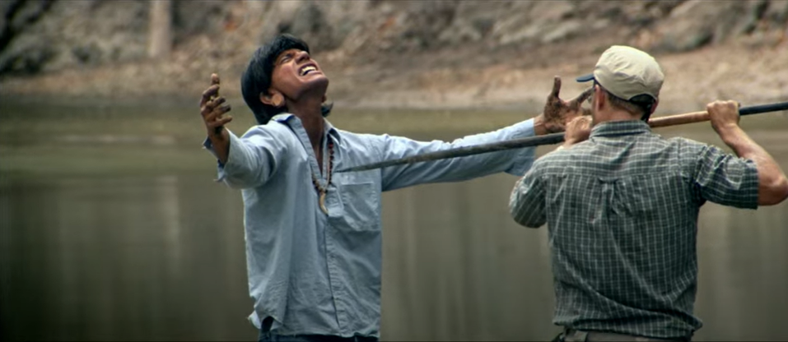
Waodani tribe
Notes:
No one took my father’s live. He gave it

Slide 34
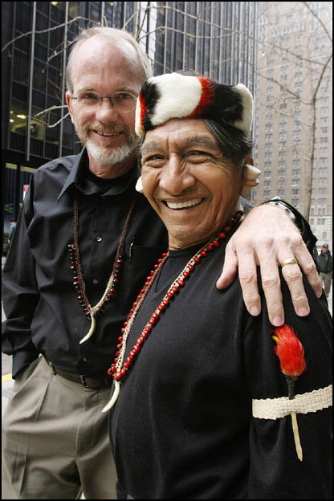
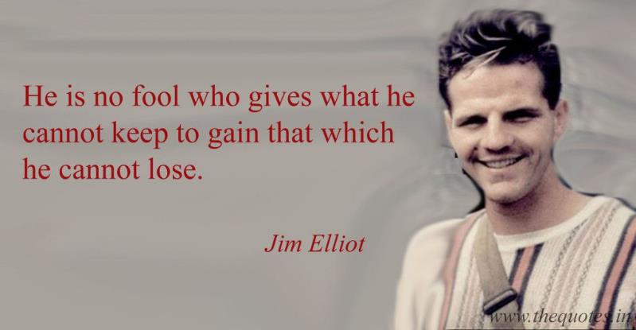

Slide 35
Life is not a journey to be taken alone
“Our Father in heaven,
hallowed be your name, ¹⁰ your kingdom come, your will be done, on earth as it is in heaven.
¹¹ Give us today our daily bread. ¹² And forgive us our debts, as we also have forgiven our debtors. ¹³ And lead us not into temptation, but deliver us from the evil one.’

Slide 36
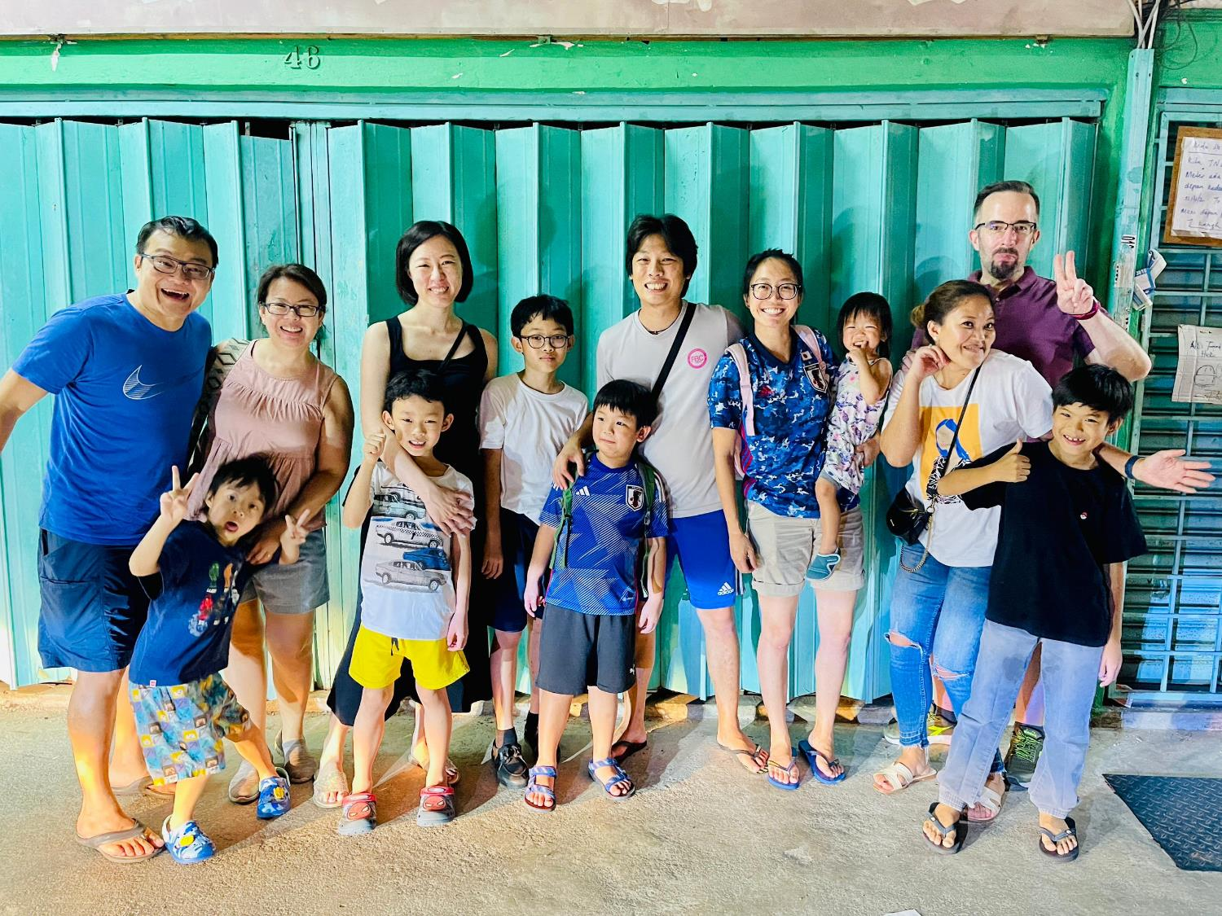
You are not alone
CIA Lifegroup
Call Johnson Lee ☺ 016-305 9027

Slide 37
Jesus is the bread of life
^{John 6:35} Then Jesus declared, “I am the bread of life. Whoever comes to me will never go hungry, and whoever believes in me will never be thirsty.

Slide 38
The Lord’s Supper
1 Cor 11:23 23 For I received from the Lord what I also passed on to you: The Lord Jesus, on the night he was betrayed, took bread, 24 and when he had given thanks, he broke it and said, “This is my body, which is for you; do this in remembrance of me.” 25 In the same way, after supper he took the cup, saying, “This cup is the new covenant in my blood; do this, whenever you drink it, in remembrance of me.” 26 For whenever you eat this bread and drink this cup, you proclaim the Lord’s death until he comes.
27 So then, whoever eats the bread or drinks the cup of the Lord in an unworthy manner will be guilty of sinning against the body and blood of the Lord. 28 Everyone ought to examine themselves before they eat of the bread and drink from the cup. 29 For those who eat and drink without discerning the body of Christ eat and drink judgment on themselves.

Slide 39
Benediction
Numbers 6:24-26
24 “The Lord bless you
and keep you;
25 the Lord make his face shine on you
and be gracious to you;
26 the Lord turn his face toward you
and give you peace.”’

