Slide 2
“Respect is earned”
“Love is earned”

Slide 3
“I love him but I don’t respect him”

Slide 4
“I respect him but I don’t love him”

Slide 5
¹⁰ Be devoted to one another in love. Honor one another above yourselves.
Romans 12: 10

Slide 6
How the Gospel shapes our relationships with others Part 2: Love, Respect and submitting to each other
Ephesians 5:22-31
A Family Life Ministry Sermon

Slide 7
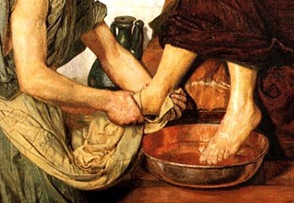
How the Gospel teachers us to submit to each other
Being willing to give ourselves – our rights, our privileges, our way of doing things, etc. for the sake of others
To think of ourselves less and others more
To be willing to serve one another
To align ourselves under the other person by perceiving ourselves as lesser in rank for the benefit of the other

Slide 8
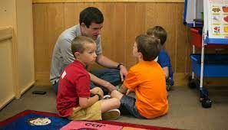
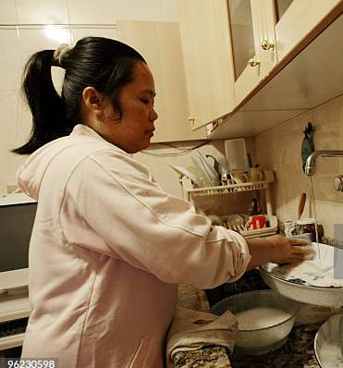
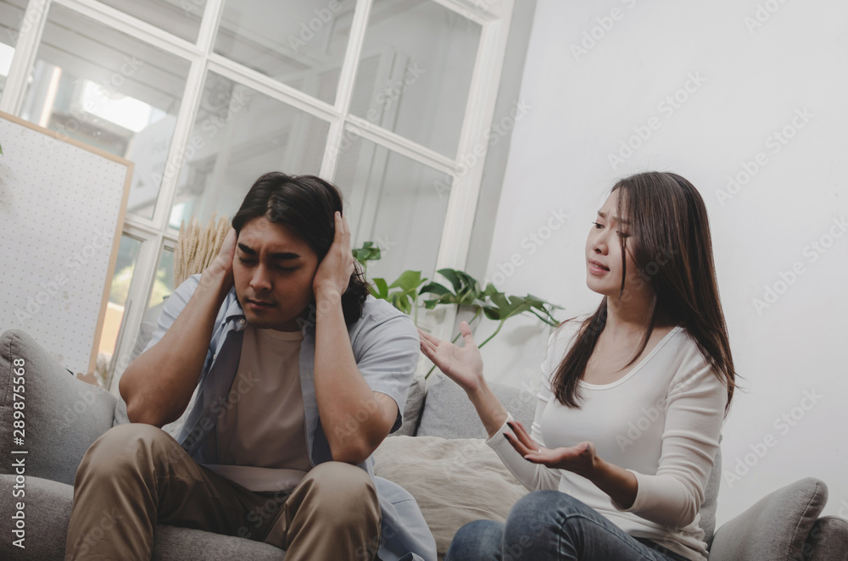

Slide 9
“Seek to serve one another in marriage rather then to be happy and you will discover a new and deeper sense of happiness”
Tim Keller, page 59,The Meaning of Marriage

Slide 10
“My husband does not love me despite everything I do. But God loves me”
³⁵ She conceived again, and when she gave birth to a son she said, “This time I will praise the Lord.” So she named him Judah. Then she stopped having children.
Genesis 29:39

Slide 11
Love, Respect and submitting to each other
Husbands and wives were created by God to love and respect each other differently
Love and respect is a 2 way street of submitting to each other
The Gospel reminds us that we need to give out both unconditional love and unconditional respect to each other

Slide 12
How some Christian books on marriages are written:-
Step 1: Use engaging stories, testimonies and illustrations to connect to the reader.
Step 2: Use these stories to propose key points that are necessary for the relationship to work
Step 3: Throw in A LOT of bible verses to justify your points
Step 4: Find some selective credible non Christian sources to prove your points were correct
Step 5: Have an appendix that publishes testimonies about how your book helped so many couples

Slide 13
Format of many Christian books on marriages
Critique
Step 1: Use engaging stories, testimonies and illustrations to connect to the reader.
Step 2: Use these stories to propose key points that are necessary for the relationship to work
Step 3: Throw in A LOT of bible verses to justify your points and to prove you are biblical.
Step 4: Find some selective credible non Christian sources to prove your points were correct
Step 5: Have an appendix that publishes testimonies about how your book helped so many couples
This is simply a technique to make the book relatable and engaging to the reader
The basis of the book is therefore based on arbitrary stories selected by the author
“Peppering” a book by quoting a lot of bible verses give the sense that it is biblical. Not necessary.
Again this is selectively done to give credibility to the book and is not necessarily evidence
Will the appendix print any critical responses to the book? This is marketing la

Slide 14
Format of many Christian books on marriages
Critique
Step 1: Use engaging stories, testimonies and illustrations to connect to the reader.
Step 2: Use these stories to propose key points that are necessary for the relationship to work
Step 3: Throw in A LOT of bible verses to justify your points and to prove you are biblical.
Step 4: Find some selective credible non Christian sources to prove your points were correct
Step 5: Have an appendix that publishes testimonies about how your book helped so many couples
Where is the Gospel in the contents of the book?
What if the book helps your marriage but doesn’t help you become a better disciple of Jesus Christ? Is it still a good book?

Slide 15
“Runaway divorce statistics reveal that “insanity is in their hearts” (Ecclesiastes 9:3).Pg 31
The context of this verse in Ecclesiastes has nothing to do with divorce whatsoever.
“a husband is geared to hear the command, “take charge and fight” (1 Samuel 4:9). Pg 50
The text is addressed to the Philistines who are fighting the Israelites on their own strength. This is a Pagan illustration
A good-willed husband does not try to displease his wife but to please her, as Paul clearly states in 1 Corinthans 7:33. I always urge a wife who is feeling unloved to be slow in asserting that her husband is unloving or does not want to love her. That is impugning an evil motive upon her husband, which is too drastic a judgement. Pg 188
The context of this verse has nothing to do with a good- willed husband. It is about the virtues of being single

Slide 16
1. Husbands and wives are made by God to love and respect each other differently:-
How husbands should love their wives-
²² Wives, submit yourselves to your own husbands as you do to the Lord. ²³ For the husband is the head of the wife as Christ is the head of the church, his body, of which he is the Savior. ²⁴ Now as the church submits to Christ, so also wives should submit to their husbands in everything.
²⁵ Husbands, love your wives, just as Christ loved the church and gave himself up for her ²⁶ to make her holy, cleansing her by the washing with water through the word, ²⁷ and to present her to himself as a radiant church, without stain or wrinkle or any other blemish, but holy and blameless. ²⁸ In this same way, husbands ought to love their wives as their own bodies. He who loves his wife loves himself. ²⁹ After all, no one ever hated their own body, but they feed and care for their body, just as Christ does the church— ³⁰ for we are members of his body. ³¹ “For this reason a man will leave his father and mother and be united to his wife, and the two will become one flesh.” ³² This is a profound mystery—but I am talking about Christ and the church. ³³ However, each one of you also must love his wife as he loves himself, and the wife must respect her husband.
Ephesians 5:22-33

Slide 17
²² Wives, submit yourselves to your own husbands as you do to the Lord. ²³ For the husband is the head of the wife as Christ is the head of the church, his body, of which he is the Savior. ²⁴ Now as the church submits to Christ, so also wives should submit to their husbands in everything.
²⁵ Husbands, love your wives, just as Christ loved the church and gave himself up for her ²⁶ to make her holy, cleansing her by the washing with water through the word, ²⁷ and to present her to himself as a radiant church, without stain or wrinkle or any other blemish, but holy and blameless. ²⁸ In this same way, husbands ought to love their wives as their own bodies. He who loves his wife loves himself. ²⁹ After all, no one ever hated their own body, but they feed and care for their body, just as Christ does the church— ³⁰ for we are members of his body. ³¹ “For this reason a man will leave his father and mother and be united to his wife, and the two will become one flesh.” ³² This is a profound mystery—but I am talking about Christ and the church. ³³ However, each one of you also must love his wife as he loves himself, and the wife must respect her husband.
Ephesians 5:22-33

Slide 18
How should husbands love their wives
The Greek word for “love” in verse 25 is a form of Agape
Husbands are to love their wives the way Christ loved the church – by leading, sacrificing and caring.
Loving her until being able to give up his life (v25)
Loving her by being accountable for her spiritual welfare(v26-27)
Loving her the way he loves his own body. To view her as one with himself (v28,29.31 &33)
To give the wife priority over love for parents by leaving and cleaving (v 31)

Slide 19
How should wives love their husbands
Paul does not give instructions to wives on this

Slide 20
How wives should love their husbands
³ Likewise, teach the older women to be reverent in the way they live, not to be slanderers or addicted to much wine, but to teach what is good. ⁴ Then they can urge the younger women to love their husbands and children, ⁵ to be self-controlled and pure, to be busy at home, to be kind, and to be subject to their husbands, so that no one will malign the word of God.
Titus 2:3-5
The Greek word for “love” here is philandros, from the root word Phileo.

Slide 21
How husbands and wives love each other differently
Wives need to understand the needs of their husbands more by loving them in a Philandros manner while husbands have a long list of how to love their wives in an Agape manner.
In relation to the relationship between husbands and wives mirroring Christ and the church, the emphasis in Ephesians 5:22-31 is therefore on husbands loving wives more than wives loving husbands

Slide 22
How husbands should love their wives
How wives should love their husbands
The Greek word for “love” in verse 25 is a form of Agape
Husbands are to love their wives the way Christ loved the church – selfless and sacrificial
Sacrificially to the point of giving up their lives (v25)
Helping his wife achieve the goal of being more Christlike (v26-27)
Take care of her the way he takes care of his health (v28,29.31 &33)
To give the wife priority over love for parents by leaving and cleaving (v 31)
By being considerate in how you live together (1 Peter 3:7)
The Greek word for “love” in Titus 2:5 is philandros, from the root word Phileo
Phileo means to be affectionate and denotes intimate friendship
No further description in Titus 2:5
No description at all in Ephesians 5:22-31

Slide 23
How husbands should respect their wives-
²² Wives, submit yourselves to your own husbands as you do to the Lord. ²³ For the husband is the head of the wife as Christ is the head of the church, his body, of which he is the Savior. ²⁴ Now as the church submits to Christ, so also wives should submit to their husbands in everything.
²⁵ Husbands, love your wives, just as Christ loved the church and gave himself up for her ²⁶ to make her holy, cleansing her by the washing with water through the word, ²⁷ and to present her to himself as a radiant church, without stain or wrinkle or any other blemish, but holy and blameless. ²⁸ In this same way, husbands ought to love their wives as their own bodies. He who loves his wife loves himself. ²⁹ After all, no one ever hated their own body, but they feed and care for their body, just as Christ does the church— ³⁰ for we are members of his body. ³¹ “For this reason a man will leave his father and mother and be united to his wife, and the two will become one flesh.” ³² This is a profound mystery—but I am talking about Christ and the church. ³³ However, each one of you also must love his wife as he loves himself, and the wife must respect her husband.
Ephesians 5:22-33

Slide 24
How should husbands love their wives
Paul does not give instructions to husbands on this

Slide 25
How husbands should respect their wives
⁷ Husbands, in the same way be considerate as you live with your wives, and treat them with respect as the weaker partner and as heirs with you of the gracious gift of life, so that nothing will hinder your prayers.
1 Peter 3:7
The Greek word for “partner” means vessel and “weaker” is widely seen to mean physical strength or might involve emotional vulnerability

Slide 26
How should husbands respect their wives
Paul doesn’t mention it in Ephesians 5: 22-33
The context of Ephesians is the Gospel creates a new humanity where all are equal including women
In 1 Peter 3:7 men respect their wives in 2 ways:-
protecting them as they are physically weaker and possibly emotionally more vulnerable
By treating them as equals, as co heirs of gracious gift of life
Peter rounds off by warning husbands if they don’t respect their wives their prayers will be hindered

Slide 27
How wives should respect their husbands-
²² Wives, submit yourselves to your own husbands as you do to the Lord. ²³ For the husband is the head of the wife as Christ is the head of the church, his body, of which he is the Savior. ²⁴ Now as the church submits to Christ, so also wives should submit to their husbands in everything.
²⁵ Husbands, love your wives, just as Christ loved the church and gave himself up for her ²⁶ to make her holy, cleansing her by the washing with water through the word, ²⁷ and to present her to himself as a radiant church, without stain or wrinkle or any other blemish, but holy and blameless. ²⁸ In this same way, husbands ought to love their wives as their own bodies. He who loves his wife loves himself. ²⁹ After all, no one ever hated their own body, but they feed and care for their body, just as Christ does the church— ³⁰ for we are members of his body. ³¹ “For this reason a man will leave his father and mother and be united to his wife, and the two will become one flesh.” ³² This is a profound mystery—but I am talking about Christ and the church. ³³ However, each one of you also must love his wife as he loves himself, and the wife must respect her husband.
Ephesians 5:22-33

Slide 28
²² Wives, submit yourselves to your own husbands as you do to the Lord. ²³ For the husband is the head of the wife as Christ is the head of the church, his body, of which he is the Savior. ²⁴ Now as the church submits to Christ, so also wives should submit to their husbands in everything.
²⁵ Husbands, love your wives, just as Christ loved the church and gave himself up for her ²⁶ to make her holy, cleansing her by the washing with water through the word, ²⁷ and to present her to himself as a radiant church, without stain or wrinkle or any other blemish, but holy and blameless. ²⁸ In this same way, husbands ought to love their wives as their own bodies. He who loves his wife loves himself. ²⁹ After all, no one ever hated their own body, but they feed and care for their body, just as Christ does the church— ³⁰ for we are members of his body. ³¹ “For this reason a man will leave his father and mother and be united to his wife, and the two will become one flesh.” ³² This is a profound mystery—but I am talking about Christ and the church. ³³ However, each one of you also must love his wife as he loves himself, and the wife must respect her husband.
Ephesians 5:22-33

Slide 29
How should wives respect their husbands
Verse 33b is a mirror of verse 24. Paul swaps the word “submit” for “respect”
Wives respect their husbands by submitting to them the way the church submits to Christ
The Greek word for “respect” is phobetai and is only used here in the entire New Testament for husband and wife relationships. The term is most often used in reference to our relationship with God
Both the Greek words Agape for husbands to love wives and phobetai for wives to respect their husbands are therefore Christ focused and not to each other

Slide 30
How wives should respect their husbands
How husbands should respect their wives
Verse 33b is a mirror of verse 24. Paul swaps the word “submit” for “respect”
Wives respect their husbands by submitting to them the way the church submits to Christ
The Greek word for “respect” is phobetai and is only used here in the entire New Testament in husband and wife relationship. The term is most often used in relation to our relationship with God
Both the Greek words Agape for husbands to love wives and phobetai for wives to love their husbands are therefore Christ focused and not to each other
No description in Ephesians 5:22- 33
By protecting them 1 Peter 3:7a
By treating them as equals as co heirs in this life 1 Peter 3:7b

Slide 31
Love and Respect in marriage
Men are called to love their wives in a very wide and encompassing manner reflecting how Christ loved the church. Women on the other hand are called to love their husbands in very specific ways by being affectionate and understanding their needs
Women are called to respect their husbands in a very wide and encompassing manner reflecting how the church honors Christ. Men on the other hand are called to respect their wives in very specific ways by protecting them and treating them as equals in this life

Slide 32
Men are commanded to love their wives in a wide encompassing manner as this is their area of weakness
Women are commanded to respect their husbands in a wide encompassing manner as this is their area of weakness
A man’s identity is shaped more by a sense of respect he receives. A woman’s identity is shaped more by a sense of love she feels.
Husbands should lean more into understanding how to love their wives in marriage
Wives should lean more into understanding how to respect their husbands in marriage

Slide 33
Husbands and wives were created by God to love and respect each other differently
Love and respect is a 2 way street of submitting to each other

Slide 34
Love and respect is a 2 way street of submitting to each other
Husbands and wives submit to each other when they love and respect the way scripture teaches us.
When a husband submits to love his wife in a humble godly manner, it is easier for the wife to respect him.
When a wife submits to respect her husband in a humble godly manner, it is easier for the husband to love her.

Slide 35
Men and women bring their own expectations on love and respect into marriages shaped by past hurts and current social influences.
Unless the relationship between Christ and His church becomes the lenses to view your marriage, it will end up with a series of dos and donts just to maintain a sense of peace at home
The relationship will then move to be more and more transactional. Once the other partner feels he/she does not need you it’s the beginning of the end
The husband will then tend to be abusive, the wife will tend towards emotional manipulation and a vicious cycle begins
And the children end up collateral damage and another vicious cycle begins with the next generation

Slide 36
When a man loves his wife the way God intended, it is easier for a wife to respect him
Example 1: Which makes more sense:-
A: Husband and wife walking down the street when robber comes up with knife. Husband instinctively jumps in front to shield the wife
B: Husband and wife walking down the street when robber comes up with knife. Wife instinctively jumps in front to shield the husband

Slide 37
When a man loves his wife the way God intended, it is easier for a wife to respect him
Example 2: Which makes more sense:-
A: Both husband and wife going for formal dinner function. Both dressed formally. Car breaks down. Husband instinctively opens bonnet of car to try to fix problem and dirties his dinner clothes.
B: Both husband and wife going for formal dinner function. Both dressed formally. Car breaks down. Wife instinctively opens bonnet of car to try to fix problem and dirties her expensive dinner dress.

Slide 38
When a boy loves a girl the way God intended, it is easier for her to decide if she should marry him
Example 3: Which makes more sense:-
A: Boy gets down on his knees to ask girl to marry him
B: Girl gets down on her knees to ask boy to marry her

Slide 39
Loving your wife with respect
Make it easier for her to submit to you by loving her the way Christ loved the church
Before you tell your wife to submit, ask yourself are you serving her in humility?
Its easier to be right. Its harder to be loving.
Learn to really, really listen. How are you going to present her as holy and blameless if you can’t even listen?
Affirm her you are her protector. If you can’t give up the remote, do you really think you can sacrifice your life for her?
Don’t try to “fix” her. Stop being an engineer, your wife isn’t a project.
Never make any decision unilaterally
Learn her love language

Slide 40
Respecting your husband in love
Make it easier for your husband to love you by showing him respect the way the church respects Christ
Submission does not make you a doormat. You submit as “onto the Lord”
Its easier to be right. Its harder to be respectful
Affirm his achievements. Even small ones as it encourages him to continue to lead both at home and at work and he feels respected, appreciated and loved
You can’t nag your husband to be a Christian or be a better believer. He feels disrespected.
Learn his love language

Slide 41
Love, Respect and submitting to each other
Husbands and wives were created by God to love and respect each other differently
Love and respect is a 2 way street of submitting to each other
The Gospel reminds us that we need to give out both unconditional love and unconditional respect to each other

Slide 42
“Respect is earned”
“I have low self esteem”

Slide 43
When you say respect is earned you are saying the other person must be worthy of it
³ Blessed be the God and Father of our Lord Jesus Christ, who has blessed us in Christ with every spiritual blessing in the heavenly places, ⁴ even as he chose us in him before the foundation of the world, that we should be holy and blameless before him. In love ⁵ he predestined us for adoption to himself as sons through Jesus Christ, according to the purpose of his will, ⁶ to the praise of his glorious grace, with which he has blessed us in the Beloved. ⁷ In him we have redemption through his blood, the forgiveness of our trespasses, according to the riches of his grace, ⁸ which he lavished upon us, in all wisdom and insight ⁹ making known to us the mystery of his will, according to his purpose, which he set forth in Christ ¹⁰ as a plan for the fullness of time, to unite all things in him, things in heaven and things on earth.
Ephesians 1:3-10
⁸ For by grace you have been saved through faith. And this is not your own doing; it is the gift of God, ⁹ not a result of works, so that no one may boast.
Ephesians 2:8-9

Slide 44
Likewise, wives, be subject to your own husbands, so that even if some do not obey the word, they may be won without a word by the conduct of their wives, ² when they see your respectful and pure conduct.
1 Peter 3:1-2 (note: this verse has been wrongly used by some to say that wives should remain in an abusive relationship and stay silent)
¹⁸ Servants, be subject to your masters with all respect, not only to the good and gentle but also to the unjust.
1 Peter 2:18
¹¹ Beloved, I urge you as sojourners and exiles to abstain from the passions of the flesh, which wage war against your soul. ¹² Keep your conduct among the Gentiles honorable, so that when they speak against you as evildoers, they may see your good deeds and glorify God on the day of visitation.
1 Peter 2:11-12
¹⁷ Honor everyone. Love the brotherhood. Fear God. Honor the emperor.
1 Peter 2:17

Slide 45
To love and respect someone unconditionally is a choice
Love and respect comes down to choosing to esteem someone and their God-given role, even when our natural self finds it hard to do so
Just as the unconditional love of Christ can change us, so can the unconditional love and respect that we give to others change them

Slide 46
But if when you do good and suffer for it you endure, this is a gracious thing in the sight of God. ²¹ For to this you have been called, because Christ also suffered for you, leaving you an example, so that you might follow in his steps. ²² He committed no sin, neither was deceit found in his mouth. ²³ When he was reviled, he did not revile in return; when he suffered, he did not threaten, but continued entrusting himself to him who judges justly. ²⁴ He himself bore our sins in his body on the tree, that we might die to sin and live to righteousness. By his wounds you have been healed. ²⁵ For you were straying like sheep, but have now returned to the Shepherd and Overseer of your souls.
1 Peter 2:20-25

