Slide 1
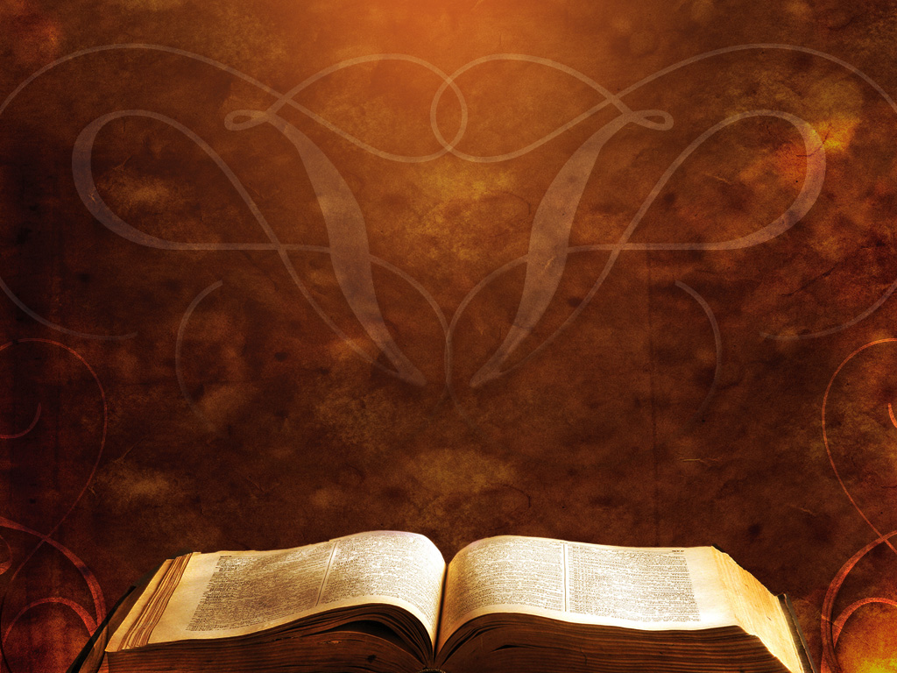
Responding to God According to His Word
Nehemiah 8: 1-18

Slide 2
1. Value God’s Word
II. Listen/Study / seek to Understand God’s Word
III. Respond appropriately to God and His Word
IV. Rejoice in the Lord! - remembering Who He is, what He has done, and what He will do!

Slide 3
1. Value God’s Word
Nehemiah 8:1 And all the people gathered as one man into the square before the Water Gate. And they told Ezra the scribe to bring the Book of the Law of Moses that the LORD had commanded Israel.
2 So Ezra the priest brought the Law before the assembly, both men and women and all who could understand what they heard, on the first day of the seventh month.

Slide 4
1. Value God’s Word
Nehemiah 8:1 And all the people gathered as one man into the square before the Water Gate. And they told Ezra the scribe to bring the Book of the Law of Moses that the LORD had commanded Israel.
2 So Ezra the priest brought the Law before the assembly, both men and women and all who could understand what they heard, on the first day of the seventh month.

Slide 5
1. Value God’s Word
Nehemiah 8:1 And all the people gathered as one man into the square before the Water Gate. And they told Ezra the scribe to bring the Book of the Law of Moses that the LORD had commanded Israel.
2 So Ezra the priest brought the Law before the assembly, both men and women and all who could understand what they heard, on the first day of the seventh month.

Slide 6
1. Value God’s Word
Nehemiah 8:1 And all the people gathered as one man into the square before the Water Gate. And they told Ezra the scribe to bring the Book of the Law of Moses that the LORD had commanded Israel.
2 So Ezra the priest brought the Law before the assembly, both men and women and all who could understand what they heard, on the first day of the seventh month.

Slide 7
1. Value God’s Word
8:3 And he read from it facing the square before the Water Gate from early morning until midday, in the presence of the men and the women and those who could understand. And the ears of all the people were attentive to the Book of the Law.

Slide 8
1. Value God’s Word
8:3 And he read from it facing the square before the Water Gate from early morning until midday, in the presence of the men and the women and those who could understand. And the ears of all the people were attentive to the Book of the Law.

Slide 9
1. Value God’s Word
8:3 And he read from it facing the square before the Water Gate from early morning until midday, in the presence of the men and the women and those who could understand. And the ears of all the people were attentive to the Book of the Law.
13 On the second day the heads of fathers' houses of all the people, with the priests and the Levites, came together to Ezra the scribe in order to study the words of the Law.

Slide 10
1. Value God’s Word
8:18 And day by day, from the first day to the last day, he (Ezra) read from the Book of the Law of God. They kept the feast seven days, …

Slide 11
Psalm 42:1 As a deer longs for streams of water, so my soul longs for you, O God.
2 My soul thirsts for God, for the living God. …

Slide 12
Psalm 19:7 The law of the LORD is perfect, reviving the soul; …
8 the precepts of the LORD are right, rejoicing the heart; ...
9 … the rules of the LORD are true, and righteous altogether.
10 More to be desired are they than gold, even much fine gold; sweeter also than honey and drippings of the honeycomb.

Slide 13
John 6:63 The words that I have spoken to you are spirit and life.
John 5:24 Whoever hears my word and believes Him who sent me has eternal life. He does not come into judgment, but has passed from death to life.

Slide 14
Romans 10:17 Faith comes from hearing, and hearing through the word of Christ.

Slide 15
2 Timothy 3:15 … the holy Scriptures, which are able to make you wise for salvation through faith in Christ Jesus.
16 All Scripture is breathed out by God and profitable for teaching, for reproof, for correction, and for training in righteousness,
17 that the man of God may be complete, equipped for every good work.

Slide 16
1. Value God’s Word
II. Listen/Study / seek to Understand God’s Word

Slide 17
II. Listen/Study / seek to Understand God’s Word
8:3 And he read from it facing the square before the Water Gate from early morning until midday, in the presence of the men and the women and those who could understand. And the ears of all the people were attentive to the Book of the Law.

Slide 18
II. Listen/Study / seek to Understand God’s Word
8:5 Ezra opened the book in the sight of all the people. Because he was visible above all the people there, as he opened it, all the people stood up.
8:7 Furthermore … the descendants of Levi taught the Law to the people while the people remained standing.

Slide 19
II. Listen/Study / seek to Understand God’s Word
8:4 Ezra the scribe stood on a wooden rostrum erected for that purpose. Beside him to his right stood Mattithiah, … (and a dozen more)
8:7 Furthermore … the descendants of Levi taught the Law to the people while the people remained standing.
8 They read from the Book of the Law of God, distinctly communicating its meaning, so they could understand the reading.

Slide 20
II. Listen/Study / seek to Understand God’s Word
8:4 Ezra the scribe stood on a wooden rostrum erected for that purpose. Beside him to his right stood Mattithiah, … (and a dozen more)
8:7 Furthermore … the descendants of Levi taught the Law to the people while the people remained standing.
8 They read from the Book of the Law of God, distinctly communicating its meaning, so they could understand the reading.

Slide 21
II. Listen/Study / seek to Understand God’s Word
8:4 Ezra the scribe stood on a wooden rostrum erected for that purpose. Beside him to his right stood Mattithiah, … (and a dozen more)
8:7 Furthermore … the descendants of Levi taught the Law to the people while the people remained standing.
8 They read from the Book of the Law of God, distinctly communicating its meaning, so they could understand the reading.

Slide 22
II. Listen / Study/ seek to Understand God’s Word
8:8 They (the Levites) read from the Book of the Law of God, distinctly communicating its meaning, so they could understand the reading.

Slide 23
II. Listen / Study/ seek to Understand God’s Word
8:8 They (the Levites) read from the Book of the Law of God, distinctly communicating its meaning, so they could understand the reading.
8:12 So all the people … celebrated with great joy, because they understood the words that were being declared to them.

Slide 24
1. Value God’s Word
II. Listen/Study / seek to Understand God’s Word
III. Respond appropriately to God and His Word

Slide 25
III. Respond appropriately to God and His Word
8:5 And Ezra opened the book in the sight of all the people, for he was above all the people, and as he opened it all the people stood.

Slide 26
III. Respond appropriately to God and His Word
8:5 And Ezra opened the book in the sight of all the people, for he was above all the people, and as he opened it all the people stood.
6 And Ezra blessed the LORD, the great God, and all the people answered, “Amen, Amen,” lifting up their hands. And they bowed their heads and worshiped the LORD with their faces to the ground.
“Blessed are you, Lord, O great God, who gave the Torah to your people Israel”

Slide 27
III. Respond appropriately to God and His Word
8:5 And Ezra opened the book in the sight of all the people, for he was above all the people, and as he opened it all the people stood.
6 And Ezra blessed the LORD, the great God, and all the people answered, “Amen, Amen,” lifting up their hands. And they bowed their heads and worshiped the LORD with their faces to the ground.

Slide 28
8:6 Ezra “blessed” God
בָּרַךְ
bârak baw-rak’
This comes from a primitive rootword, meaning to kneel; by implication to bless God (as an act of adoration)
Psalm 95:6 Oh come, let us worship and bow down; let us kneel before the LORD, our Maker!

Slide 29
III. Respond appropriately to God and His Word
8:5 And Ezra opened the book in the sight of all the people, for he was above all the people, and as he opened it all the people stood.
6 And Ezra blessed the LORD, the great God, and all the people answered, “Amen, Amen,” lifting up their hands. And they bowed their heads and worshiped the LORD with their faces to the ground.

Slide 30
8:6 the people “worshiped” the LORD
שָׁחָה
shâchâh (shaw-khaw’)
From a primitive rootword: to prostrate oneself (in homage to royalty or to God): - bow (self) down, fall down (flat), humbly beseech
Neh. 8:6 … They worshiped the LORD with their faces to the ground.

Slide 31
προσκυνέω
proskuneō (pros-koo-neh’-o)
prostrate oneself in homage; do reverence to

Slide 32
1. Value God’s Word
II. Listen/Study / seek to Understand God’s Word
III. Respond appropriately to God and His Word
a. Come to God’s Word with respect, humility, submission
b. Apply God’s Word to your life

Slide 33
2 Timothy 3:16 All Scripture is breathed out by God and profitable for teaching, for reproof, for correction, and for training in righteousness,
17 that the man of God may be complete, equipped for every good work.
James 1:22 But be doers of the word, and not hearers only, deceiving yourselves.

Slide 34
Nehemiah 8:9 … For all the people wept as they heard the words of the Law.
“mourned and wept”
“grieved”

Slide 35
1. Value God’s Word
II. Listen/Study / seek to Understand God’s Word
III. Respond appropriately to God and His Word
a. Come to God’s Word with respect, humility, submission
b. Apply God’s Word to your life
c. REPENT: let God change your mind, heart, and life
d. OBEY

Slide 36
8:14 And they found it written in the Law that the LORD had commanded by Moses that the people of Israel should dwell in booths during the feast of the seventh month,
15 and that they should proclaim it and publish it in all their towns and in Jerusalem, “Go out to the hills and bring branches of olive, wild olive, myrtle, palm, and other leafy trees to make booths, as it is written.”
16 So the people went out and brought them and made booths for themselves, each on his roof, and in their courts and in the courts of the house of God, …
17 And all the assembly of those who had returned from the captivity made booths and lived in the booths,
… And there was very great rejoicing.

Slide 37
Trust and Obey,
For there’s no other way
To be happy in Jesus,
But to Trust and Obey

Slide 38
1. Value God’s Word
II. Listen/Study / seek to Understand God’s Word
III. Respond appropriately to God and His Word
a. Come to God’s Word with respect, humility, submission
b. Apply God’s Word to your life
c. REPENT: let God change your mind, heart, and life
d. OBEY
IV. Rejoice in the Lord! - remembering Who He is, what He has done, and what He will do!

Slide 39
Nehemiah 8:9 … “This day is holy to the LORD your God; do not mourn or weep.” …
10 Then he said to them, “Go your way. Eat the fat and drink sweet wine and send portions to anyone who has nothing ready, for this day is holy to our Lord. And do not be grieved, for the joy of the LORD is your strength.”

Slide 40
Nehemiah 8:9 … “This day is holy to the LORD your God; do not mourn or weep.” …
10 Then he said to them, “Go your way. Eat the fat and drink sweet wine and send portions to anyone who has nothing ready, for this day is holy to our Lord. And do not be grieved, for the joy of the LORD is your strength.”
12 And all the people went their way … to make great rejoicing, because they had understood the words that were declared to them.

Slide 41
1. Value God’s Word
II. Listen/Study / seek to Understand God’s Word
III. Respond appropriately to God and His Word
a. Come to God’s Word with respect, humility, submission
b. Apply God’s Word to your life
c. REPENT: let God change your mind, heart, and life
d. OBEY
IV. Rejoice in the Lord! - remembering Who He is, what He has done, and what He will do!

