Slide 1
Bodily Resurrection
1 Cor 15:35-58

Slide 2
Introduction
Notes:
The issue about resurrection was not something new. It was something that was a constant debate
Jewish rabbis believed that God created man as a unit of body and spirit. At death the spirit returns to God who gave it and the body returns to the dust of the earth (Eccl. 12:7). And at the resurrection, the dead will rise with the same body that perished.99
The Saducees however did not believe in the resurrection. And you would see that when they tried to trap Jesus with questions about the resurrection.

Slide 3
Introduction
Gnostic = Knowledge
Believe they have the secret knowledge to those with true understanding leading to salvation
Human Spirit = Good
The Body = Bad
We are entrapped/imprisoned in the body that is evil and a mere illusion
New Gnosticism

Slide 4
Introduction
Resurrection remains a mystery
Nobody can tell you how it happens
What happens is not entirely clear
Paul is trying to make clear, that as sure as Christ is risen, physical resurrection is certain for believers
Why is our physical resurrection so important?
The 1st Level issue is the incarnational presence of Christ
Notes:
Greek philosophers taught the immortality of the soul but denied the immortality of the body. Paul was scorned by Epicurean and Stoic philosophers in Athens when at the end of his Areopagus address he mentioned the resurrection from the dead (Acts 17:31–32).
But those Corinthians who were influenced by Greek philosophy repudiated the teachings on the resurrection. They told Paul that raising a person from the dead was impossible. They refused to listen to the message of the Old Testament Scriptures, the account of Jesus’ resurrection, and the promise that believers in Christ will rise from the dead. Last, they rejected the thought of continuity, for they saw only the dissolution of the physical body when death occurred.
Simon J. Kistemaker and William Hendriksen, Exposition of the First Epistle to the Corinthians, vol. 18, New Testament Commentary (Grand Rapids: Baker Book House, 1953–2001), 566–567.

Slide 5
Introduction
To simplify the Incarnation of Jesus , there are two aspects that are essential to it.
God with us = Emmanuel
God became like us so be could become like Him

Slide 6
Presence vs Absence
How is Christ present with us?
Where is His presence now?
His Absence in Body?
Denial of Christ’s physical presence is denying the very essence of who He is
The premise of our salvation through His incarnational presence lies in our faith and belief that He rose from the dead.

Slide 7
Notes:
Lee Strobel, was out to prove that the resurrection is not real.

Slide 8
Overview
Foolish to deny resurrection (v.36 – 41)
Christ our glory unto resurrection (v.42 – 49)
All will be changed; All will be restored (v. 50-55)
Keep pressing on, we will be with Him soon (v.56-58)

Slide 9
Foolish to Deny Resurrection (v. 35-41)
For Paul, life after death is unthinkable (foolish) without some kind of bodily existence (v36)
We are united in Christ in life and death. Our now physical body will ‘die’. (more precisely pass away) (v36)
The Corinthian because they could not imagine resurrection as a possibility abandoned any trust that is was possible (Gordan Fee)
The idea of the foolishness that Paul implies has deeper biblical roots. For the denial of resurrection is the denial of God himself (Ps 14:1; 53:1) (v.35-36)
Just as to deny the resurrection of Christ is to deny the very essence of Christ himself. To deny our physical resurrection is to deny the very work of God to redeem us as His creation

Slide 10
Foolish to Deny Resurrection (v. 35-41)
We can believe in resurrection because the transformation from seed to plant is the work of God (1 Cor 3:6-7)
1 Cor 15:36
How foolish! What you sow does not come to life unless it dies.
Notes:
1 Corinthians 3:6-7 New International Version (NIV)
⁶ I planted the seed, Apollos watered it, but God has been making it grow. ⁷ So neither the one who plants nor the one who waters is anything, but only God, who makes things grow.
he points to something this person does from time to time: sowing seed. When someone plants a seed in fertile soil that has sufficient moisture and warm temperature, it germinates. The germination process causes the seed to disintegrate. That dying seed gives birth to new life in the form of a developing plant that eventually matures and produces seed (see John 12:24). Notice that we sow the seed but are unable to bring about germination and new life. That is God’s work.
But the Greek text has the passive voice of the verb to come to life, which an older version (KJV) translates accurately: “is quickened.” The passive voice conveys the sense that God alone is the agent who creates life and that human beings can only watch this miracle occur.100 Life comes from God who is its source.

Slide 11
Foolish to Deny Resurrection (v. 35-41)
We can believe in resurrection because the transformation from seed to plant is the work of God (1 Cor 3:6-7)
God created us and is the sower of all life. And He can transform our earthly body into a heavenly body. This is not a foolish notion. Because He determines all things such as the flesh of all. (v.38-39)
God will give us the substance of glory (the substance of heavenly beings). The weight of His presence. (v.40-41)
Paul has no intention of explaining how the resurrection happens but only to make the case that it happens! Our earthly bodies will not be identical with our heavenly bodies.
Notes:
1 Corinthians 3:6-7 New International Version (NIV)
⁶ I planted the seed, Apollos watered it, but God has been making it grow. ⁷ So neither the one who plants nor the one who waters is anything, but only God, who makes things grow.
he points to something this person does from time to time: sowing seed. When someone plants a seed in fertile soil that has sufficient moisture and warm temperature, it germinates. The germination process causes the seed to disintegrate. That dying seed gives birth to new life in the form of a developing plant that eventually matures and produces seed (see John 12:24). Notice that we sow the seed but are unable to bring about germination and new life. That is God’s work.
But the Greek text has the passive voice of the verb to come to life, which an older version (KJV) translates accurately: “is quickened.” The passive voice conveys the sense that God alone is the agent who creates life and that human beings can only watch this miracle occur.100 Life comes from God who is its source.

Slide 12
So will it be with the resurrection of the dead. The body that is sown is perishable, it is raised imperishable; 43 it is sown in dishonor, it is raised in glory; it is sown in weakness, it is raised in power; 44 it is sown a natural body, it is raised a spiritual body.
If there is a natural body, there is also a spiritual body. 45 So it is written: “The first man Adam became a living being”; the last Adam, a life-giving spirit. 46 The spiritual did not come first, but the natural, and after that the spiritual.

Slide 13
Christ Our Glory Unto Resurrection (v.42 – 49)
Sowing is an anthropogenic metaphor describing creation (v42-46)
This happens because of the second Adam or heavenly man. The first made from dust must be put away to put on the second that is of God. (v. 47-49)
The state of humanity upon its creation in the person of Adam is | The state of humanity upon its creation in the second person of Christ
In a state of corruptibility In dishonor In weakness A natural body | In a state of incorruptibility In glory In power A spiritual body
Notes:
We through Christ will become like Christ

Slide 14
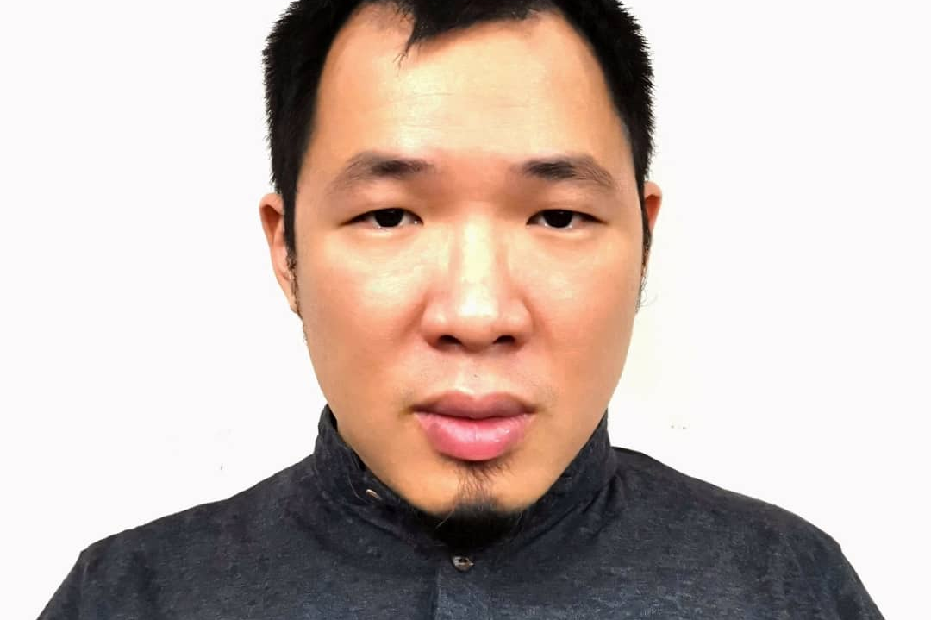
What will this change look like?

Slide 15
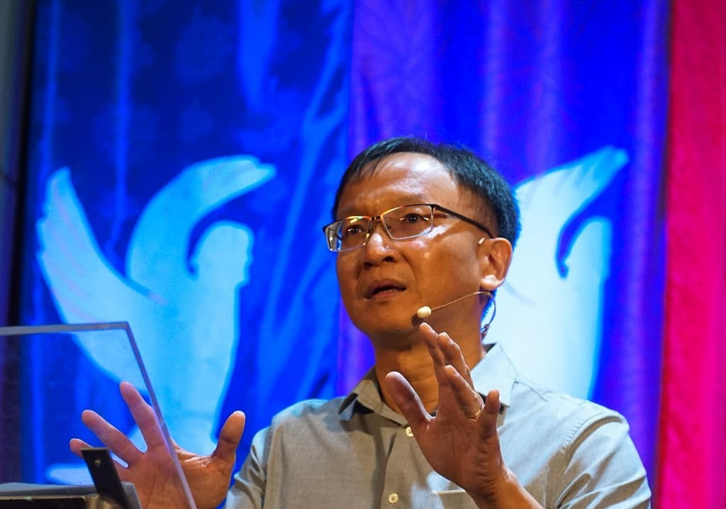
What will this change look like?

Slide 16
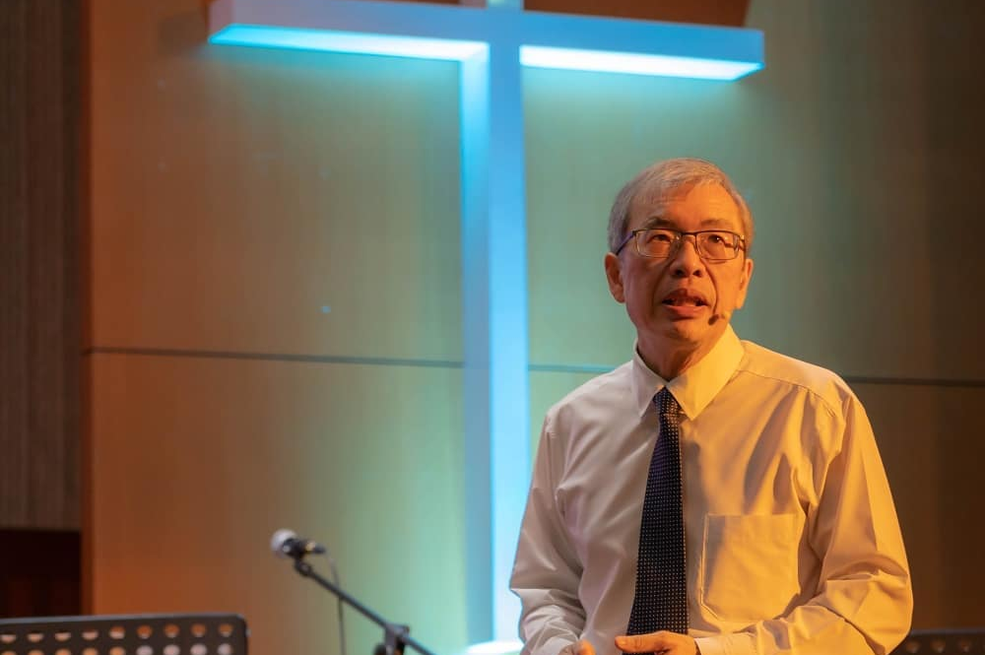
What will this change look like?
Notes:
My father always joked when he gets to heaven his body will look like this

Slide 17
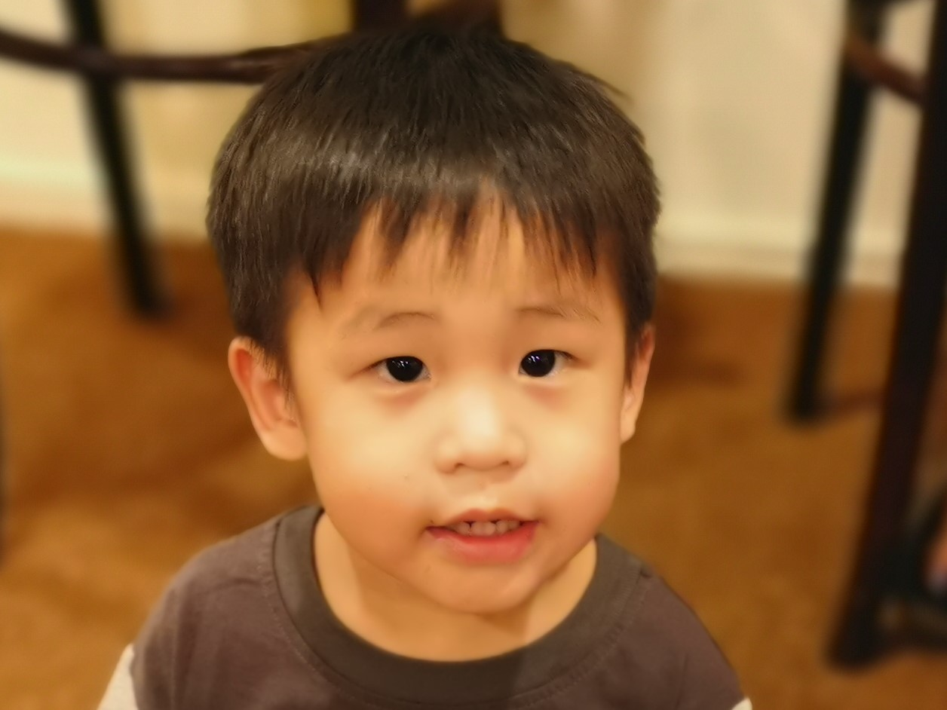
What will this change look like?
Notes:
Will disablilties be gone when we are in heaven? Or will they be redeemed? Christ bore his scars

Slide 18
Notes:
I think part of the reason why people can’t see the value of resurrection is because they cannot see how God see’s it being so valuable for us as His people
Without physical resurrection we have no hope. We are saying that the value of life as God created and see’s, is not valuable at all.

Slide 19
All Will Change; All Will Be Restored (v. 50-55)
Paul’s point was that we cannot remain the same and inherit our heavenly status (v. 50)
If humans take the shape of the first Adam sown with a body made from dust that goes back to dust, then Christians will take the shape of Christ in their heavenly existence, who is from heaven and has a spiritual body (David Garland)
There will be a change and it must change. This change takes place through Christ’s life-giving Spirit. (v.45)
Notes:
After the fall into sin, their bodies were not fit for the Holy Spirit to fill them permanently
necessity that the living and the dead be changed, because in their earthly physicality they cannot inherit the kingdom of God

Slide 20
All Will Change; All Will Be Restored (v. 50-55)
Romans 8:9
9 You, however, are not in the realm of the flesh but are in the realm of the Spirit, if indeed the Spirit of God lives in you. And if anyone does not have the Spirit of Christ, they do not belong to Christ.
Notes:
We are already not for this earthly realm but for the realm of the Spirit. However, that work is not completed until our resurrection is made complete. When the trumpet sounds.
There are some who believe that this is the redeemed state. But we who live here cannot comprehend how this can be.

Slide 21
All Will Change; All Will Be Restored
This change has yet to occur and it lies at the future when we are resurrected (v.51-52) – Matt 24:31
A seed cannot remain a seed. It must fulfil its purpose and become a tree. So that we can be with Christ. (v.53)
Paul’s clothing imagery conveys the idea that the transformation to an immortal body is accomplished by adding a new garment to the mortal body. This change takes place through Christ to become like Christ (v.53)
The realisation of the gospel happens when we are resurrected. Our bodies raised from the dead as being completely Spirit-filled and Spirit-governed. (v. 54-55)
Notes:
Before his death, Jesus raised people from the dead (the daughter of Jairus, the young man of Nain, and Lazarus), but their physical bodies remained mortal. After his resurrection, immortality for his people became a certainty
It is not the same resurrection. It will be different! Glorious!
In a moment, in the twinkling of an eye, at the last trumpet.” The Greek term Paul uses for “moment” is atomos, from which we have the derivative atom. The word refers to something so small that it cannot be divided any more. Here atomos applies to time. The phrase in the twinkling of an eye is appositional; it represents a momentary wink of the eyelid. (Our equivalent is “in a split second,” which commonly signifies the shortest possible moment.) In such a brief moment the miracle of transformation will occur both for those who rise from the dead and for those who are alive
He means to say that some believers will not have to face death; not everyone will die a physical death. Those who live to the end will be changed at Christ’s return and so will all those who have died in the Lord

Slide 22
Notes:
Most statistics say that 60% to 80% of those who enter the ministry will not still be in it 10 years later, and only a fraction will stay in it as a lifetime career.
Seventy percent of pastors constantly fight depression.
Eighty percent of seminary and Bible school graduates who enter the ministry will leave the ministry within the first five years.

Slide 23
Keep Pressing On, We Will Be With Him Soon (v 56-58)
Ultimate destruction of death requires the resurrection of the dead
Life and death is in the hands of God
We share Christ in both life and death
He is with us and He has given us the victory (v.57)
Stand firm, let nothing shake this truth. (v.58)
Notes:
Resurrection was not a big deal to me. I knew I was going to be resurrected. 100 percent. No doubt. I didn’t really bother too much about it. I mean why think about something I cannot fully understand or have to deal with only when I die or in the future right?
I have been to many funerals in my life. It has been very painful every time. Last month I had two dear friends pass away.
But nothing really hit home as when my dad passed away. I miss my dad a lot as I have shared. And I never really bothered to much about his presence until he was gone. I mean the house feels empty a lot of time. The laughter that he has still reverberates sometimes in my mind. In fact sometimes the way my brother coughs sometimes even makes me feel is Dad around?
My dad is a big fat man. And we used to joke all the time about how he would have six packs when he got to heaven. I never knew how much his presence meant until he was absent. In some ways, he is present with me now more than he was present when he was on earth.
I never bothered too much about the physicality of resurrection until I realize how much I miss my dads hug. There is something about the presence of his hug that makes people feel secure. I remember at the funeral, it was time to go to cremate his body. And hundreds were lining up to pay their last respects. And it felt like it took forever. We were crying because everybody hugged us and cried. But the line seemed to bottle neck at my brother because everybody that hugged him wept like crazy. We didn’t really understand why.
Later we would in discussion reflect. And my brother said. I think I know why. Because my brother is ‘shaped’ like my father. And when he hugged them, they would immediately feel like my dad was hugging them. Like he was present with them comforting them.
Christ came as a person, so that His embrace will not feel distant but physical. The physicality of his nature was something he took on permanently for eternity to tell us He is with us. And will be with us forever. I don’t know if you’ve felt like God has been distant all your life. Or he doesn’t really care about your problems. We Asians like to ‘not bother’ people with problems we can handle. But Resurrection is a promise not only of His presence but the promise that we will see him face to face one day. Touch the scars on his hands. Feel the warmth of His embrace. Resurrection is the hope we have that when we hug him one day. We will feel the comfort of His embrace saying well done.
Resurrection is a promise that I can feel and hug my dad and friends one day at the end of it all. As much as I long to feel my dad’s embrace. I long to feel Christ’s embrace the day he comes to take us home. But we do not have to wait until then to feel his presence. To know the warmth of his embrace. To understand that we have hope in him
Perhaps to some of us today, Christ is absent. We deny his power or presence to use through the holy communion, or the church. We may even deny his presence here right now just as the Corinthians were denying the resurrection because it can’t be real. The manifestations of the gifts of the Holy Spirit can’t be real. Healings cannot happen. My problem is not big enough for him to be bothered. Perhaps some of you here think suicide is a possibility because you feel alone in this world.
Let me tell you what Christ did for us is very real. The presence of the Holy Spirit in this hall is very real. And he longs to show you His presence. Every week he gathers us together because He wants to be present with us. If you need God to be present if your life just as much as I do. Let us pray for you

Slide 24
Keep Pressing On, We Will Be With Him Soon (v 56-58)
Trust wholly in the work of God and devote yourself to it.
Our labor and excellence will never be in vain, it will only be for a season.
Be thankful because Christ is present with us.
We have hope because He is here with us!
Notes:
Resurrection was not a big deal to me. I knew I was going to be resurrected. 100 percent. No doubt. I didn’t really bother too much about it. I mean why think about something I cannot fully understand or must deal with only when I die or in the future right? Resurrection is something so distant. Like some of you here also would think. Or maybe not you’re nearing the end you’re more concerned about this.
I have been to many funerals in my life. It has been very painful every time. Last month I had two dear friends pass away.
But nothing really hit home as when my dad passed away. I miss my dad a lot as I have shared. And I never really bothered to much about his presence until he was gone. I mean the house feels empty a lot of time. The laughter that he has still reverberates sometimes in my mind. In fact sometimes the way my brother coughs sometimes even makes me feel is Dad around?
My dad is a big fat man. And we used to joke all the time about how he would have six packs when he got to heaven. I never knew how much his presence meant until he was absent. In some ways, he is present with me now more than he was present when he was on earth.
I never bothered too much about the physicality of resurrection until I realize how much I miss my dads hug. There is something about the presence of his hug that makes people feel secure. I remember at the funeral, it was time to go to cremate his body. And hundreds were lining up to pay their last respects. And it felt like it took forever. We were crying because everybody hugged us and cried. But the line seemed to bottle neck at my brother because everybody that hugged him wept like crazy. We didn’t really understand why.
Later we would in discussion reflect. And my brother said. I think I know why. Because my brother is ‘shaped’ like my father. And when he hugged them, they would immediately feel like my dad was hugging them. Like he was present with them comforting them.
Christ came as a person, so that His embrace will not feel distant but physical. The physicality of his nature was something he took on permanently for eternity to tell us He is with us. And will be with us forever. I don’t know if you’ve felt like God has been distant all your life. Or he doesn’t really care about your problems. We Asians like to ‘not bother’ people with problems we can handle. But Resurrection is a promise not only of His presence but the promise that we will see him face to face one day. Touch the scars on his hands. Feel the warmth of His embrace. Resurrection is the hope we have that when we hug him one day. We will feel the comfort of His embrace saying well done.
Resurrection is a promise that I can feel and hug my dad and friends one day at the end of it all. As much as I long to feel my dad’s embrace. I long to feel Christ’s embrace the day he comes to take us home. But we do not have to wait until then to feel his presence. To know the warmth of his embrace. To understand that we have hope in him
Perhaps to some of us today, Christ is absent. We deny his power or presence to use through the holy communion, or the church. We may even deny his presence here right now just as the Corinthians were denying the resurrection because it can’t be real. The manifestations of the gifts of the Holy Spirit can’t be real. Healings cannot happen. My problem is not big enough for him to be bothered. Perhaps some of you here think suicide is a possibility because you feel alone in this world.
Let me tell you what Christ did for us is very real. The presence of the Holy Spirit in this hall is very real. And he longs to show you His presence. Every week he gathers us together because He wants to be present with us. If you need God to be present if your life just as much as I do. Let us pray for you

