Slide 1
Family Life Ministry Grief Support Group
Mobilizing the church to care for those who have lost loved ones
For more information contact Adeline: 0163565626

Slide 2
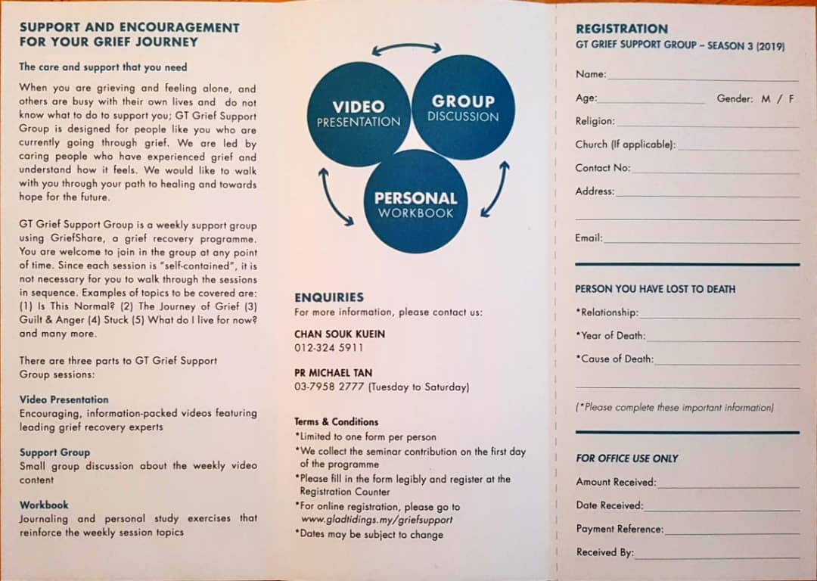

Slide 3
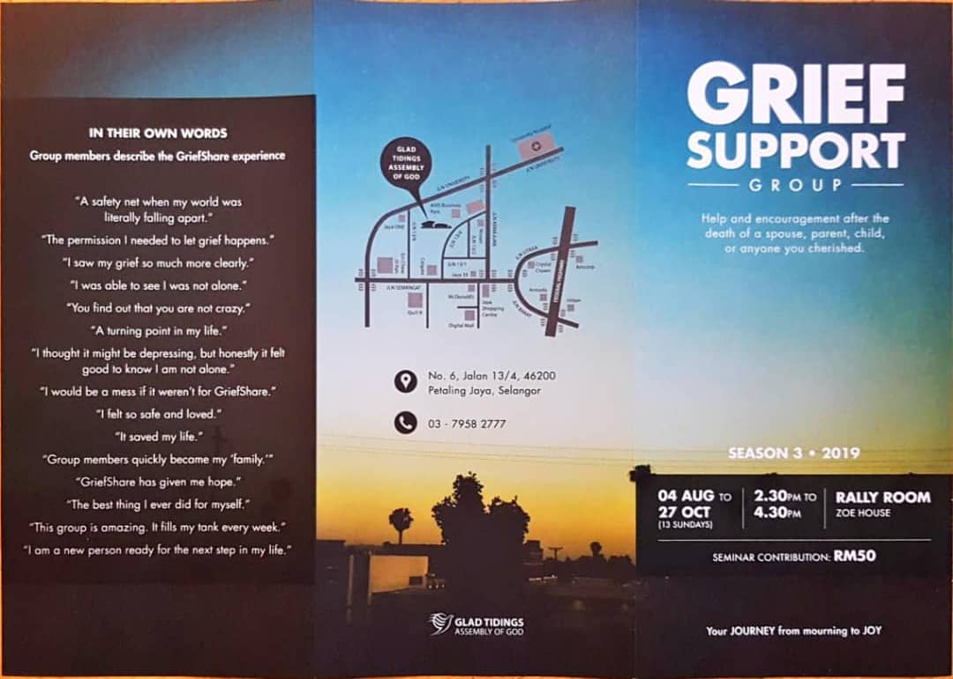

Slide 4
Breaking destructive cycles in our lives
With thanks to Pastor Joshua Tan from Life Journey Centre for input as professional therapist

Slide 7
What is Biblical Counselling
Biblical counseling, in its best conception, gets at how the entirety of the church — not just trained professionals — can be mobilized to love others well. It’s about ordinary people being used by God to help the lives of others. At one level, it’s even as simple as learning enough about somebody to be able to pray for them. It’s average-joe Christian beginning with the basic questions How are you doing? and How can we pray for you?
Ed Welch

Slide 8
Biblical counseling proposes that counseling is an integral part of discipleship for every believer
Reviews counseling presuppositions. Biblical counselors have exposed the dangerously unbiblical presuppositions behind much secular counseling today (and some Christian), and have re-built biblical counseling on biblical presuppositions resulting in more biblical aims and methods.
Has boldly re-claimed pastoral care, so much of which has been usurped by secular counseling in our day.
Emphasis on the power and suitability of God’s Word in addressing people’s problems. They have inspired and trained many Christians to use the Bible to diagnose the roots of problems and to prescribe lasting solutions.
Has restored the biblical vocabulary of personal sin and personal responsibility, giving huge hope of forgiveness and change.
Has large quality of theological and practical resources provided for the church to address a vast range of life problems.
Stresses on the necessity of the Holy Spirit, prayer, and the Christian community to effect long-term transformation.
Emphasizes compassion for people to invest in repairing broken lives.
Modified from Gospel Coalition article by David Murray 2012,

Slide 9
Weakness of the Biblical Counseling Model
Mostly supported by pastors and not so much by trained psychologist, psychiatrist, etc.
Can tend to be overtly judgmental to those who embraced secular counseling.
Can tend to give dangerously simplistic counseling advice based on scripture.
Accused of undermining progress in scientific research and data collection especially in field of neuroscience.
Accused of creating a false dichotomy between science and the bible.
Is unable to use counseling as an evangelistic tool as it breeches Secular Counseling ethics of not imposing worldview on counselees.
Accused of undermining client confidentiality as it stresses accountability with the local church.

Slide 10
Why we all should be involved in counselling
Follow the Wonderful Counsellor (Isaiah 9:2,6-7).
Follow Him who gives rest to those who are heavy burdened (Matthew 11.25-30).
Follow Him who speaks the truth that sets people free (John 8:32).
Follow Him who knew what was in each person (John 2:25).
Follow Him who restores self esteem, especially in fallen leaders (John 21:15-23).
Follow Him who gives us the “Paracletos” (Counselor, Comforter,Advocate) (John 14:16-17) to help us when we try to counsel others.
Follow Him as His ambassadors of comfort (2 Cor 1:4,5:20).

Slide 11
Aim of today’s talk
“Counsel yourself before you counsel others”

Slide 12
What must I do to be ok
WORTH
VALUE
QUEST

Slide 13
Behavior
Reactions
Idolatrous Strategies
Surface idols:
Deep idols:
Reactive
Emotions
View of self
Past
Present
Core Hurts

Slide 14
Behavior
Reactions
Idolatrous Strategies
Surface idols:
Deep idols:
Reactive
Emotions
View of self
I am inadequate
Past
Present
Core Hurts

Slide 15
Behavior
Reactions
Idolatrous Strategies
Surface idols:
Deep idols:
Reactive
Emotions
View of self
I am inadequate
Past
Present
Core Hurts
Parents never gave me much attention

Slide 16
Behavior
Reactions
Idolatrous Strategies
Surface idols:
Deep idols:
Reactive
Emotions
View of self
I am inadequate
Past
Present
Core Hurts
Parents never gave me much attention
Don’t feel appreciated at work

Slide 17
Behavior
Reactions
Idolatrous Strategies
Surface idols:
Deep idols:
Reactive
Emotions
View of self
I am inadequate
Past
Present
Core Hurts
Parents never gave me much attention
Don’t feel appreciated at work
Feel Invisible & rejected

Slide 18
Behavior
Reactions
Idolatrous Strategies
Surface idols:
Deep idols:
Reactive
Emotions
View of self
Sad
Lonely
Bitter
Jealous
I am inadequate
Past
Present
Core Hurts
Parents never gave me much attention
Don’t feel appreciated at work
Feel Invisible & rejected

Slide 19
Behavior
Reactions
Withdrawn
Easily panic
Idolatrous Strategies
Surface idols:
Deep idols:
Reactive
Emotions
View of self
Sad
Lonely
Bitter
Jealous
I am inadequate
Past
Present
Core Hurts
Parents never gave me much attention
Don’t feel appreciated at work
Feel Invisible & rejected

Slide 20
Behavior
Reactions
Withdrawn
Easily panic
Idolatrous Strategies
Surface idols:
Deep idols:
Reactive
Emotions
Different personality in front of different people
View of self
Sad
Lonely
Bitter
Jealous
I am inadequate
Past
Present
Core Hurts
Parents never gave me much attention
Don’t feel appreciated at work
Feel Invisible & rejected

Slide 21
Behavior
Reactions
Withdrawn
Easily panic
Idolatrous Strategies
Surface idols:
Deep idols:
Reactive
Emotions
Very involved in specific church ministry
View of self
Sad
Lonely
Bitter
Jealous
Ministry defines my identity
I am inadequate
Past
Present
Core Hurts
Parents never gave me much attention
Don’t feel appreciated at work
Feel Invisible & rejected

Slide 22
Behavior
Reactions
Idolatrous Strategies
Surface idols:
Deep idols:
Reactive
Emotions
View of self
Past
Present
Core Hurts

Slide 23
WHO AM I?
Behavior
Reactions
Selective of friends
Boastful
Indifferent to what others think
Idolatrous Strategies
Surface idols:
Deep idols:
Reactive
Emotions
Likes to show off his gift of speaking in tongues
View of self
Divisive
Confrontational
Full of yourself
Proud of his bible knowledge and gifts
Thinks he is mature Christian
Past
Present
Core Feelings
Not very significant in society
In society now with many pagan beliefs
Form of love shaped by the world

Slide 24
Behavior
Reactions
Move from reactive behavior to biblical behavior
God centered Strategies
Renew your mind:
Act of worship:
Reactive
Emotions
Progressively move to biblical thinking
View of self
Move from negative emotions to God centered positive emotions
Progressively being more filled with Christ
Identity rooted in Christ
Past
Present
Core Feelings
Commit to break free
How does God view what I do, not the world
Move from hurt feelings to biblical feelings

Slide 25
1. The power of prayer
What should we pray for?
1 Cor 10:1-13

Slide 26
Pray to know the extend of sin that keeps you in a repetitive cycle
The sin of presumption (v1-6, 11-12)
The sin of self indulgence (v7-8)
The sin of constant negativity (v9-10)

Slide 27
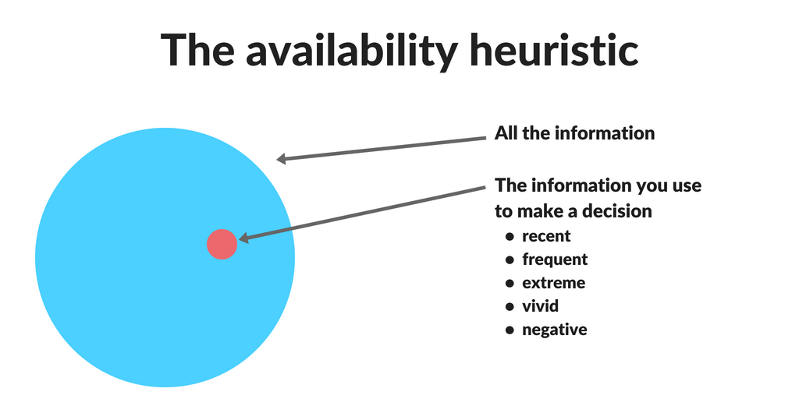

Slide 28
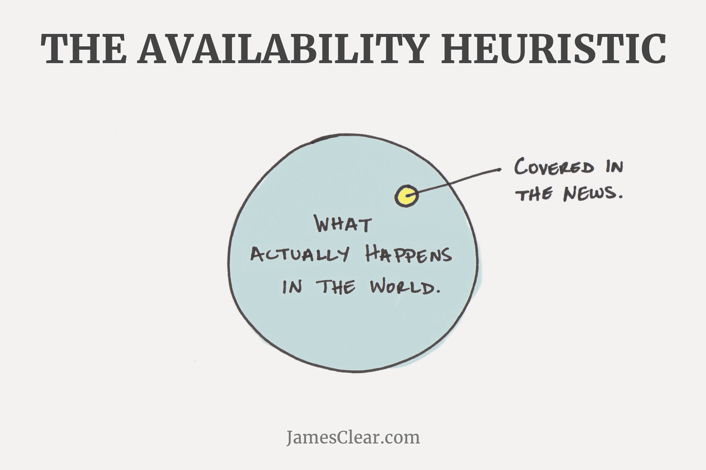

Slide 29
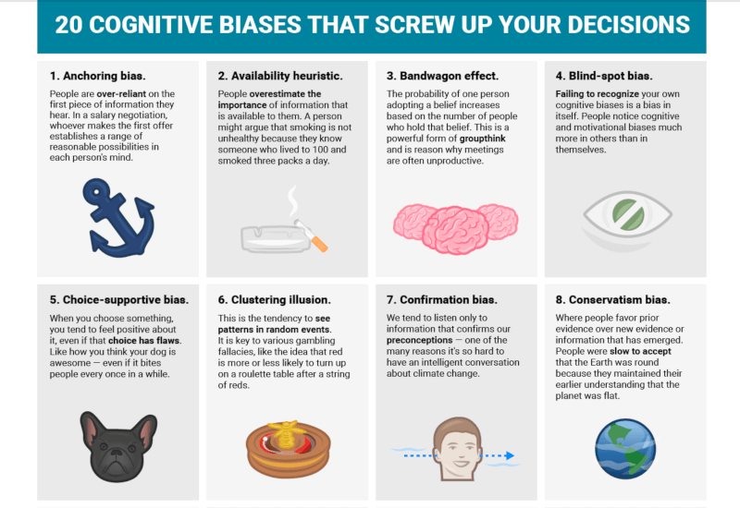

Slide 30
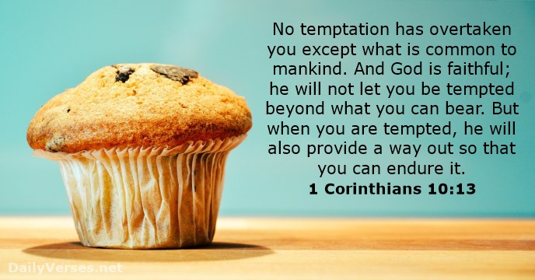
Pray for faith to rely on a faithful God

Slide 31
2. The power of scripture
1 Cor 10:13

Slide 33
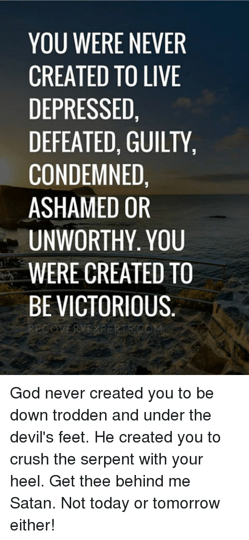

Slide 34
The power of Scripture combined with prayer
AWARE- by developing the habit of prayer with scripture we become aware of our idols and negative thoughts.
ARREST- pray for God’s strength to discipline us to arrest our negative thoughts and for a way out of our destructive cycles.
ADJUST- look at your life and adjust the environment that puts you in a destructive cycle. Use specific scripture to speak into our issues.

Slide 35
3. The power of community
1 Cor 11-14

Slide 36
¹⁷ From Miletus, Paul sent to Ephesus for the elders of the church.¹⁸ When they arrived, he said to them: “You know how I lived the whole time I was with you, from the first day I came into the province of Asia.¹⁹ I served the Lord with great humility and with tears and in the midst of severe testing by the plots of my Jewish opponents. ²⁰ You know that I have not hesitated to preach anything that would be helpful to you but have taught you publicly and from house to house. ²¹ I have declared to both Jews and Greeks that they must turn to God in repentance and have faith in our Lord Jesus.
Acts 20:17

Slide 37
Progressive Sanctification
The power of a worshipping community (chp 14)
The accountability of a complimenting community (chps 11-12)
The change that comes in a loving community (chps 13)

Slide 38
Progressive Sanctification
The worshipping body on Sunday
The Life Groups
The accountability partner
The regular prayer meetings
The mentor/pastor/Christian counselor

Slide 39
Adapted from “Effective Biblical Counseling” by Larry Crabb
Receiving encouragement (requires communal empathy)
Shift from problem feelings to biblical feelings
Commitment

Slide 40
Adapted from “Effective Biblical Counseling” by Larry Crabb
Receiving encouragement (requires communal empathy)
Shift from problem feelings to biblical feelings
Receiving exhortation (requires community with knowledge of bible)
Shift from problem behavior to biblical behavior

Slide 41
Adapted from “Effective Biblical Counseling” by Larry Crabb
Receiving encouragement (requires communal empathy)
Shift from problem feelings to biblical feelings
Receiving exhortation (requires community with knowledge of bible)
Shift from problem behavior to biblical behavior
Receiving enlightenment (requires personal counseling)
Shift from problem thinking to biblical thinking

Slide 42
Behavior
Reactions
Move from reactive behavior to biblical behavior
God centered Strategies
Renew your mind:
Act of worship:
Reactive
Emotions
Progressively move to biblical thinking
View of self
Move from negative emotions to God centered positive emotions
Progressively being more filled with Christ
Identity rooted in Christ
Past
Present
Core Feelings
Commit to break free
How does God view what I do, not the world
Move from hurt feelings to biblical feelings

Slide 43
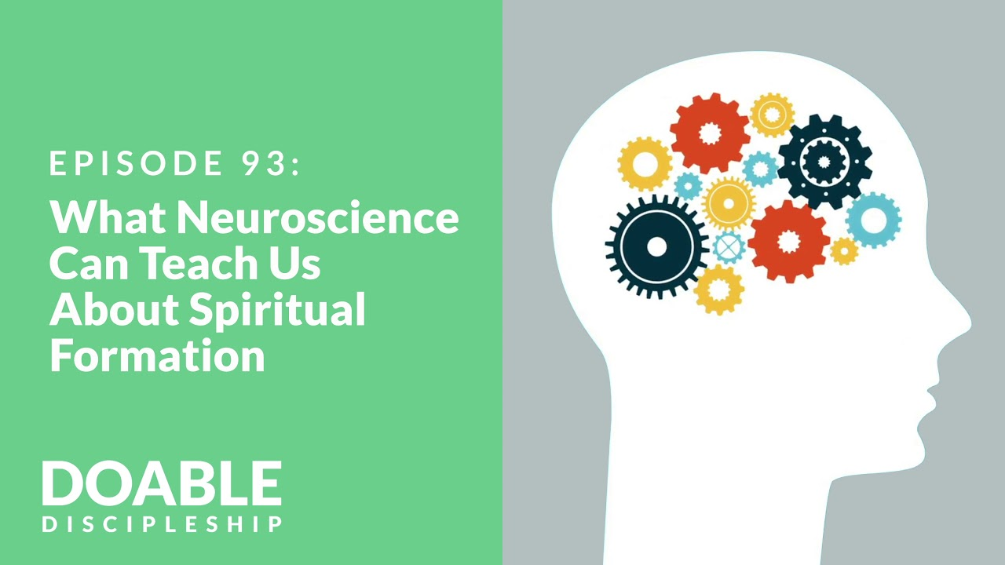
Next Family Life Ministry Gamma class: Spiritual Formation and emotional healthy spirituality
Guest co-speaker: Pastor Joshua Tan, certified therapist

