Slide 1
1 Corinthians 10:23~32 (NIV)
²³ “I have the right to do anything,” you say—but not everything is beneficial.
“I have the right to do anything”—but not everything is constructive.
²⁴ No one should seek their own good, but the good of others.
²⁵ Eat anything sold in the meat market without raising questions of conscience,
²⁶ for, “The earth is the Lord’s, and everything in it.”
²⁷ If an unbeliever invites you to a meal and you want to go,
eat whatever is put before you without raising questions of conscience.
²⁸ But if someone says to you, “This has been offered in sacrifice,” then do not eat it,
both for the sake of the one who told you and for the sake of conscience.
²⁹ I am referring to the other person’s conscience, not yours.
For why is my freedom being judged by another’s conscience?
³⁰ If I take part in the meal with thankfulness,
why am I denounced because of something I thank God for?
³¹ So whether you eat or drink or whatever you do, do it all for the glory of God.
³² Do not cause anyone to stumble, whether Jews, Greeks or the church of God—

Slide 2
1 Corinthians 10:23~32
Glorifying God
Everything is permissible, but NOT everything is beneficial !

Slide 3
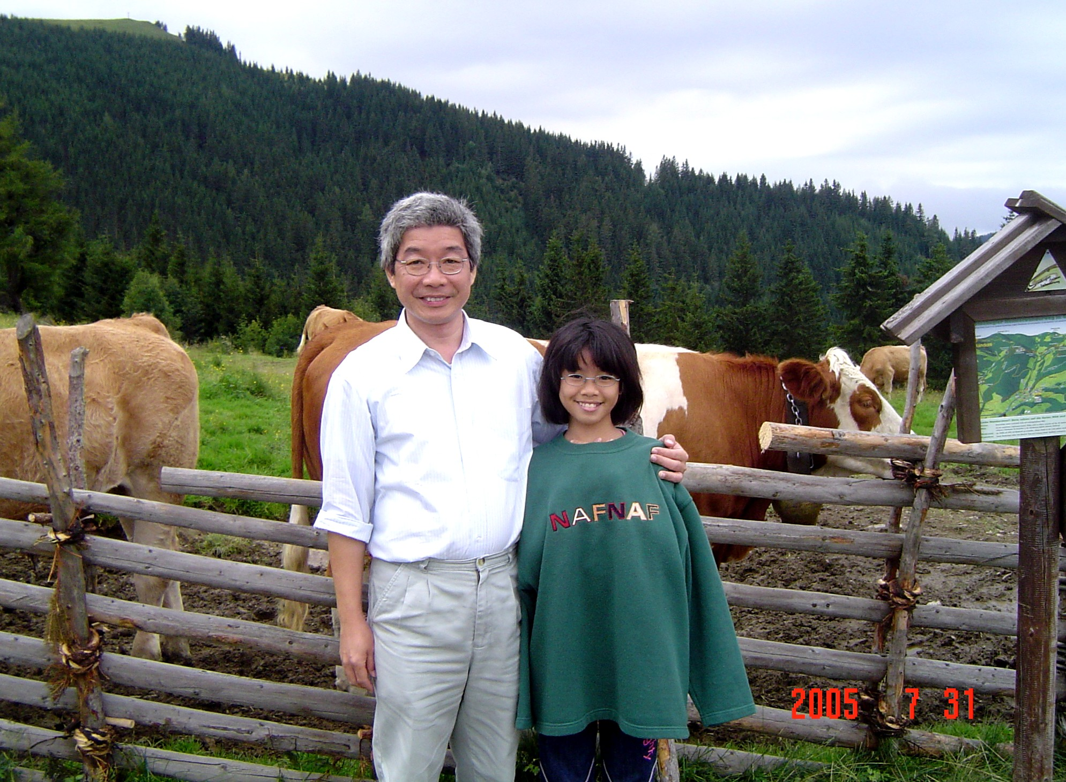

Slide 4
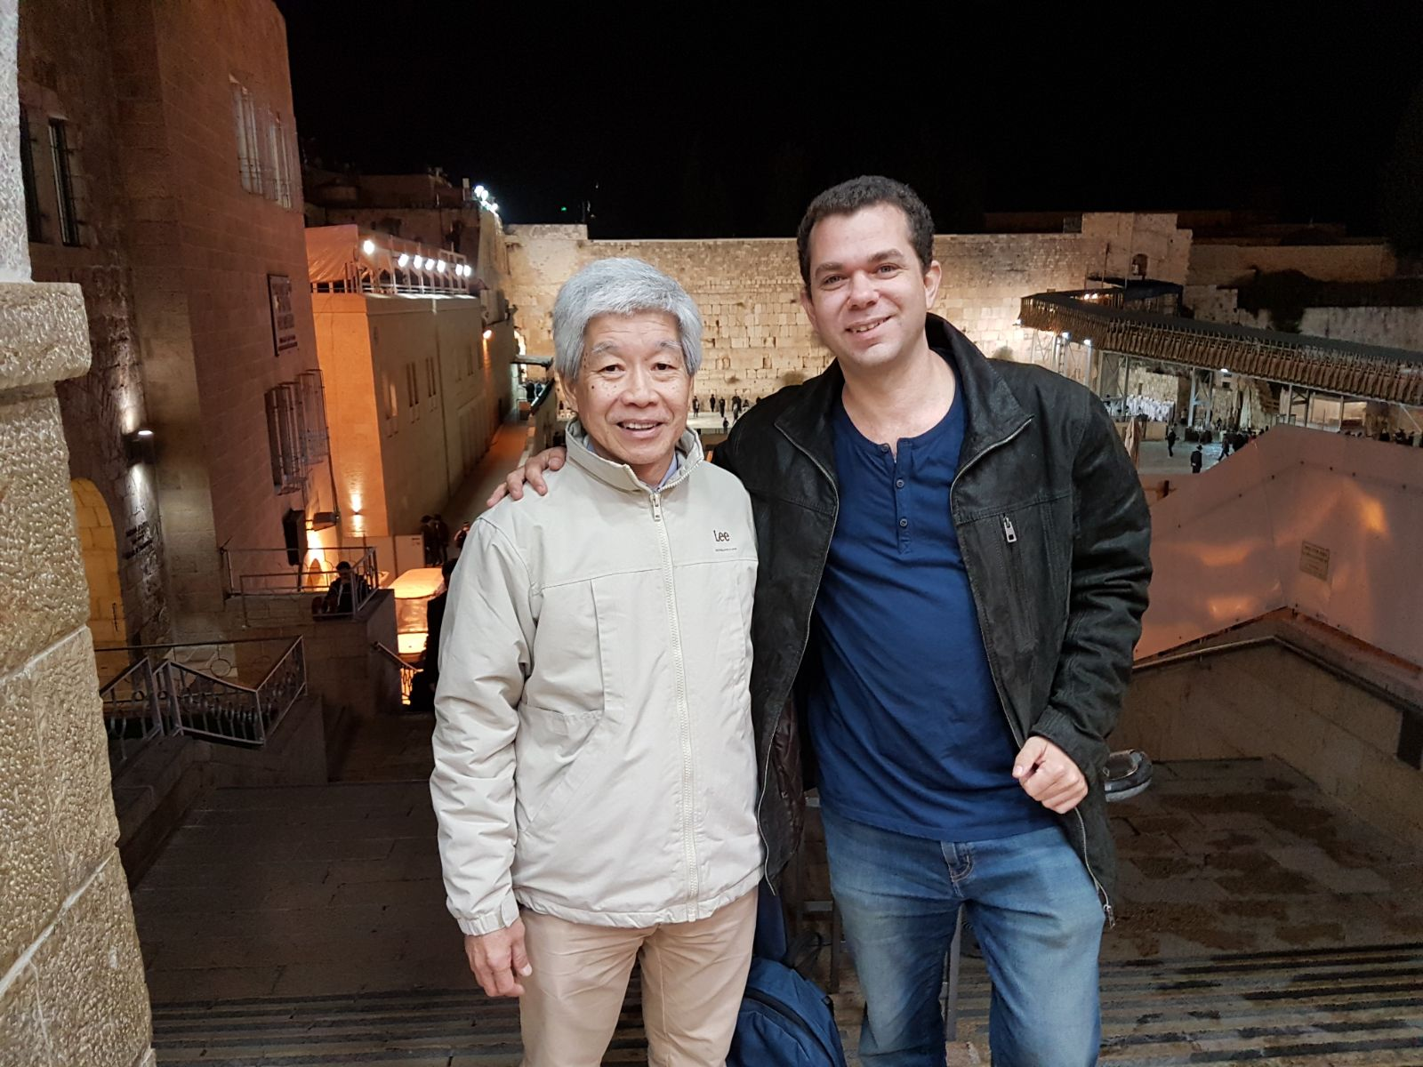

Slide 6
1 Corinthians 10:23~32 (NIV)
²³ “I have the right to do anything,” you say—but not everything is beneficial.
“I have the right to do anything”—but not everything is constructive.
²⁴ No one should seek their own good, but the good of others.
²⁵ Eat anything sold in the meat market without raising questions of conscience,
²⁶ for, “The earth is the Lord’s, and everything in it.”
²⁷ If an unbeliever invites you to a meal and you want to go,
eat whatever is put before you without raising questions of conscience.
²⁸ But if someone says to you, “This has been offered in sacrifice,” then do not eat it,
both for the sake of the one who told you and for the sake of conscience.
²⁹ I am referring to the other person’s conscience, not yours.
For why is my freedom being judged by another’s conscience?
³⁰ If I take part in the meal with thankfulness,
why am I denounced because of something I thank God for?
³¹ So whether you eat or drink or whatever you do, do it all for the glory of God.
³² Do not cause anyone to stumble, whether Jews, Greeks or the church of God—

Slide 7
Structure of 1 Corinthians 10:23~32
1. Liberty with Limits verses 23~24
2. Overcoming Legalism verses 25~27
3. Virtuous Latitude verses 28~29a
4. Exalting the Lord verses 29b~32

Slide 8
profitable / helpful
Part 1 – Liberty with Limits
²³ “I have the right to do anything,” you say—but not everything is beneficial.
“I have the right to do anything”—but not everything is constructive.
²⁴ No one should seek their own good, but the good of others.
²⁵ Eat anything sold in the meat market without raising questions of conscience,
²⁶ for, “The earth is the Lord’s, and everything in it.”
²⁷ If an unbeliever invites you to a meal and you want to go,
eat whatever is put before you without raising questions of conscience.
²⁸ But if someone says to you, “This has been offered in sacrifice,” then do not eat it,
both for the sake of the one who told you and for the sake of conscience.
²⁹ I am referring to the other person’s conscience, not yours.
For why is my freedom being judged by another’s conscience?
³⁰ If I take part in the meal with thankfulness,
why am I denounced because of something I thank God for?
³¹ So whether you eat or drink or whatever you do, do it all for the glory of God.
³² Do not cause anyone to stumble, whether Jews, Greeks or the church of God—
builds up / edifies

Slide 9
1 Corinthians 6:12
“I have the right to do anything,” you say
—but not everything is beneficial.
“I have the right to do anything”
—but I will not be mastered by anything.
sin
brought under the power of anything

Slide 10
Part 1 – Liberty with Limits
²³ “I have the right to do anything,” you say—but not everything is beneficial.
“I have the right to do anything”—but not everything is constructive.
²⁴ No one should seek their own good, but the good of others.
²⁵ Eat anything sold in the meat market without raising questions of conscience,
²⁶ for, “The earth is the Lord’s, and everything in it.”
²⁷ If an unbeliever invites you to a meal and you want to go,
eat whatever is put before you without raising questions of conscience.
²⁸ But if someone says to you, “This has been offered in sacrifice,” then do not eat it,
both for the sake of the one who told you and for the sake of conscience.
²⁹ I am referring to the other person’s conscience, not yours.
For why is my freedom being judged by another’s conscience?
³⁰ If I take part in the meal with thankfulness,
why am I denounced because of something I thank God for?
³¹ So whether you eat or drink or whatever you do, do it all for the glory of God.
³² Do not cause anyone to stumble, whether Jews, Greeks or the church of God—

Slide 11
1 Corinthians 10:19
Do I mean then that food sacrificed to an idol is anything,
or that an idol is anything?

Slide 12
1 Corinthians 10:21
You cannot drink the cup of the Lord
and the cup of demons too;
you cannot have a part in both the Lord’s table
and the table of demons.

Slide 13
Part 1 – Liberty with Limits
²³ “I have the right to do anything,” you say—but not everything is beneficial.
“I have the right to do anything”—but not everything is constructive.
²⁴ No one should seek their own good, but the good of others.
²⁵ Eat anything sold in the meat market without raising questions of conscience,
²⁶ for, “The earth is the Lord’s, and everything in it.”
²⁷ If an unbeliever invites you to a meal and you want to go,
eat whatever is put before you without raising questions of conscience.
²⁸ But if someone says to you, “This has been offered in sacrifice,” then do not eat it,
both for the sake of the one who told you and for the sake of conscience.
²⁹ I am referring to the other person’s conscience, not yours.
For why is my freedom being judged by another’s conscience?
³⁰ If I take part in the meal with thankfulness,
why am I denounced because of something I thank God for?
³¹ So whether you eat or drink or whatever you do, do it all for the glory of God.
³² Do not cause anyone to stumble, whether Jews, Greeks or the church of God—

Slide 15
²³ “I have the right to do anything,” you say—but not everything is beneficial.
“I have the right to do anything”—but not everything is constructive.
²⁴ No one should seek their own good, but the good of others.
²⁵ Eat anything sold in the meat market without raising questions of conscience,
²⁶ for, “The earth is the Lord’s, and everything in it.”
²⁷ If an unbeliever invites you to a meal and you want to go,
eat whatever is put before you without raising questions of conscience.
²⁸ But if someone says to you, “This has been offered in sacrifice,” then do not eat it,
both for the sake of the one who told you and for the sake of conscience.
²⁹ I am referring to the other person’s conscience, not yours.
For why is my freedom being judged by another’s conscience?
³⁰ If I take part in the meal with thankfulness,
why am I denounced because of something I thank God for?
³¹ So whether you eat or drink or whatever you do, do it all for the glory of God.
³² Do not cause anyone to stumble, whether Jews, Greeks or the church of God—
Part 2 – Overcoming Legalism

Slide 16
1 Corinthians 10:23~32 (NIV)
²³ “I have the right to do anything,” you say—but not everything is beneficial.
“I have the right to do anything”—but not everything is constructive.
²⁴ No one should seek their own good, but the good of others.
²⁵ Eat anything sold in the meat market without raising questions of conscience,
²⁶ for, “The earth is the Lord’s, and everything in it.”
²⁷ If an unbeliever invites you to a meal and you want to go,
eat whatever is put before you without raising questions of conscience.
²⁸ But if someone says to you, “This has been offered in sacrifice,” then do not eat it,
both for the sake of the one who told you and for the sake of conscience.
²⁹ I am referring to the other person’s conscience, not yours.
For why is my freedom being judged by another’s conscience?
³⁰ If I take part in the meal with thankfulness,
why am I denounced because of something I thank God for?
³¹ So whether you eat or drink or whatever you do, do it all for the glory of God.
³² Do not cause anyone to stumble, whether Jews, Greeks or the church of God—
mixed congregation

Slide 17
²³ “I have the right to do anything,” you say—but not everything is beneficial.
“I have the right to do anything”—but not everything is constructive.
²⁴ No one should seek their own good, but the good of others.
²⁵ Eat anything sold in the meat market without raising questions of conscience,
²⁶ for, “The earth is the Lord’s, and everything in it.”
²⁷ If an unbeliever invites you to a meal and you want to go,
eat whatever is put before you without raising questions of conscience.
²⁸ But if someone says to you, “This has been offered in sacrifice,” then do not eat it,
both for the sake of the one who told you and for the sake of conscience.
²⁹ I am referring to the other person’s conscience, not yours.
For why is my freedom being judged by another’s conscience?
³⁰ If I take part in the meal with thankfulness,
why am I denounced because of something I thank God for?
³¹ So whether you eat or drink or whatever you do, do it all for the glory of God.
³² Do not cause anyone to stumble, whether Jews, Greeks or the church of God—
Part 2 – Overcoming Legalism

Slide 18
Galatians 5:1
It is for freedom that Christ has set us free.
Stand firm, then, and do not let yourselves
be burdened again by a yoke of slavery.

Slide 19
²³ “I have the right to do anything,” you say—but not everything is beneficial.
“I have the right to do anything”—but not everything is constructive.
²⁴ No one should seek their own good, but the good of others.
²⁵ Eat anything sold in the meat market without raising questions of conscience,
²⁶ for, “The earth is the Lord’s, and everything in it.”
²⁷ If an unbeliever invites you to a meal and you want to go,
eat whatever is put before you without raising questions of conscience.
²⁸ But if someone says to you, “This has been offered in sacrifice,” then do not eat it,
both for the sake of the one who told you and for the sake of conscience.
²⁹ I am referring to the other person’s conscience, not yours.
For why is my freedom being judged by another’s conscience?
³⁰ If I take part in the meal with thankfulness,
why am I denounced because of something I thank God for?
³¹ So whether you eat or drink or whatever you do, do it all for the glory of God.
³² Do not cause anyone to stumble, whether Jews, Greeks or the church of God—
Part 3 – Virtuous Latitude

Slide 20
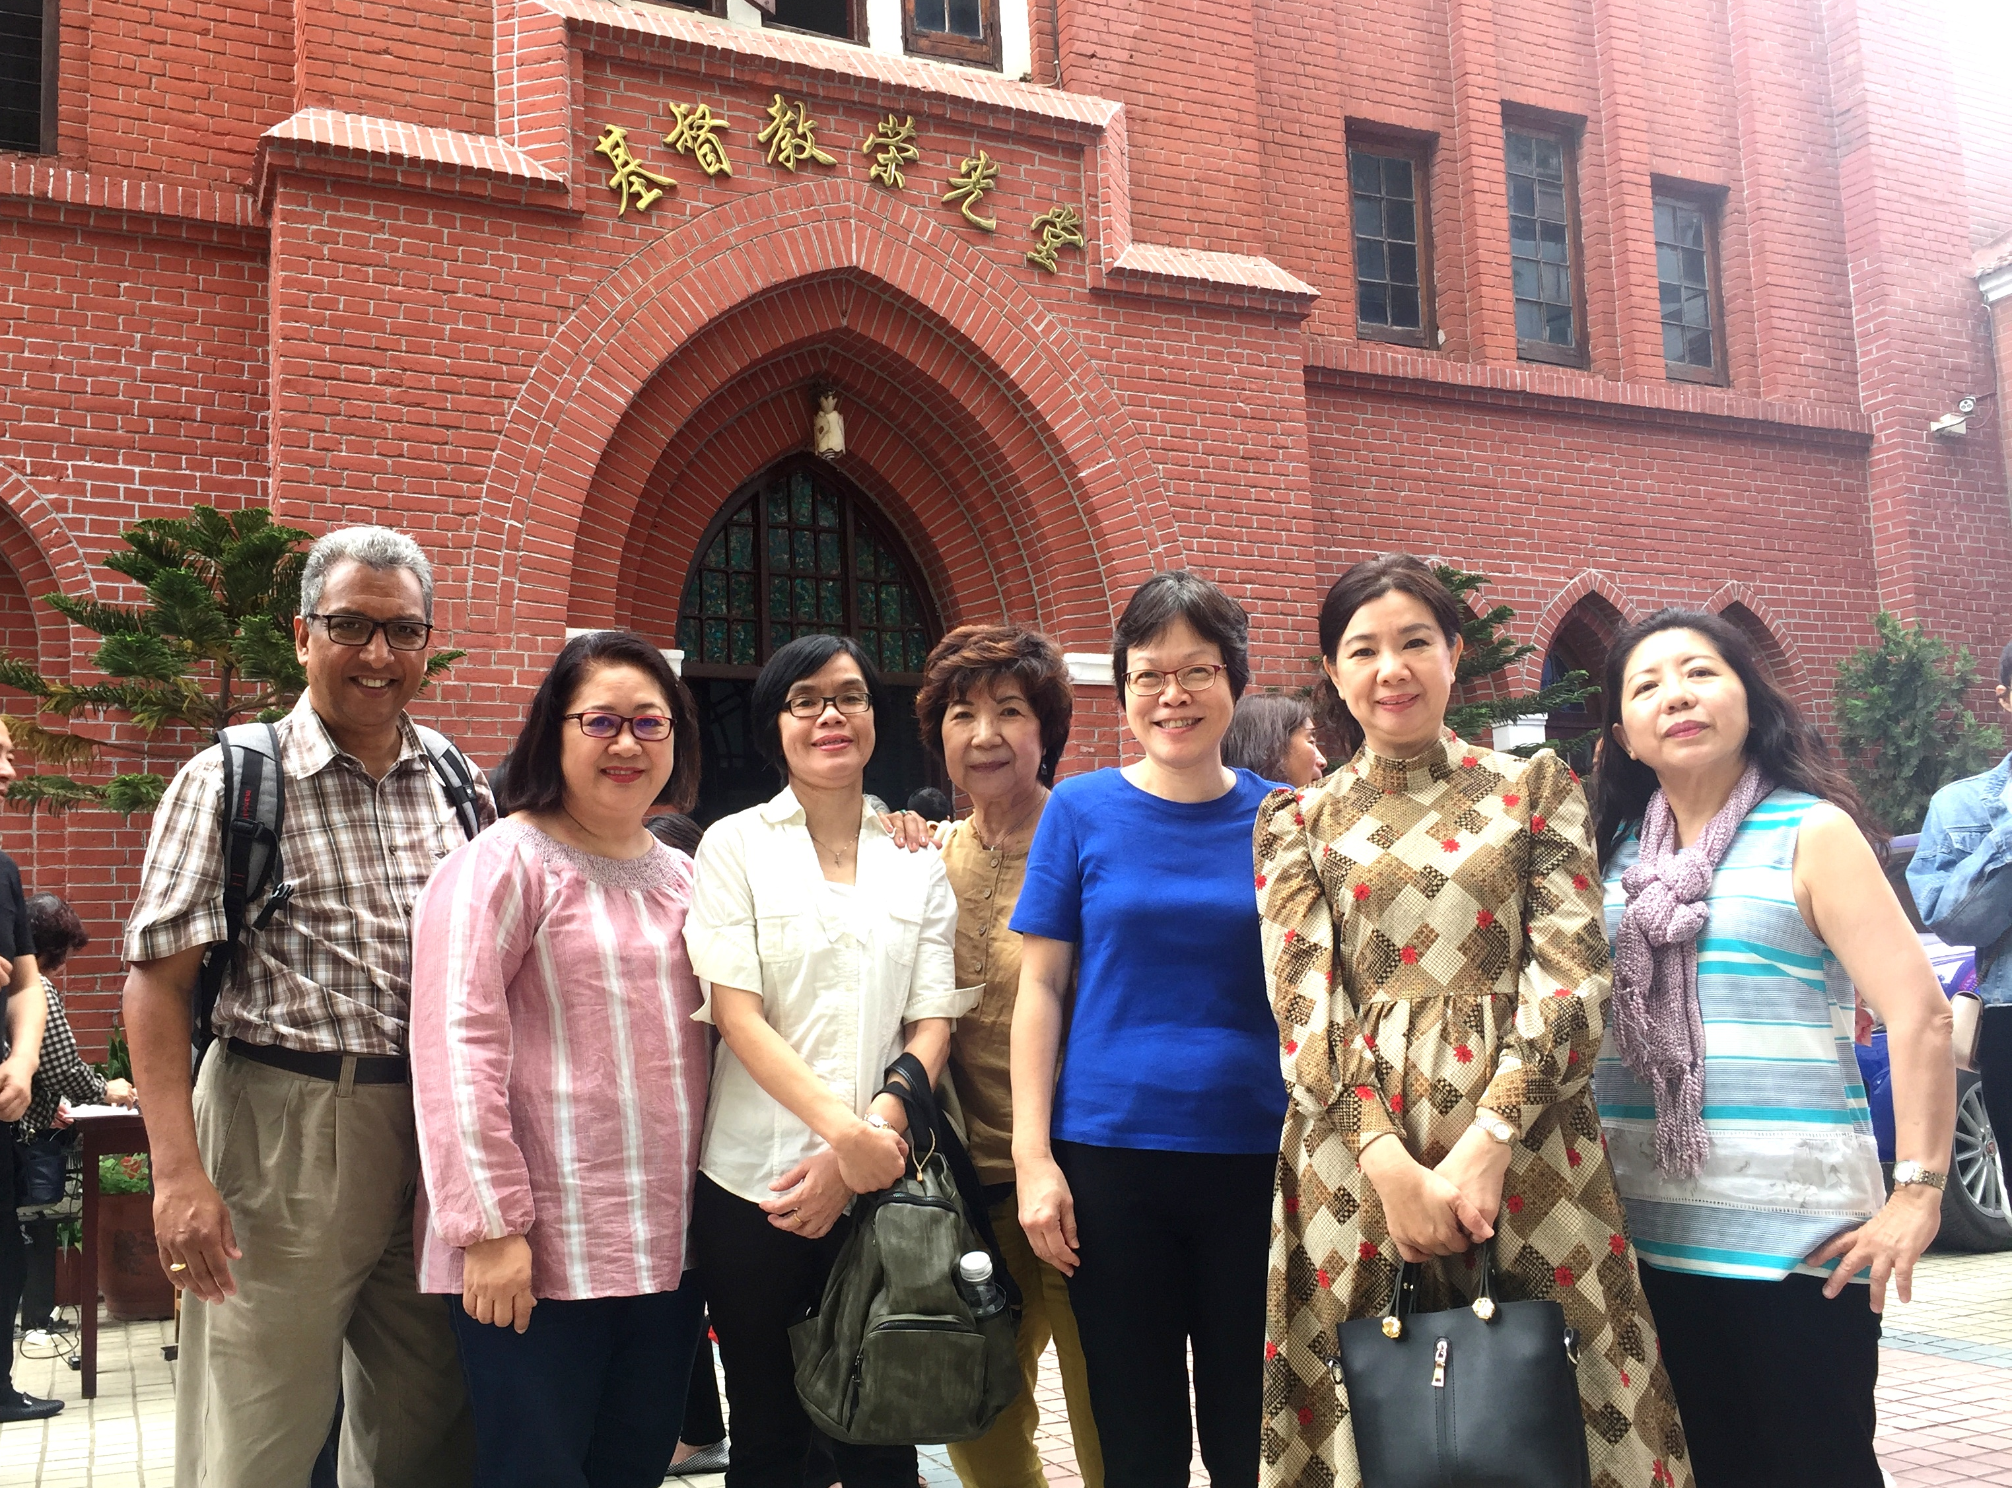

Slide 21
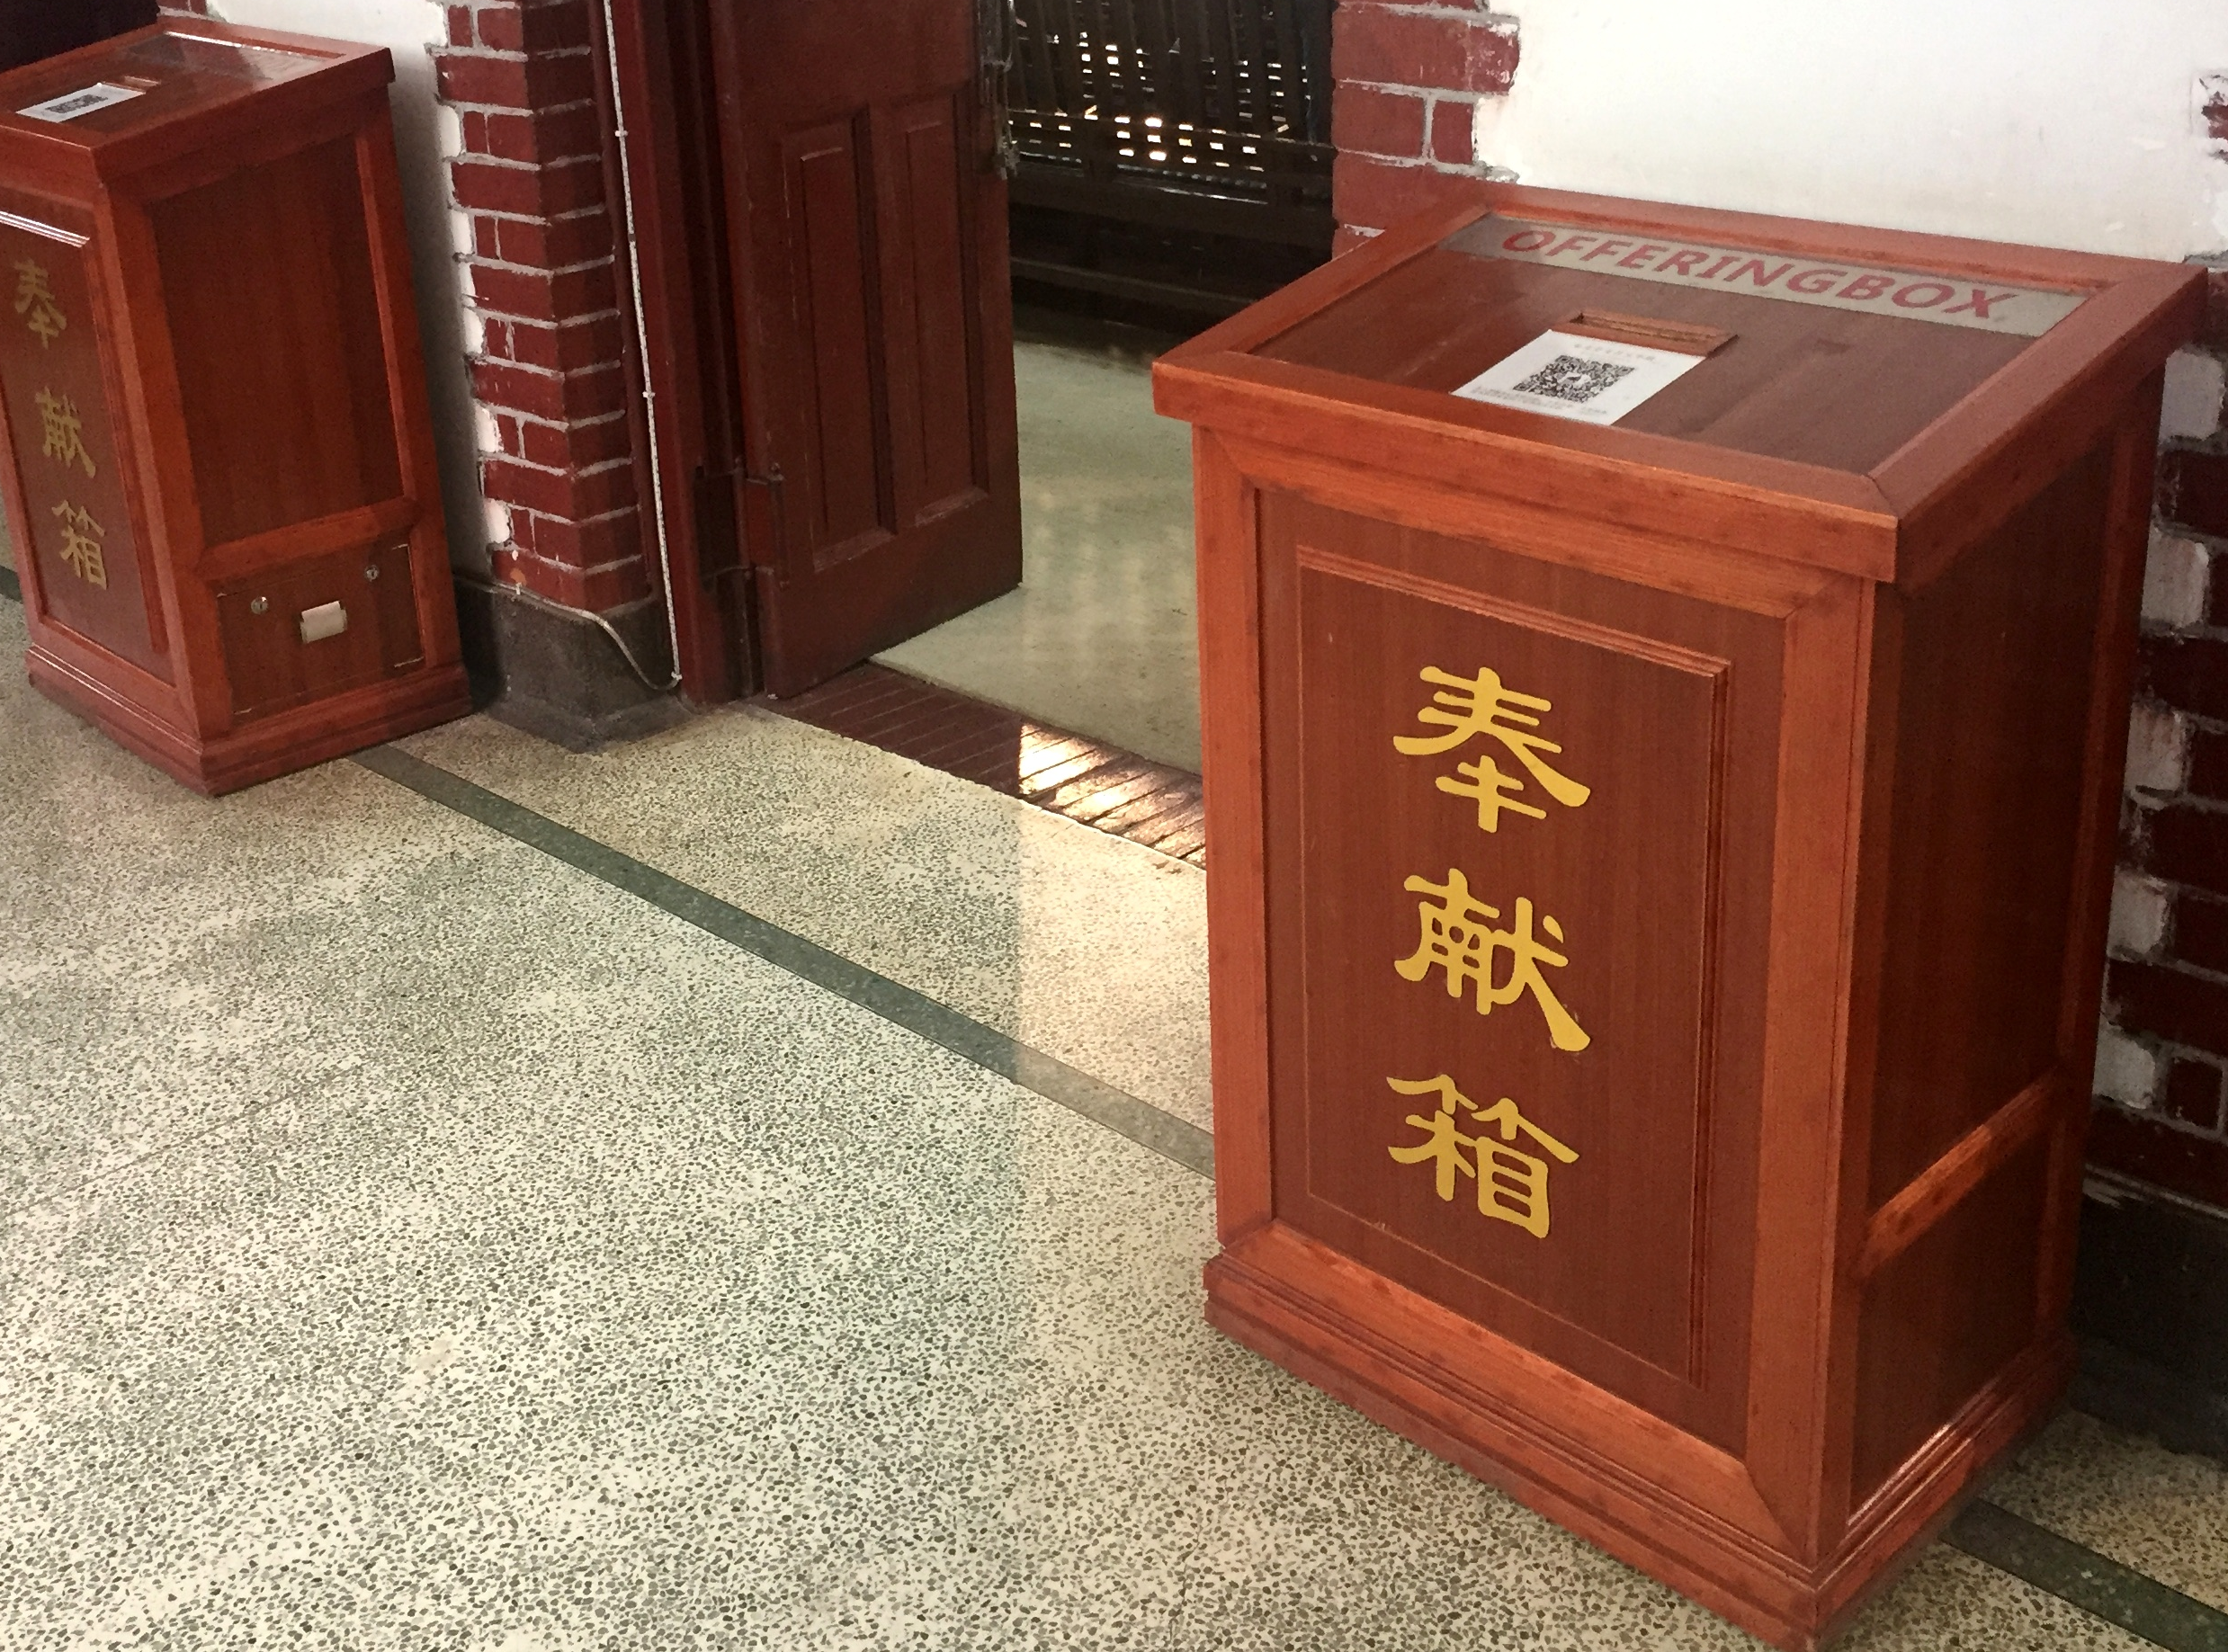

Slide 22
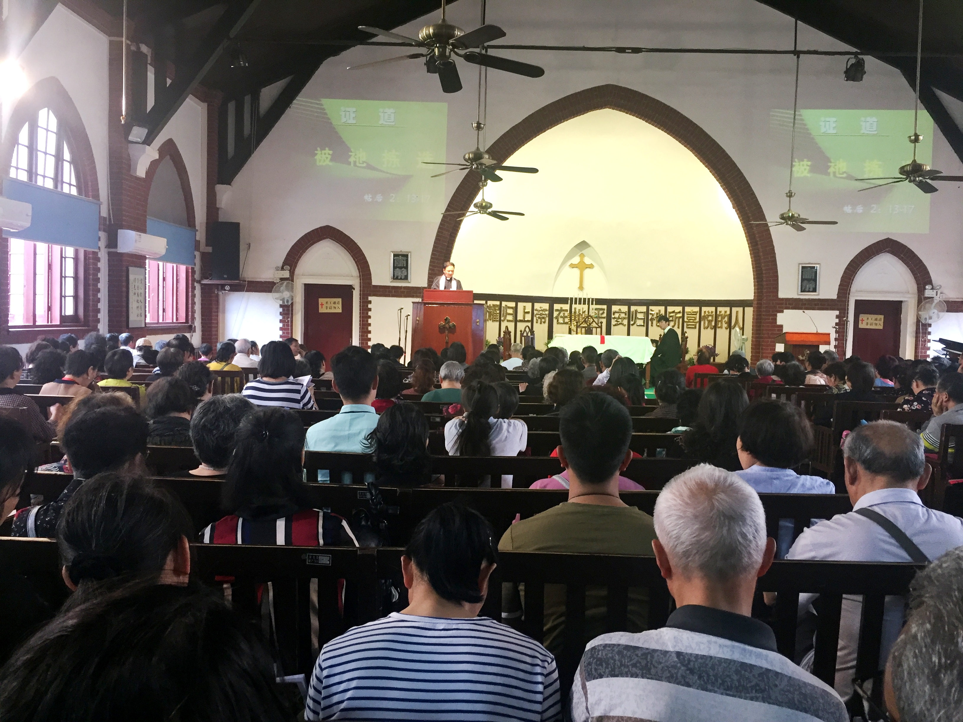

Slide 23
1 Corinthians 8:9
Be careful … that the exercise of your rights
does not become a stumbling block to the weak.

Slide 24
²³ “I have the right to do anything,” you say—but not everything is beneficial.
“I have the right to do anything”—but not everything is constructive.
²⁴ No one should seek their own good, but the good of others.
²⁵ Eat anything sold in the meat market without raising questions of conscience,
²⁶ for, “The earth is the Lord’s, and everything in it.”
²⁷ If an unbeliever invites you to a meal and you want to go,
eat whatever is put before you without raising questions of conscience.
²⁸ But if someone says to you, “This has been offered in sacrifice,” then do not eat it,
both for the sake of the one who told you and for the sake of conscience.
²⁹ I am referring to the other person’s conscience, not yours.
For why is my freedom being judged by another’s conscience?
³⁰ If I take part in the meal with thankfulness,
why am I denounced because of something I thank God for?
³¹ So whether you eat or drink or whatever you do, do it all for the glory of God.
³² Do not cause anyone to stumble, whether Jews, Greeks or the church of God—
Part 4 – Exalting the Lord

Slide 28
²³ “I have the right to do anything,” you say—but not everything is beneficial.
“I have the right to do anything”—but not everything is constructive.
²⁴ No one should seek their own good, but the good of others.
²⁵ Eat anything sold in the meat market without raising questions of conscience,
²⁶ for, “The earth is the Lord’s, and everything in it.”
²⁷ If an unbeliever invites you to a meal and you want to go,
eat whatever is put before you without raising questions of conscience.
²⁸ But if someone says to you, “This has been offered in sacrifice,” then do not eat it,
both for the sake of the one who told you and for the sake of conscience.
²⁹ I am referring to the other person’s conscience, not yours.
For why is my freedom being judged by another’s conscience?
³⁰ If I take part in the meal with thankfulness,
why am I denounced because of something I thank God for?
³¹ So whether you eat or drink or whatever you do, do it all for the glory of God.
³² Do not cause anyone to stumble, whether Jews, Greeks or the church of God—
Part 4 – Exalting the Lord

Slide 29
Matthew 5:17~19
“Do not think that I have come to abolish the Law or the Prophets;
I have not come to abolish them but to fulfill them.
For truly I tell you, until heaven and earth disappear,
not the smallest letter...will by any means disappear from the Law
until everything is accomplished.
…whoever practices and teaches these commands
will be called great in the kingdom of heaven.

Slide 30
Galatians 5:2
Mark my words! I, Paul, tell you that
if you let yourselves be circumcised,
Christ will be of no value to you at all.

Slide 31
Matthew 7:12
So in everything,
do to others what you would have them do to you,
for this sums up the Law and the Prophets.

Slide 32
The Golden Rule

Slide 33
Matthew 22:37~40
‘Love the Lord your God with all your heart
and with all your soul and with all your mind.’
This is the first and greatest commandment.
And the second is like it: ‘Love your neighbor as yourself.’
All the Law and the Prophets hang on these two commandments.

Slide 35
Galatians 5:6
For in Christ Jesus neither circumcision
nor uncircumcision has any value.
The only thing that counts is faith expressing itself through love.

Slide 36
1 Corinthians 8:1
Now about food sacrificed to idols:
We know that “We all possess knowledge.”
But knowledge puffs up while love builds up.

Slide 37
1 Corinthians 10:23~32 (NIV)
²³ “I have the right to do anything,” you say—but not everything is beneficial.
“I have the right to do anything”—but not everything is constructive.
²⁴ No one should seek their own good, but the good of others.
²⁵ Eat anything sold in the meat market without raising questions of conscience,
²⁶ for, “The earth is the Lord’s, and everything in it.”
²⁷ If an unbeliever invites you to a meal and you want to go,
eat whatever is put before you without raising questions of conscience.
²⁸ But if someone says to you, “This has been offered in sacrifice,” then do not eat it,
both for the sake of the one who told you and for the sake of conscience.
²⁹ I am referring to the other person’s conscience, not yours.
For why is my freedom being judged by another’s conscience?
³⁰ If I take part in the meal with thankfulness,
why am I denounced because of something I thank God for?
³¹ So whether you eat or drink or whatever you do, do it all for the glory of God.
³² Do not cause anyone to stumble, whether Jews, Greeks or the church of God—

Slide 38
1 Corinthians 10:23~32 (NIV)
²³ “I have the right to do anything,” you say—but not everything is beneficial.
“I have the right to do anything”—but not everything is constructive.
²⁴ No one should seek their own good, but the good of others.
²⁵ Eat anything sold in the meat market without raising questions of conscience,
²⁶ for, “The earth is the Lord’s, and everything in it.”
²⁷ If an unbeliever invites you to a meal and you want to go,
eat whatever is put before you without raising questions of conscience.
²⁸ But if someone says to you, “This has been offered in sacrifice,” then do not eat it,
both for the sake of the one who told you and for the sake of conscience.
²⁹ I am referring to the other person’s conscience, not yours.
For why is my freedom being judged by another’s conscience?
³⁰ If I take part in the meal with thankfulness,
why am I denounced because of something I thank God for?
³¹ So whether you eat or drink or whatever you do, do it all for the glory of God.
³² Do not cause anyone to stumble, whether Jews, Greeks or the church of God—

Slide 39
Structure of 1 Corinthians 10:23~32
1. Liberty with Limits verses 23~24
2. Overcoming Legalism verses 25~27
3. Virtuous Latitude verses 28~29a
4. Exalting the Lord verses 29b~32

