Slide 1
Family Life Ministry DNA- 5 year Plan

Slide 2
Coordinator
CARE & SUPPORT
FAMILY MINISTRY
Dealing with pain and suffering- Grief, Loneliness, Depression, etc
Struggling with abuse & addictions, etc
Relational Issues
- Family problems,etc
Financial and Legal networking
Others

Slide 3
Marriage, Divorce and Remarriage 1 Cor 7
A FBC Family Life Ministry Sermon Series

Slide 4
Marriage
Divorce

Slide 5
7 Now for the matters you wrote about: “It is good for a man not to have sexual relations with a woman.” ² But since sexual immorality is occurring, each man should have sexual relations with his own wife, and each woman with her own husband. ³ The husband should fulfill his marital duty to his wife, and likewise the wife to her husband. ⁴ The wife does not have authority over her own body but yields it to her husband. In the same way, the husband does not have authority over his own body but yields it to his wife. ⁵ Do not deprive each other except perhaps by mutual consent and for a time, so that you may devote yourselves to prayer. Then come together again so that Satan will not tempt you because of your lack of self-control. ⁶ I say this as a concession, not as a command. ⁷ I wish that all of you were as I am. But each of you has your own gift from God; one has this gift, another has that.

Slide 6
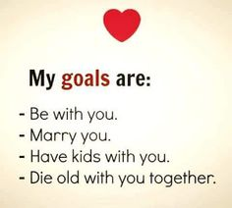
Marriage
Marriage is a Covenant, not a Transaction.

Slide 8
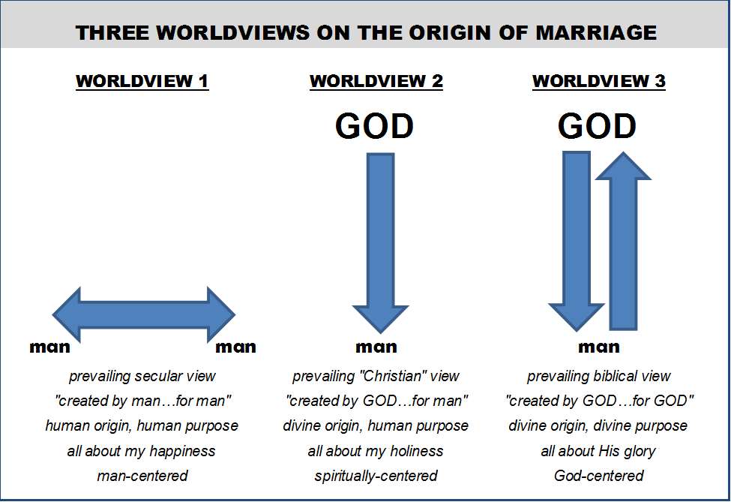

Slide 10
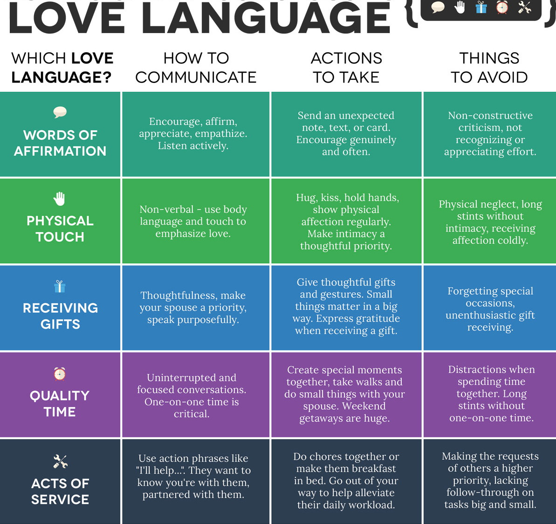

Slide 11
Marriage
Accounta-bility
Shared biblical values
Body of Christ
Marriage is a Covenant, not a Transaction.
Marriage and the Body of Christ.

Slide 12
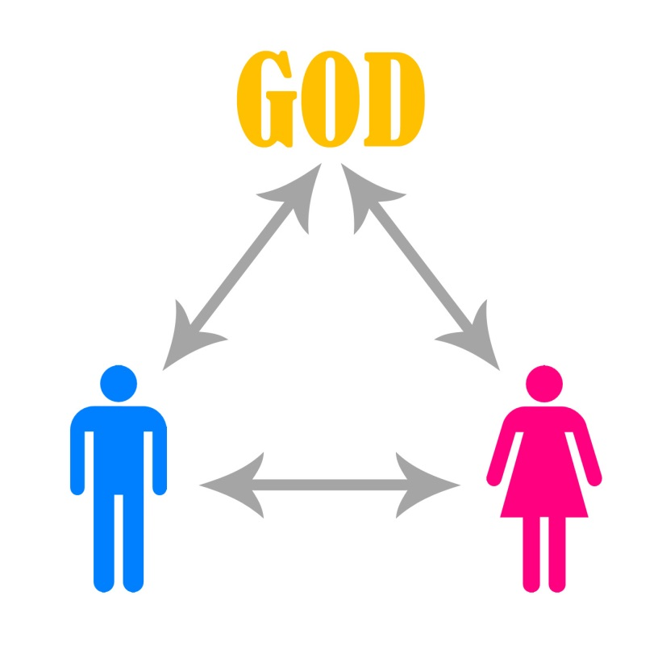

Slide 13
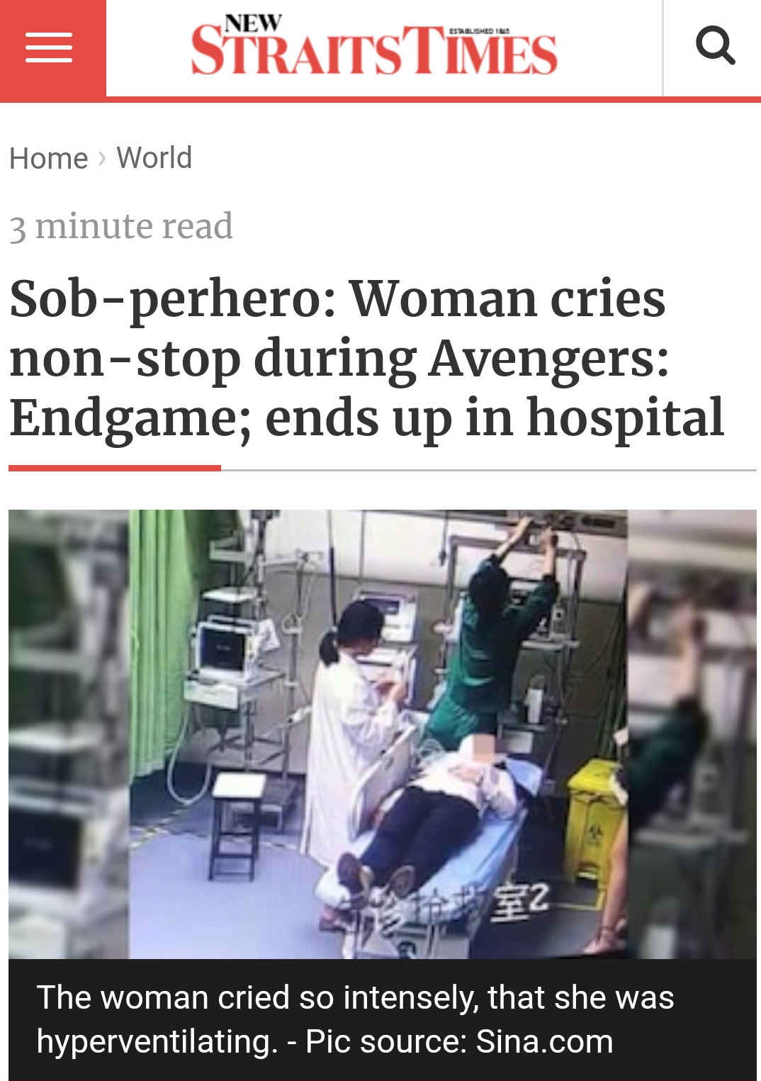
Marriage
Marriage is a Covenant, not a Transaction.
Marriage and Church membership.
Do not idolize marriage.

Slide 14
¹⁷ Nevertheless, each person should live as a believer in whatever situation the Lord has assigned to them, just as God has called them. This is the rule I lay down in all the churches. ¹⁸ Was a man already circumcised when he was called? He should not become uncircumcised. Was a man uncircumcised when he was called? He should not be circumcised. ¹⁹ Circumcision is nothing and uncircumcision is nothing. Keeping God’s commands is what counts. ²⁰ Each person should remain in the situation they were in when God called them.
²¹ Were you a slave when you were called? Don’t let it trouble you—although if you can gain your freedom, do so. ²² For the one who was a slave when called to faith in the Lord is the Lord’s freed person; similarly, the one who was free when called is Christ’s slave. ²³ You were bought at a price; do not become slaves of human beings. ²⁴ Brothers and sisters, each person, as responsible to God, should remain in the situation they were in when God called them.

Slide 15
²⁵ Now about virgins: I have no command from the Lord, but I give a judgment as one who by the Lord’s mercy is trustworthy. ²⁶ Because of the present crisis, I think that it is good for a man to remain as he is.²⁷ Are you pledged to a woman? Do not seek to be released. Are you free from such a commitment? Do not look for a wife. ²⁸ But if you do marry, you have not sinned; and if a virgin marries, she has not sinned. But those who marry will face many troubles in this life, and I want to spare you this.
²⁹ What I mean, brothers and sisters, is that the time is short. From now on those who have wives should live as if they do not; ³⁰ those who mourn, as if they did not; those who are happy, as if they were not; those who buy something, as if it were not theirs to keep; ³¹ those who use the things of the world, as if not engrossed in them. For this world in its present form is passing away.
³² I would like you to be free from concern. An unmarried man is concerned about the Lord’s affairs—how he can please the Lord. ³³ But a married man is concerned about the affairs of this world—how he can please his wife— ³⁴ and his interests are divided. An unmarried woman or virgin is concerned about the Lord’s affairs: Her aim is to be devoted to the Lord in both body and spirit. But a married woman is concerned about the affairs of this world—how she can please her husband. ³⁵ I am saying this for your own good, not to restrict you, but that you may live in a right way in undivided devotion to the Lord.

Slide 16
Marriage
Divorce

Slide 17
Marriage. Divorce.
Remarriage.
Biblically Divorced VS Un-Biblically Divorced.
CONSCIENCE

Slide 18
Tertullian (c.200)
No divorce and remarriage under any circumstances.
Origen of Alexandria (c.253)
Divorce and remarriage permitted as Christ rejected “the opinion that a wife was to be put away for every cause.” Considered this the “lesser of 2 evils”.
Council of Elvira (c.300)
No divorce and remarriage under any circumstances but remarriage not considered serious sin for victim. If wife dies before adulterous husband she would receive the sacrament of extreme unction.
Council of Aries (c.314)
More lenient then Council of Elvira as no excommunication imposed.
Jerome of Stridon (347-420)
No divorce and remarriage under any circumstances.
Augustine of Hippo (354-430)
No divorce and remarriage under any circumstances. Thomas Aquinas would follow suite to set the official framework for the Catholic Church’s official position on marriage and divorce.
Council of Trent (1563)
No divorce and remarriage under any circumstances.

Slide 19
Martin Luther (1483-1546)
Divorce and remarriage allowed for adultery, abandonment, hatred and continual conflict.
John Calvin (1509-1564)
Divorce and remarriage allowed for adultery, impotence, extreme religious incompatibility and abandonment (Ecclesiastical Ordinances adopted by Little and Large Councils of 1561)
William Tyndale (1494- 1536)
Divorce and remarriage allowed for adultery and abandonment.
Thomas Cranmer first Archbishop of Canterbury (1489-1556)
No divorce and remarriage under any circumstances.
Martin Bucer, Continental reformer (1491- 1551)
Divorce and remarriage allowed for adultery, insanity, leprosy and impotence.
John Knox (1513-1572)
Divorce and remarriage allowed as per Calvin’s view.
Westminster Confession (1647)
Divorce and remarriage allowed for adultery.
John Wesley (1703-1791)
Divorce and remarriage allowed for adultery.
John Murray (1961)
Divorce and remarriage allowed for adultery or when a partner deserts willfully and irremediably (“Divorce”-Prebysterian & Reformed Publishing)
William Heth and Gordon Wenham (1984)
All remarriages while the partners are living is wrong (“Jesus and Divorce”- Nashville: Thomas Nelson Publishing.)
Source: Trinity Journal 11.2

Slide 20
Divorce and Remarriage- summary of differing views
Remarriage under any circumstances of divorce is permitted by the church.
Remarriage is permitted even if the individual was unbiblically divorced, but on condition remorse and repentance was shown.
Remarriage is only permitted if there is evidence that the individual was biblically divorced.
Remarriage is not permitted under any circumstances even if the individual was biblically divorced, except when the other spouse has passed away.
Remarriage is permitted if the individual was biblically divorced AND the other spouse had either passed away or had remarried, essentially terminating any possibility of reconciliation.
Remarriage is permitted if the individual was biblically divorced AND after the church leadership is satisfied that all attempts at reconciliation has been exhausted. This is on a case by case basis, and does not require the other spouse to have passed away or have remarried.

Slide 21
Grounds for consideration for divorce and remarriage
Adultery.
Abandonment.
Physical Abuse leading to possible risk of life (including children and other family members).

Slide 22
Adultery
Matthew 19:3-11 (NIV)
³ Some Pharisees came to him to test him. They asked, “Is it lawful for a man to divorce his wife for any and every reason?”
⁴ “Haven’t you read,” he replied, “that at the beginning the Creator ‘made them male and female,’^{[a]} ⁵ and said, ‘For this reason a man will leave his father and mother and be united to his wife, and the two will become one flesh’^{[b]}? ⁶ So they are no longer two, but one flesh. Therefore what God has joined together, let no one separate.”
⁷ “Why then,” they asked, “did Moses command that a man give his wife a certificate of divorce and send her away?”
⁸ Jesus replied, “Moses permitted you to divorce your wives because your hearts were hard. But it was not this way from the beginning. ⁹ I tell you that anyone who divorces his wife, except for sexual immorality, and marries another woman commits adultery.”
¹⁰ The disciples said to him, “If this is the situation between a husband and wife, it is better not to marry.”

Slide 23
^{Abandonment}
¹⁰ To the married I give this command (not I, but the Lord): A wife must not separate from her husband. ¹¹ But if she does, she must remain unmarried or else be reconciled to her husband. And a husband must not divorce his wife.
¹² To the rest I say this (I, not the Lord): If any brother has a wife who is not a believer and she is willing to live with him, he must not divorce her. ¹³ And if a woman has a husband who is not a believer and he is willing to live with her, she must not divorce him. ¹⁴ For the unbelieving husband has been sanctified through his wife, and the unbelieving wife has been sanctified through her believing husband. Otherwise your children would be unclean, but as it is, they are holy.
¹⁵ But if the unbeliever leaves, let it be so. The brother or the sister is not bound in such circumstances; God has called us to live in peace.¹⁶ How do you know, wife, whether you will save your husband? Or, how do you know, husband, whether you will save your wife?

Slide 24
Physical abuse leading to possible threat of life.
There are no explicit verses in the bible allowing for remarriage for these reasons but major churches and bodies like Bethlehem Baptist Church in USA, St Matthias Anglican Church in Sydney and the National Conference Policy on Marriage and Divorce by the Australian Assemblies of God all consent to this. This can be classified as “situational ethics”, where the church leadership has to assess after attempts at providing counselling to the party carrying out the physical abuse that for the safety of the abused party and/or any children or any other family members involved that divorce is necessary.

Slide 25
2014 research

Slide 26
Remarriage after divorce is allowed under the following: -
Spouse has passed away, rendering the marriage covenant as over. (Rom 7:2-3, 1 Cor 7:39)
Remarriage by the aggrieving spouse as this effectively has severed the marriage. The party whose behaviour did not justify the divorce is now free to remarry a believer.
On grounds for biblical divorce- adultery, abandonment and extreme physical abuse. This however does not automatically mean the condonement of remarriage. Remarriage will be considered on a case by case basis after all attempts at reconciliation have failed. In line with the teachings of Jesus in Matt 5:31 and 19:6-8 special attention is to be given to protect women who are unable to fend for themselves financially by allowing them to remarry.

Slide 27
The role of the church when members are experiencing marriage breakdown leading to possible divorce.
Assessment to be carried out to verify authenticity of situation.
Counselling to be carried out by elders, pastors or deputized marriage counsellors.
Couple to be encouraged to confess any sins that led to current marriage crisis.
If there is confirmed sin that is affecting the marriage covenant and party refuses to confess, then in accordance with Matthew 18:17 discipline action is required to be taken to protect the aggrieved spouse.
It was must be stressed that the process of church discipline is often a very sensitive and difficult matter and needs to be treated with much care.

Slide 28
Divorce relating to non-members of FBC
Jesus teaches that the church has the keys to the kingdom of God and whatever they bind on earth they also bind in heaven. This is the context of Matthew 18:17 and 1 Corinthians 5 and why the assembly of believers are asked to be present when discipline is meted out. But this does not cover non-believers or even those that do not belong to the local assembly (i.e. members of the local church). As such church membership precedes any action taken by the church leadership to assist in issues relating to marriage, divorce and remarriage.

Slide 29
Learning to show empathy to those undergoing marriage and family issues
Automatic Talking-Cocktail Conversation
Discounted conversation
Universalization.
Spiritualization.
Counter-disclosure.
Counter-feedback.
Moralizing.
Solution/Advice –giving
III. Paraphrasing

