Slide 1
Running the Race of Faith
Hebrews 12: 1-3

Slide 2
Beloved, I pray that all may go well with you
and that you may be in good health,
as it goes well with your soul.
(even as thy soul prospereth)
3 John (1):2

Slide 3
…., putting aside every weight and the sin that so easily ensnares us,
let us run with patient endurance the race that has been set before us,
fixing our eyes on Jesus, …
from Hebrews 12:1,2

Slide 5
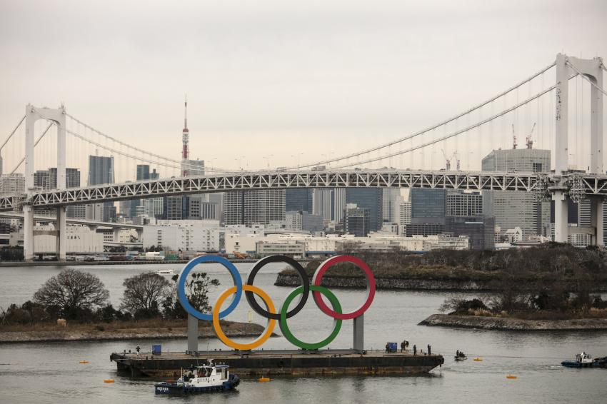

Slide 6
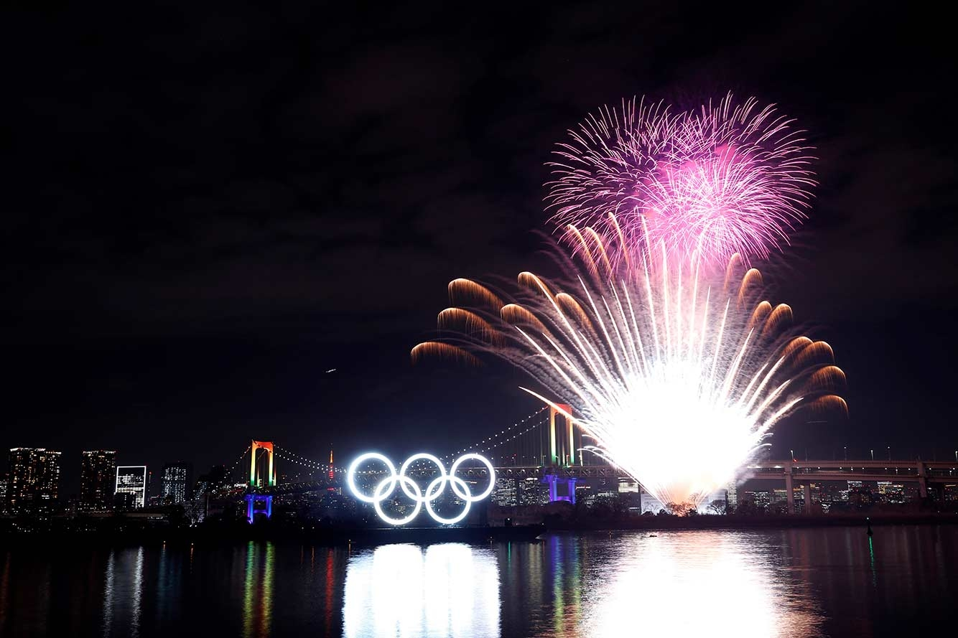

Slide 7
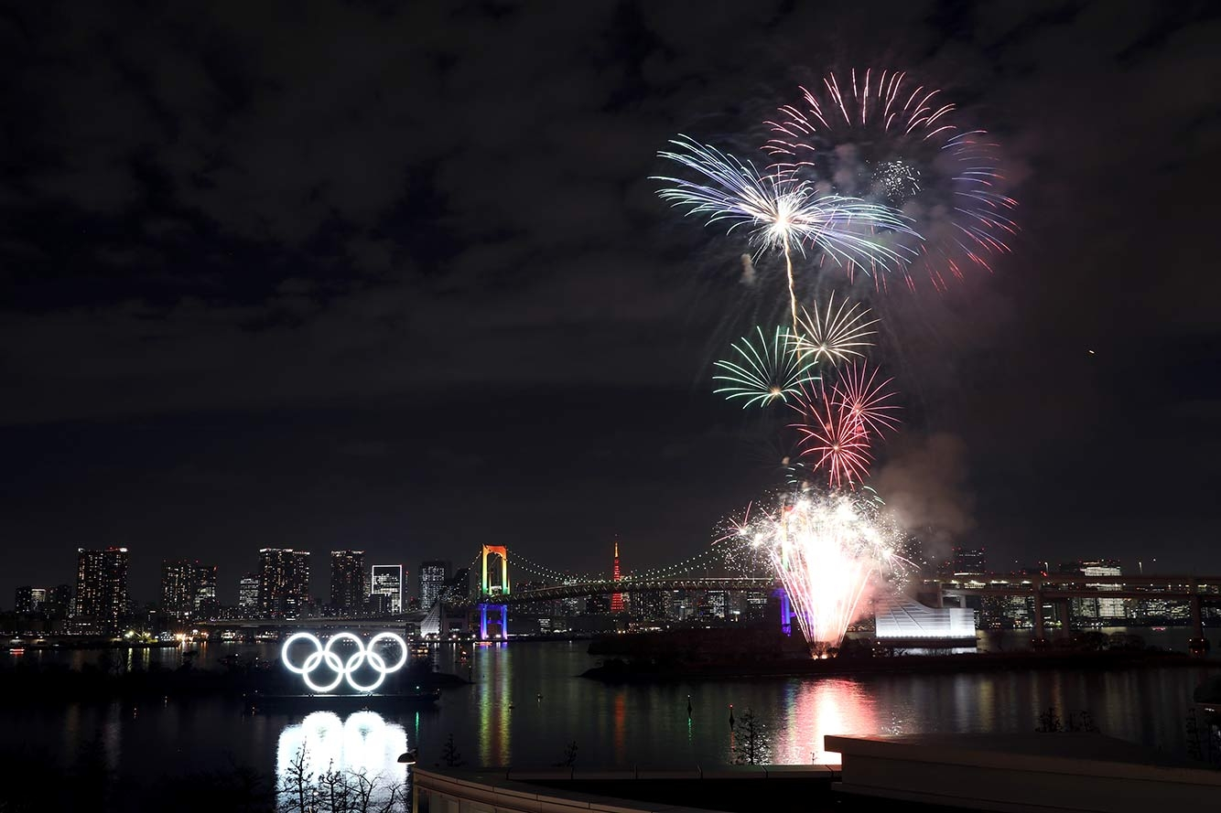

Slide 8
Hebrews 12:1 Therefore, since we also have such a great cloud of witnesses surrounding us, putting aside every weight and the sin that so easily ensnares us, let us run with patient endurance the race that has been set before us,
2 fixing our eyes on Jesus, the originator and perfecter of faith, who for the joy that was set before him endured the cross, disregarding the shame, and has sat down at the right hand of the throne of God.

Slide 9
Running the Race of Faith
1. Qualification for running in the race
2. The Motivation for running
3. The Preparation for the race
4. Running the Race
5. The Inspiration for running

Slide 10
Running the Race of Faith
1. Qualification for running in the race

Slide 11
Running the Race of Faith
1. Qualification for running in the race
Hebrews 11:1 Faith makes us sure of what we hope for and gives us proof of what we cannot see.
2 It was their faith that made our ancestors pleasing to God.
3 Because of our faith, we know …

Slide 12
Running the Race of Faith
1. Qualification: What Jesus has done; FAITH
So run that you may obtain the prize.
1 Corinthians 9:24

Slide 13
Running the Race of Faith
1. Qualification: What Jesus has done; FAITH
2. The Motivation for running
Heb 12:1 Therefore, since we are surrounded by so great a cloud of witnesses, let us also lay aside every weight, and sin which clings so closely, and let us run with endurance the race that is set before us
11:39 These were all commended for their faith ...

Slide 14
Heb 11:33 who through faith conquered kingdoms, … stopped the mouths of lions, 34 quenched the power of fire, escaped the edge of the sword, were made strong out of weakness, became mighty in war, put foreign armies to flight.
36 Others suffered mocking and flogging, and even chains and imprisonment. 37 They were stoned, they were sawn in two, they were killed with the sword.

Slide 15
Heb 11:33 who through faith conquered kingdoms, … stopped the mouths of lions, 34 quenched the power of fire, escaped the edge of the sword, were made strong out of weakness, became mighty in war, put foreign armies to flight.
36 Others suffered mocking and flogging, and even chains and imprisonment. 37 They were stoned, they were sawn in two, they were killed with the sword.
11:39 These were all commended for their faith ...

Slide 16
11:39 These were all commended for their faith,
yet none of them received what had been promised

Slide 17
Running the Race of Faith
1. Qualification: What Jesus has done; FAITH
2. The Motivation for running
Heb 12:1 Therefore, since we are surrounded by so great a cloud of witnesses, let us also lay aside every weight, and sin which clings so closely, and let us run with endurance the race that is set before us

Slide 18
We're pilgrims on the journey
Of the narrow road,
And those who've gone before us
Line the way.
Cheering on the faithful,
Encouraging the weary,
Their lives a stirring testament
To God's sustaining grace.

Slide 19
O may all who come behind us
Find us faithful,
May the fire of our devotion
Light their way.
May the footprints that we leave,
Lead them to believe,
And the lives we live
Inspire them to obey.
O may all who come behind us
Find us faithful.

Slide 20
Surrounded by so great
A cloud of witnesses,
Let us run the race
Not only for the prize,
But as those who've gone before us.
Let us leave to those behind us,
The heritage of faithfulness
Passed on thru godly lives.

Slide 21
O may all who come behind us
Find us faithful,
May the fire of our devotion
Light their way.
May the footprints that we leave,
Lead them to believe,
And the lives we live
Inspire them to obey.
O may all who come behind us
Find us faithful.

Slide 22
Running the Race of Faith
1. Qualification: What Jesus has done; FAITH
2. The Motivation: the lives of faithful people
3. The Preparation for running the race
12:1 Therefore, since we are surrounded by such a great cloud of witnesses, let us throw off everything that hinders and the sin that so easily entangles. And let us run with perseverance the race marked out for us,

Slide 23
Mark 4:18 And others are the ones sown among thorns. They are those who hear the word,
19 but the cares of the world and the deceitfulness of riches and the desires for other things enter in and choke the word, and it proves unfruitful.

Slide 24
Running the Race of Faith
1. Qualification: What Jesus has done; FAITH
2. The Motivation: the lives of faithful people
3. The Preparation for running the race
12:1 Therefore, since we are surrounded by such a great cloud of witnesses, let us throw off everything that hinders and the sin that so easily entangles.
let us also lay aside every weight, and sin which clings so closely,

Slide 25
Running the Race of Faith
1. Qualification: What Jesus has done; FAITH
2. The Motivation: the lives of faithful people
3. The Preparation: put aside hindrances / sin
4. Running the Race
12:1 Therefore, since we are surrounded by such a great cloud of witnesses, let us throw off everything that hinders and the sin that so easily entangles. And let us run with perseverance the race marked out for us

Slide 26
12: 5 And have you completely forgotten this word of encouragement that addresses you as a father addresses his son? It says, “My son, do not make light of the Lord’s discipline, and do not lose heart when he rebukes you,
6 because the Lord disciplines the one he loves, and he chastens everyone he accepts as his son.”
7 Endure hardship as discipline; God is treating you as his children.

Slide 27
Running the Race of Faith
1. Qualification: What Jesus has done; FAITH
2. The Motivation: the lives of faithful people
3. The Preparation: put aside hindrances / sin
4. Running the Race
12:1 Therefore, since we are surrounded by such a great cloud of witnesses, let us throw off everything that hinders and the sin that so easily entangles. And let us run with perseverance the race marked out for us

Slide 28
Not by might, not by power
But by the Spirit of God
Yes, I will run the race
'Till I see Your face

Slide 29
Running the Race of Faith
1. Qualification: What Jesus has done; FAITH
2. The Motivation: the lives of faithful people
3. The Preparation: put aside hindrances / sin
4. Run the Race: with patient endurance
5. The Inspiration for running
12:2 fixing our eyes on Jesus, the pioneer and perfecter of faith. For the joy set before him he endured the cross, scorning its shame, and sat down at the right hand of the throne of God.

Slide 30
Running the Race of Faith
1. Qualification: What Jesus has done; FAITH
2. The Motivation: the lives of faithful people
3. The Preparation: put aside hindrances / sin
4. Run the Race: with patient endurance
5. The Inspiration: JESUS

Slide 31
2 Timothy 4:7 I have fought the good fight, I have finished the race, I have kept the faith.
8 Henceforth there is laid up for me the crown of righteousness, which the Lord, the righteous judge, will award to me on that day, and not only to me but also to all who have loved his appearing.

Slide 32
a d

