Slide 1
Nehemiah 5 (NIV)
¹ Now the men and their wives raised a great outcry against their fellow Jews.
² Some were saying, “We and our sons and daughters are numerous;
in order for us to eat and stay alive, we must get grain.”
³ Others were saying, “We are mortgaging our fields,
our vineyards and our homes to get grain during the famine.”
⁴ Still others were saying,
“We have had to borrow money to pay the king’s tax on our fields and vineyards.
⁵ Although we are of the same flesh and blood as our fellow Jews
and though our children are as good as theirs, yet we have to subject our sons
and daughters to slavery. Some of our daughters have already been enslaved,
but we are powerless, because our fields and our vineyards belong to others.”
⁶ When I heard their outcry and these charges, I was very angry.
⁷ I pondered them in my mind and then accused the nobles and officials.
I told them, “You are charging your own people interest!”
So I called together a large meeting to deal with them
⁸ and said: “As far as possible, we have bought back our fellow Jews
who were sold to the Gentiles. Now you are selling your own people,
only for them to be sold back to us!”
They kept quiet, because they could find nothing to say.

Slide 2
Nehemiah 5 (NIV)
⁹ So I continued, “What you are doing is not right.
Shouldn’t you walk in the fear of our God to avoid the reproach of our Gentile enemies?
¹⁰ I and my brothers and my men are also lending the people money and grain.
But let us stop charging interest!
¹¹ Give back to them immediately their fields, vineyards, olive groves and houses,
and also the interest you are charging them—
one percent of the money, grain, new wine and olive oil.”
¹² “We will give it back,” they said. “And we will not demand anything more from them.
We will do as you say.” Then I summoned the priests
and made the nobles and officials take an oath to do what they had promised.
¹³ I also shook out the folds of my robe and said,
“In this way may God shake out of their house and possessions anyone
who does not keep this promise. So may such a person be shaken out and emptied!”
At this the whole assembly said, “Amen,” and praised the Lord.
And the people did as they had promised.
¹⁴ Moreover, from the twentieth year of King Artaxerxes,
when I was appointed to be their governor in the land of Judah,
until his thirty-second year—twelve years—
neither I nor my brothers ate the food allotted to the governor.

Slide 3
Nehemiah 5 (NIV)
¹⁵ But the earlier governors—those preceding me—
placed a heavy burden on the people and took forty shekels of silver from them
in addition to food and wine. Their assistants also lorded it over the people.
But out of reverence for God I did not act like that.
¹⁶ Instead, I devoted myself to the work on this wall.
All my men were assembled there for the work; we did not acquire any land.
¹⁷ Furthermore, a hundred and fifty Jews and officials ate at my table,
as well as those who came to us from the surrounding nations.
¹⁸ Each day one ox, six choice sheep and some poultry were prepared for me,
and every ten days an abundant supply of wine of all kinds.
In spite of all this, I never demanded the food allotted to the governor,
because the demands were heavy on these people.
¹⁹ Remember me with favor, my God, for all I have done for these people.

Slide 4
Nehemiah 6 (NIV)
¹ When word came to Sanballat, Tobiah, Geshem the Arab and the rest of our enemies
that I had rebuilt the wall and not a gap was left in it—
though up to that time I had not set the doors in the gates—
² Sanballat and Geshem sent me this message:
“Come, let us meet together in one of the villages on the plain of Ono.”
But they were scheming to harm me;
³ so I sent messengers to them with this reply:
“I am carrying on a great project and cannot go down.
Why should the work stop while I leave it and go down to you?”
⁴ Four times they sent me the same message,
and each time I gave them the same answer.
⁵ Then, the fifth time, Sanballat sent his aide to me with the same message,
and in his hand was an unsealed letter
⁶ in which was written:
“It is reported among the nations—and Geshem says it is true—
that you and the Jews are plotting to revolt, and therefore you are building the wall.
Moreover, according to these reports you are about to become their king
⁷ and have even appointed prophets to make this proclamation about you in Jerusalem:
‘There is a king in Judah!’ Now this report will get back to the king; so come,
let us meet together.”

Slide 5
Nehemiah 6 (NIV)
⁸ I sent him this reply: “Nothing like what you are saying is happening;
you are just making it up out of your head.”
⁹ They were all trying to frighten us, thinking,
“Their hands will get too weak for the work, and it will not be completed.”
But I prayed, “Now strengthen my hands.”
¹⁰ One day I went to the house of Shemaiah son of Delaiah, the son of Mehetabel,
who was shut in at his home. He said, “Let us meet in the house of God,
inside the temple, and let us close the temple doors,
because men are coming to kill you—by night they are coming to kill you.”
¹¹ But I said, “Should a man like me run away?
Or should someone like me go into the temple to save his life? I will not go!”
¹² I realized that God had not sent him, but that he had prophesied against me
because Tobiah and Sanballat had hired him.
¹³ He had been hired to intimidate me so that I would commit a sin by doing this,
and then they would give me a bad name to discredit me.
¹⁴ Remember Tobiah and Sanballat, my God, because of what they have done;
remember also the prophet Noadiah
and how she and the rest of the prophets have been trying to intimidate me.
¹⁵ So the wall was completed on the twenty-fifth of Elul, in fifty-two days.

Slide 6
Nehemiah 6 (NIV)
¹⁶ When all our enemies heard about this,
all the surrounding nations were afraid and lost their self-confidence,
because they realized that this work had been done with the help of our God.
¹⁷ Also, in those days the nobles of Judah were sending many letters to Tobiah,
and replies from Tobiah kept coming to them.
¹⁸ For many in Judah were under oath to him,
since he was son-in-law to Shekaniah son of Arah,
and his son Jehohanan had married the daughter of Meshullam son of Berekiah.
¹⁹ Moreover, they kept reporting to me his good deeds and then telling him what I said.
And Tobiah sent letters to intimidate me.

Slide 7
Fearing GOD in a
Fallen World
Nehemiah 5~6

Slide 8
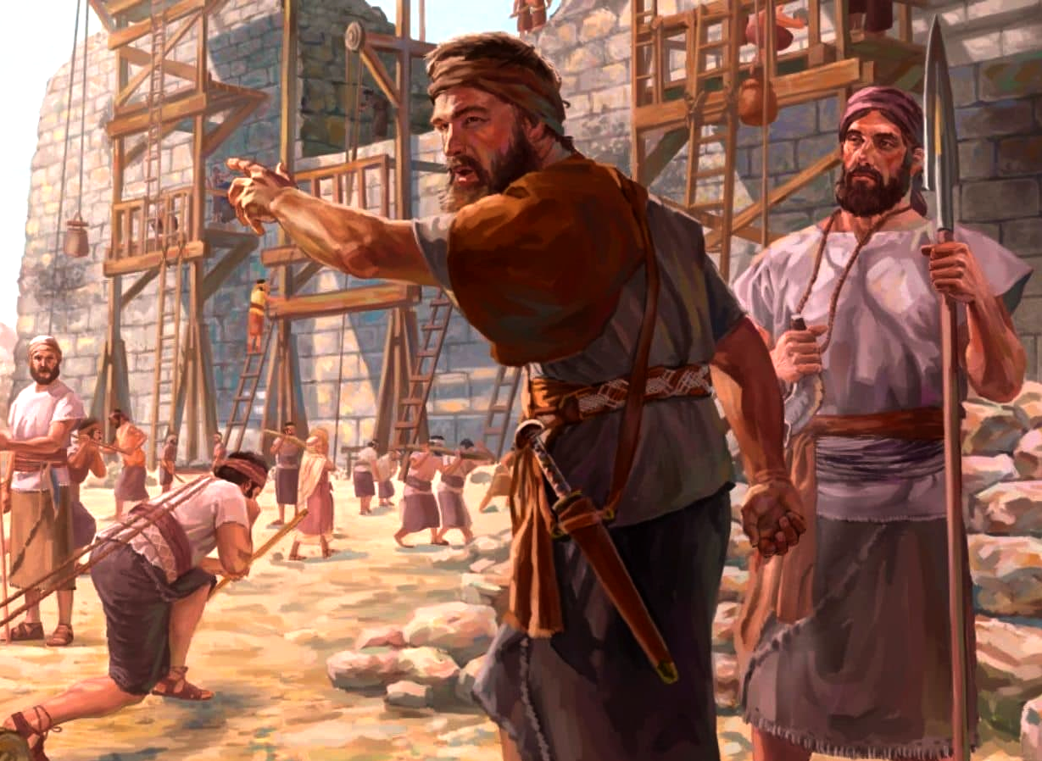

Slide 9
Nehemiah 6 (NIV)
⁸ I sent him this reply: “Nothing like what you are saying is happening;
you are just making it up out of your head.”
⁹ They were all trying to frighten us, thinking,
“Their hands will get too weak for the work, and it will not be completed.”
But I prayed, “Now strengthen my hands.”
¹⁰ One day I went to the house of Shemaiah son of Delaiah, the son of Mehetabel,
who was shut in at his home. He said, “Let us meet in the house of God,
inside the temple, and let us close the temple doors,
because men are coming to kill you—by night they are coming to kill you.”
¹¹ But I said, “Should a man like me run away?
Or should someone like me go into the temple to save his life? I will not go!”
¹² I realized that God had not sent him, but that he had prophesied against me
because Tobiah and Sanballat had hired him.
¹³ He had been hired to intimidate me so that I would commit a sin by doing this,
and then they would give me a bad name to discredit me.
¹⁴ Remember Tobiah and Sanballat, my God, because of what they have done;
remember also the prophet Noadiah
and how she and the rest of the prophets have been trying to intimidate me.
¹⁵ So the wall was completed on the twenty-fifth of Elul, in fifty-two days.

Slide 10
Nehemiah 5 (NIV)
¹ Now the men and their wives raised a great outcry against their fellow Jews.
² Some were saying, “We and our sons and daughters are numerous;
in order for us to eat and stay alive, we must get grain.”
³ Others were saying, “We are mortgaging our fields,
our vineyards and our homes to get grain during the famine.”
⁴ Still others were saying,
“We have had to borrow money to pay the king’s tax on our fields and vineyards.
⁵ Although we are of the same flesh and blood as our fellow Jews
and though our children are as good as theirs, yet we have to subject our sons
and daughters to slavery. Some of our daughters have already been enslaved,
but we are powerless, because our fields and our vineyards belong to others.”
⁶ When I heard their outcry and these charges, I was very angry.
⁷ I pondered them in my mind and then accused the nobles and officials.
I told them, “You are charging your own people interest!”
So I called together a large meeting to deal with them
⁸ and said: “As far as possible, we have bought back our fellow Jews
who were sold to the Gentiles. Now you are selling your own people,
only for them to be sold back to us!”
They kept quiet, because they could find nothing to say.

Slide 11
Nehemiah 5 (NIV)
¹ Now the men and their wives raised a great outcry against their fellow Jews.
² Some were saying, “We and our sons and daughters are numerous;
in order for us to eat and stay alive, we must get grain.”
³ Others were saying, “We are mortgaging our fields,
our vineyards and our homes to get grain during the famine.”
⁴ Still others were saying,
“We have had to borrow money to pay the king’s tax on our fields and vineyards.
⁵ Although we are of the same flesh and blood as our fellow Jews
and though our children are as good as theirs, yet we have to subject our sons
and daughters to slavery. Some of our daughters have already been enslaved,
but we are powerless, because our fields and our vineyards belong to others.”
⁶ When I heard their outcry and these charges, I was very angry.
⁷ I pondered them in my mind and then accused the nobles and officials.
I told them, “You are charging your own people interest!”
So I called together a large meeting to deal with them
⁸ and said: “As far as possible, we have bought back our fellow Jews
who were sold to the Gentiles. Now you are selling your own people,
only for them to be sold back to us!”
They kept quiet, because they could find nothing to say.

Slide 12
Deuteronomy 15:7
If anyone is poor among your fellow Israelites
in any of the towns of the land the Lord your God is giving you,
do not be hardhearted or tightfisted toward them.

Slide 13
Nehemiah 5 (NIV)
⁹ So I continued, “What you are doing is not right.
Shouldn’t you walk in the fear of our God to avoid the reproach of our Gentile enemies?
¹⁰ I and my brothers and my men are also lending the people money and grain.
But let us stop charging interest!
¹¹ Give back to them immediately their fields, vineyards, olive groves and houses,
and also the interest you are charging them—
one percent of the money, grain, new wine and olive oil.”
¹² “We will give it back,” they said. “And we will not demand anything more from them.
We will do as you say.” Then I summoned the priests
and made the nobles and officials take an oath to do what they had promised.
¹³ I also shook out the folds of my robe and said,
“In this way may God shake out of their house and possessions anyone
who does not keep this promise. So may such a person be shaken out and emptied!”
At this the whole assembly said, “Amen,” and praised the Lord.
And the people did as they had promised.
¹⁴ Moreover, from the twentieth year of King Artaxerxes,
when I was appointed to be their governor in the land of Judah,
until his thirty-second year—twelve years—
neither I nor my brothers ate the food allotted to the governor.

Slide 14
Nehemiah 5 (NIV)
¹ Now the men and their wives raised a great outcry against their fellow Jews.
² Some were saying, “We and our sons and daughters are numerous;
in order for us to eat and stay alive, we must get grain.”
³ Others were saying, “We are mortgaging our fields,
our vineyards and our homes to get grain during the famine.”
⁴ Still others were saying,
“We have had to borrow money to pay the king’s tax on our fields and vineyards.
⁵ Although we are of the same flesh and blood as our fellow Jews
and though our children are as good as theirs, yet we have to subject our sons
and daughters to slavery. Some of our daughters have already been enslaved,
but we are powerless, because our fields and our vineyards belong to others.”
⁶ When I heard their outcry and these charges, I was very angry.
⁷ I pondered them in my mind and then accused the nobles and officials.
I told them, “You are charging your own people interest!”
So I called together a large meeting to deal with them
⁸ and said: “As far as possible, we have bought back our fellow Jews
who were sold to the Gentiles. Now you are selling your own people,
only for them to be sold back to us!”
They kept quiet, because they could find nothing to say.

Slide 15
Exodus 22:25
If you lend money to one of My people among you who is needy,
do not treat it like a business deal; charge no interest.

Slide 16
Deuteronomy 23:19
Do not charge a fellow Israelite interest,
whether on money or food or anything else that may earn interest.

Slide 17
Nehemiah 5 (NIV)
⁹ So I continued, “What you are doing is not right.
Shouldn’t you walk in the fear of our God to avoid the reproach of our Gentile enemies?
¹⁰ I and my brothers and my men are also lending the people money and grain.
But let us stop charging interest!
¹¹ Give back to them immediately their fields, vineyards, olive groves and houses,
and also the interest you are charging them—
one percent of the money, grain, new wine and olive oil.”
¹² “We will give it back,” they said. “And we will not demand anything more from them.
We will do as you say.” Then I summoned the priests
and made the nobles and officials take an oath to do what they had promised.
¹³ I also shook out the folds of my robe and said,
“In this way may God shake out of their house and possessions anyone
who does not keep this promise. So may such a person be shaken out and emptied!”
At this the whole assembly said, “Amen,” and praised the Lord.
And the people did as they had promised.
¹⁴ Moreover, from the twentieth year of King Artaxerxes,
when I was appointed to be their governor in the land of Judah,
until his thirty-second year—twelve years—
neither I nor my brothers ate the food allotted to the governor.

Slide 18
Deuteronomy 8:18
But remember the Lord your God,
for it is He who gives you the ability to produce wealth,…

Slide 19
For the love of money is a root of all kinds of evil. Some people, eager for money, have wandered from the faith and pierced themselves with many griefs
1 Timothy 6:10 (NIV)

Slide 20
Proverbs 19:17
Whoever is kind to the poor lends to the Lord, and He will reward them for what they have done.

Slide 21
Psalm 15:1,5
Lord, who may dwell in Your sacred tent? Who may live on Your holy mountain?
… (The one) who lends money to the poor without interest;

Slide 22
Nehemiah 5 (NIV)
¹ Now the men and their wives raised a great outcry against their fellow Jews.
² Some were saying, “We and our sons and daughters are numerous;
in order for us to eat and stay alive, we must get grain.”
³ Others were saying, “We are mortgaging our fields,
our vineyards and our homes to get grain during the famine.”
⁴ Still others were saying,
“We have had to borrow money to pay the king’s tax on our fields and vineyards.
⁵ Although we are of the same flesh and blood as our fellow Jews
and though our children are as good as theirs, yet we have to subject our sons
and daughters to slavery. Some of our daughters have already been enslaved,
but we are powerless, because our fields and our vineyards belong to others.”
⁶ When I heard their outcry and these charges, I was very angry.
⁷ I pondered them in my mind and then accused the nobles and officials.
I told them, “You are charging your own people interest!”
So I called together a large meeting to deal with them
⁸ and said: “As far as possible, we have bought back our fellow Jews
who were sold to the Gentiles. Now you are selling your own people,
only for them to be sold back to us!”
They kept quiet, because they could find nothing to say.

Slide 23
Nehemiah 5 (NIV)
⁹ So I continued, “What you are doing is not right.
Shouldn’t you walk in the fear of our God to avoid the reproach of our Gentile enemies?
¹⁰ I and my brothers and my men are also lending the people money and grain.
But let us stop charging interest!
¹¹ Give back to them immediately their fields, vineyards, olive groves and houses,
and also the interest you are charging them—
one percent of the money, grain, new wine and olive oil.”
¹² “We will give it back,” they said. “And we will not demand anything more from them.
We will do as you say.” Then I summoned the priests
and made the nobles and officials take an oath to do what they had promised.
¹³ I also shook out the folds of my robe and said,
“In this way may God shake out of their house and possessions anyone
who does not keep this promise. So may such a person be shaken out and emptied!”
At this the whole assembly said, “Amen,” and praised the Lord.
And the people did as they had promised.
¹⁴ Moreover, from the twentieth year of King Artaxerxes,
when I was appointed to be their governor in the land of Judah,
until his thirty-second year—twelve years—
neither I nor my brothers ate the food allotted to the governor.

Slide 24
Nehemiah 5 (NIV)
⁹ So I continued, “What you are doing is not right.
Shouldn’t you walk in the fear of our God to avoid the reproach of our Gentile enemies?
¹⁰ I and my brothers and my men are also lending the people money and grain.
But let us stop charging interest!
¹¹ Give back to them immediately their fields, vineyards, olive groves and houses,
and also the interest you are charging them—
one percent of the money, grain, new wine and olive oil.”
¹² “We will give it back,” they said. “And we will not demand anything more from them.
We will do as you say.” Then I summoned the priests
and made the nobles and officials take an oath to do what they had promised.
¹³ I also shook out the folds of my robe and said,
“In this way may God shake out of their house and possessions anyone
who does not keep this promise. So may such a person be shaken out and emptied!”
At this the whole assembly said, “Amen,” and praised the Lord.
And the people did as they had promised.
¹⁴ Moreover, from the twentieth year of King Artaxerxes,
when I was appointed to be their governor in the land of Judah,
until his thirty-second year—twelve years—
neither I nor my brothers ate the food allotted to the governor.

Slide 25
Nehemiah 5 (NIV)
¹⁵ But the earlier governors—those preceding me—
placed a heavy burden on the people and took forty shekels of silver from them
in addition to food and wine. Their assistants also lorded it over the people.
But out of reverence for God I did not act like that.
¹⁶ Instead, I devoted myself to the work on this wall.
All my men were assembled there for the work; we did not acquire any land.
¹⁷ Furthermore, a hundred and fifty Jews and officials ate at my table,
as well as those who came to us from the surrounding nations.
¹⁸ Each day one ox, six choice sheep and some poultry were prepared for me,
and every ten days an abundant supply of wine of all kinds.
In spite of all this, I never demanded the food allotted to the governor,
because the demands were heavy on these people.
¹⁹ Remember me with favor, my God, for all I have done for these people.

Slide 26
Structure of Nehemiah 5
1. Evil verses 1~5
2. Exposure verses 6~11
3. Expiation verses 12~13
4. Example verses 14~18

Slide 27
Nehemiah 6 (NIV)
¹ When word came to Sanballat, Tobiah, Geshem the Arab and the rest of our enemies
that I had rebuilt the wall and not a gap was left in it—
though up to that time I had not set the doors in the gates—
² Sanballat and Geshem sent me this message:
“Come, let us meet together in one of the villages on the plain of Ono.”
But they were scheming to harm me;
³ so I sent messengers to them with this reply:
“I am carrying on a great project and cannot go down.
Why should the work stop while I leave it and go down to you?”
⁴ Four times they sent me the same message,
and each time I gave them the same answer.
⁵ Then, the fifth time, Sanballat sent his aide to me with the same message,
and in his hand was an unsealed letter
⁶ in which was written:
“It is reported among the nations—and Geshem says it is true—
that you and the Jews are plotting to revolt, and therefore you are building the wall.
Moreover, according to these reports you are about to become their king
⁷ and have even appointed prophets to make this proclamation about you in Jerusalem:
‘There is a king in Judah!’ Now this report will get back to the king; so come,
let us meet together.”

Slide 28
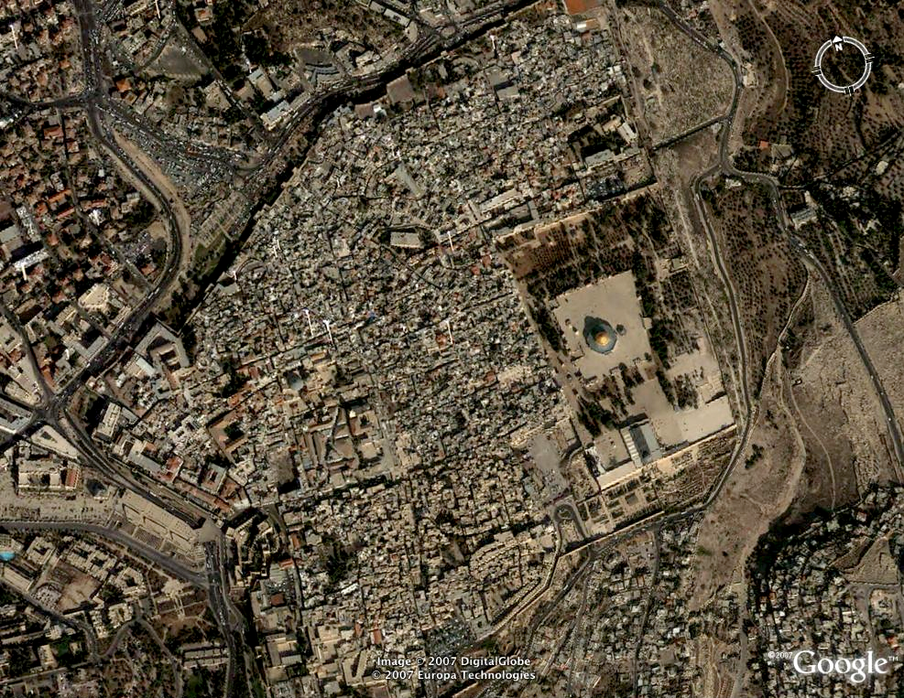
Old City

Slide 29
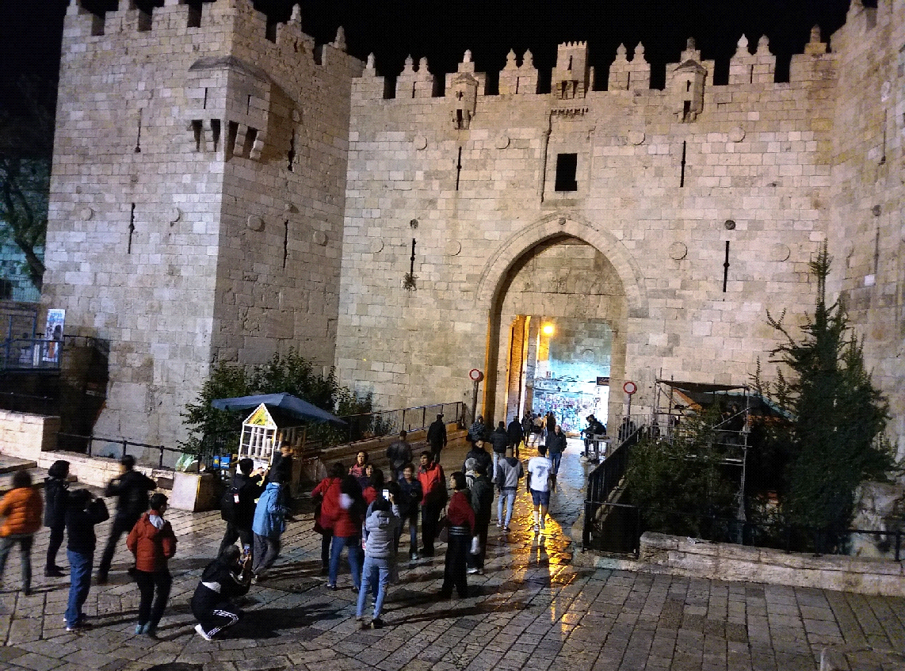
Damascus Gate

Slide 30
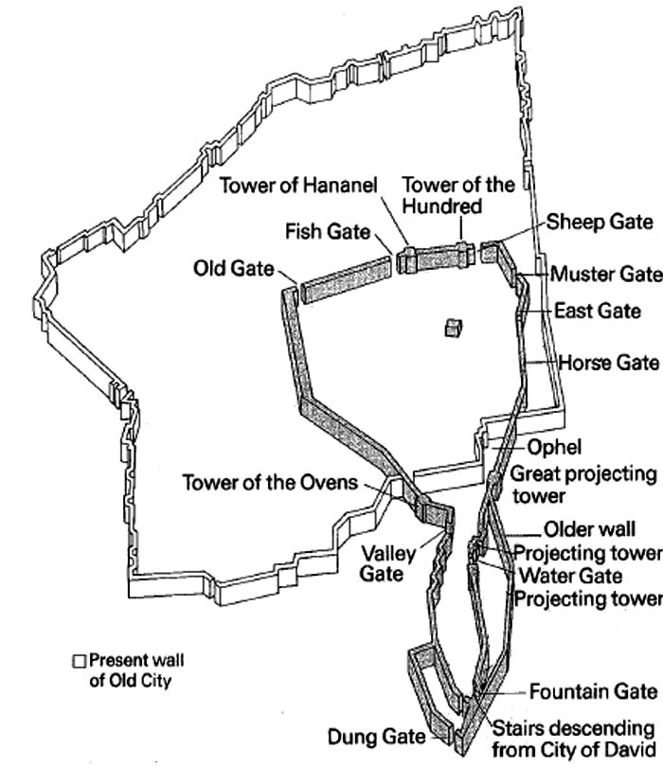
Damascus Gate
Temple
Nehemiah’s Wall
versus
Present Wall
in Jerusalem

Slide 31
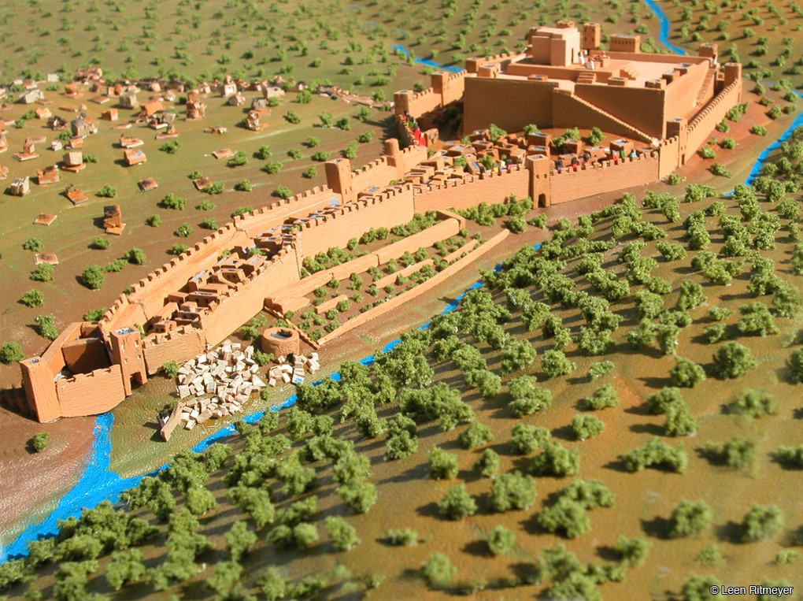

Slide 32
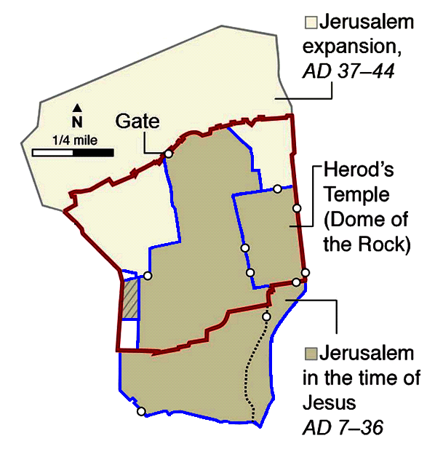
Jerusalem’s Wall in Jesus’ time
versus Present Wall
Present wall
WESTERN WALL
Wall in Jesus’ time

Slide 33
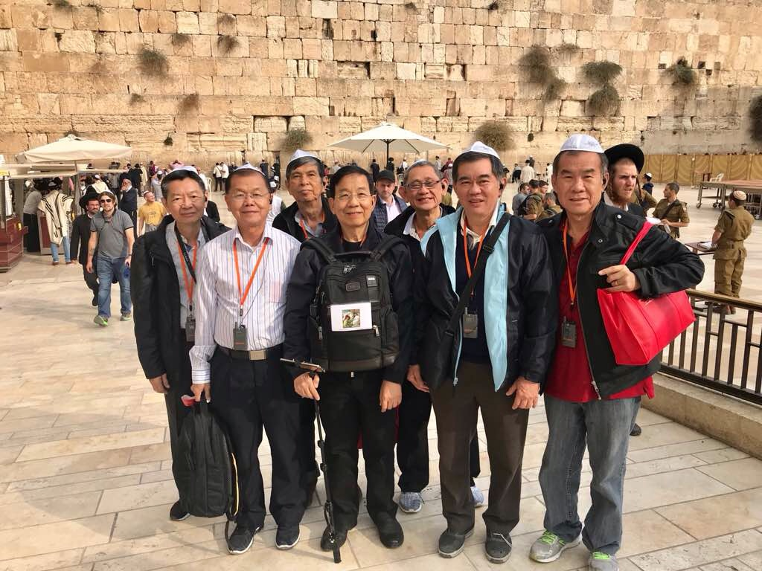
Western Wall

Slide 34
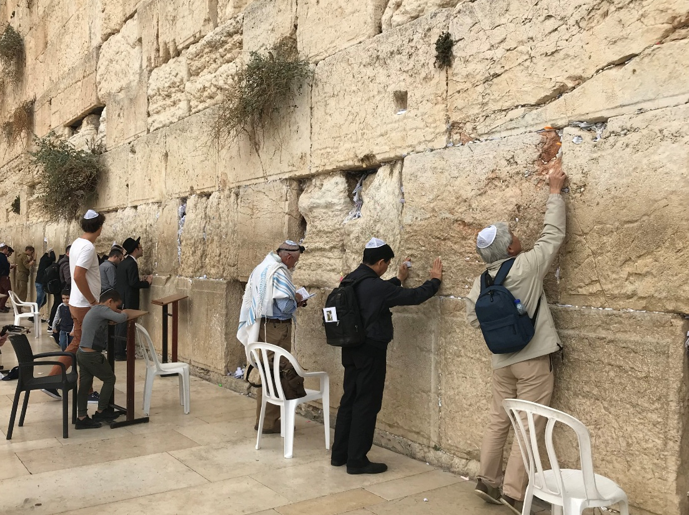

Slide 36
Nehemiah 6 (NIV)
¹ When word came to Sanballat, Tobiah, Geshem the Arab and the rest of our enemies
that I had rebuilt the wall and not a gap was left in it—
though up to that time I had not set the doors in the gates—
² Sanballat and Geshem sent me this message:
“Come, let us meet together in one of the villages on the plain of Ono.”
But they were scheming to harm me;
³ so I sent messengers to them with this reply:
“I am carrying on a great project and cannot go down.
Why should the work stop while I leave it and go down to you?”
⁴ Four times they sent me the same message,
and each time I gave them the same answer.
⁵ Then, the fifth time, Sanballat sent his aide to me with the same message,
and in his hand was an unsealed letter
⁶ in which was written:
“It is reported among the nations—and Geshem says it is true—
that you and the Jews are plotting to revolt, and therefore you are building the wall.
Moreover, according to these reports you are about to become their king
⁷ and have even appointed prophets to make this proclamation about you in Jerusalem:
‘There is a king in Judah!’ Now this report will get back to the king; so come,
let us meet together.”

Slide 37
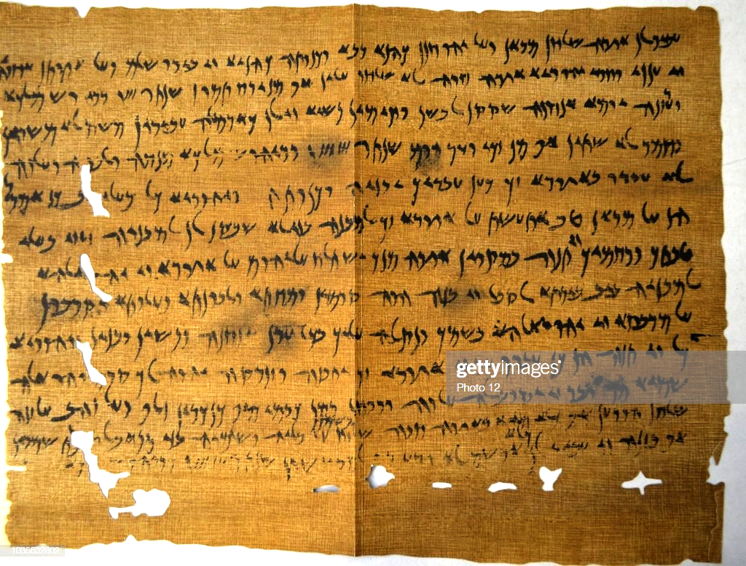
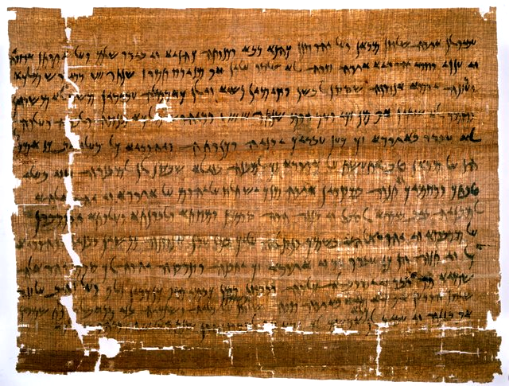
Dated 407BC, discovered in 1907

Slide 38
Structure of Nehemiah 6
1. Invitation verses 1~4
2. Incrimination verses 5~9
3. Intimidation verses 10~15
4. Infiltration verses 16~19

Slide 39
Nehemiah 6 (NIV)
¹ When word came to Sanballat, Tobiah, Geshem the Arab and the rest of our enemies
that I had rebuilt the wall and not a gap was left in it—
though up to that time I had not set the doors in the gates—
² Sanballat and Geshem sent me this message:
“Come, let us meet together in one of the villages on the plain of Ono.”
But they were scheming to harm me;
³ so I sent messengers to them with this reply:
“I am carrying on a great project and cannot go down.
Why should the work stop while I leave it and go down to you?”
⁴ Four times they sent me the same message,
and each time I gave them the same answer.
⁵ Then, the fifth time, Sanballat sent his aide to me with the same message,
and in his hand was an unsealed letter
⁶ in which was written:
“It is reported among the nations—and Geshem says it is true—
that you and the Jews are plotting to revolt, and therefore you are building the wall.
Moreover, according to these reports you are about to become their king
⁷ and have even appointed prophets to make this proclamation about you in Jerusalem:
‘There is a king in Judah!’ Now this report will get back to the king; so come,
let us meet together.”

Slide 40
Nehemiah 6 (NIV)
¹ When word came to Sanballat, Tobiah, Geshem the Arab and the rest of our enemies
that I had rebuilt the wall and not a gap was left in it—
though up to that time I had not set the doors in the gates—
² Sanballat and Geshem sent me this message:
“Come, let us meet together in one of the villages on the plain of Ono.”
But they were scheming to harm me;
³ so I sent messengers to them with this reply:
“I am carrying on a great project and cannot go down.
Why should the work stop while I leave it and go down to you?”
⁴ Four times they sent me the same message,
and each time I gave them the same answer.
⁵ Then, the fifth time, Sanballat sent his aide to me with the same message,
and in his hand was an unsealed letter
⁶ in which was written:
“It is reported among the nations—and Geshem says it is true—
that you and the Jews are plotting to revolt, and therefore you are building the wall.
Moreover, according to these reports you are about to become their king
⁷ and have even appointed prophets to make this proclamation about you in Jerusalem:
‘There is a king in Judah!’ Now this report will get back to the king; so come,
let us meet together.”

Slide 41
Nehemiah 6 (NIV)
⁸ I sent him this reply: “Nothing like what you are saying is happening;
you are just making it up out of your head.”
⁹ They were all trying to frighten us, thinking,
“Their hands will get too weak for the work, and it will not be completed.”
But I prayed, “Now strengthen my hands.”
¹⁰ One day I went to the house of Shemaiah son of Delaiah, the son of Mehetabel,
who was shut in at his home. He said, “Let us meet in the house of God,
inside the temple, and let us close the temple doors,
because men are coming to kill you—by night they are coming to kill you.”
¹¹ But I said, “Should a man like me run away?
Or should someone like me go into the temple to save his life? I will not go!”
¹² I realized that God had not sent him, but that he had prophesied against me
because Tobiah and Sanballat had hired him.
¹³ He had been hired to intimidate me so that I would commit a sin by doing this,
and then they would give me a bad name to discredit me.
¹⁴ Remember Tobiah and Sanballat, my God, because of what they have done;
remember also the prophet Noadiah
and how she and the rest of the prophets have been trying to intimidate me.
¹⁵ So the wall was completed on the twenty-fifth of Elul, in fifty-two days.

Slide 42
Nehemiah 6 (NIV)
⁸ I sent him this reply: “Nothing like what you are saying is happening;
you are just making it up out of your head.”
⁹ They were all trying to frighten us, thinking,
“Their hands will get too weak for the work, and it will not be completed.”
But I prayed, “Now strengthen my hands.”
¹⁰ One day I went to the house of Shemaiah son of Delaiah, the son of Mehetabel,
who was shut in at his home. He said, “Let us meet in the house of God,
inside the temple, and let us close the temple doors,
because men are coming to kill you—by night they are coming to kill you.”
¹¹ But I said, “Should a man like me run away?
Or should someone like me go into the temple to save his life? I will not go!”
¹² I realized that God had not sent him, but that he had prophesied against me
because Tobiah and Sanballat had hired him.
¹³ He had been hired to intimidate me so that I would commit a sin by doing this,
and then they would give me a bad name to discredit me.
¹⁴ Remember Tobiah and Sanballat, my God, because of what they have done;
remember also the prophet Noadiah
and how she and the rest of the prophets have been trying to intimidate me.
¹⁵ So the wall was completed on the twenty-fifth of Elul, in fifty-two days.

Slide 43
Nehemiah 6 (NIV)
¹⁶ When all our enemies heard about this,
all the surrounding nations were afraid and lost their self-confidence,
because they realized that this work had been done with the help of our God.
¹⁷ Also, in those days the nobles of Judah were sending many letters to Tobiah,
and replies from Tobiah kept coming to them.
¹⁸ For many in Judah were under oath to him,
since he was son-in-law to Shekaniah son of Arah,
and his son Jehohanan had married the daughter of Meshullam son of Berekiah.
¹⁹ Moreover, they kept reporting to me his good deeds and then telling him what I said.
And Tobiah sent letters to intimidate me.

Slide 44
The Ezra-Nehemiah Metaphor
1. The years in exile pre-salvation
2. The return to Jerusalem our salvation
3. The building of Temple in-dwelling of HS
4. The building of the wall fortification of our faith
against internal
and external threats

Slide 45
Backsliding
Growing
Me
1. Old Self
2. The World
Holy Spirit
3. Satan
Motivated by increasing FEAR OF GOD
Conversion
Departure

Slide 46
Nehemiah 5 (NIV)
⁹ So I continued, “What you are doing is not right.
Shouldn’t you walk in the fear of our God to avoid the reproach of our Gentile enemies?
¹⁰ I and my brothers and my men are also lending the people money and grain.
But let us stop charging interest!
¹¹ Give back to them immediately their fields, vineyards, olive groves and houses,
and also the interest you are charging them—
one percent of the money, grain, new wine and olive oil.”
¹² “We will give it back,” they said. “And we will not demand anything more from them.
We will do as you say.” Then I summoned the priests
and made the nobles and officials take an oath to do what they had promised.
¹³ I also shook out the folds of my robe and said,
“In this way may God shake out of their house and possessions anyone
who does not keep this promise. So may such a person be shaken out and emptied!”
At this the whole assembly said, “Amen,” and praised the Lord.
And the people did as they had promised.
¹⁴ Moreover, from the twentieth year of King Artaxerxes,
when I was appointed to be their governor in the land of Judah,
until his thirty-second year—twelve years—
neither I nor my brothers ate the food allotted to the governor.

Slide 47
Nehemiah 5 (NIV)
¹⁵ But the earlier governors—those preceding me—
placed a heavy burden on the people and took forty shekels of silver from them
in addition to food and wine. Their assistants also lorded it over the people.
But out of reverence for God I did not act like that.
¹⁶ Instead, I devoted myself to the work on this wall.
All my men were assembled there for the work; we did not acquire any land.
¹⁷ Furthermore, a hundred and fifty Jews and officials ate at my table,
as well as those who came to us from the surrounding nations.
¹⁸ Each day one ox, six choice sheep and some poultry were prepared for me,
and every ten days an abundant supply of wine of all kinds.
In spite of all this, I never demanded the food allotted to the governor,
because the demands were heavy on these people.
¹⁹ Remember me with favor, my God, for all I have done for these people.

Slide 48
Lessons from Nehemiah 5
1. We must take sin seriously.
2. We must confront sin resolutely.
3. We must confess our sins honestly.
4. We must repent of our sins sincerely.

